Slide 1







TUTOR.COM ONLINE CLASSROOM
Get Your Schoolwork done!
Get Back To Your LIFE!
Tutor.com through your library is designed so that students of all ages can get their schoolwork done and get back to life!
Notes:
Tutor.com through your library is designed so that students of all ages can get their schoolwork done and get back to life!

Slide 2
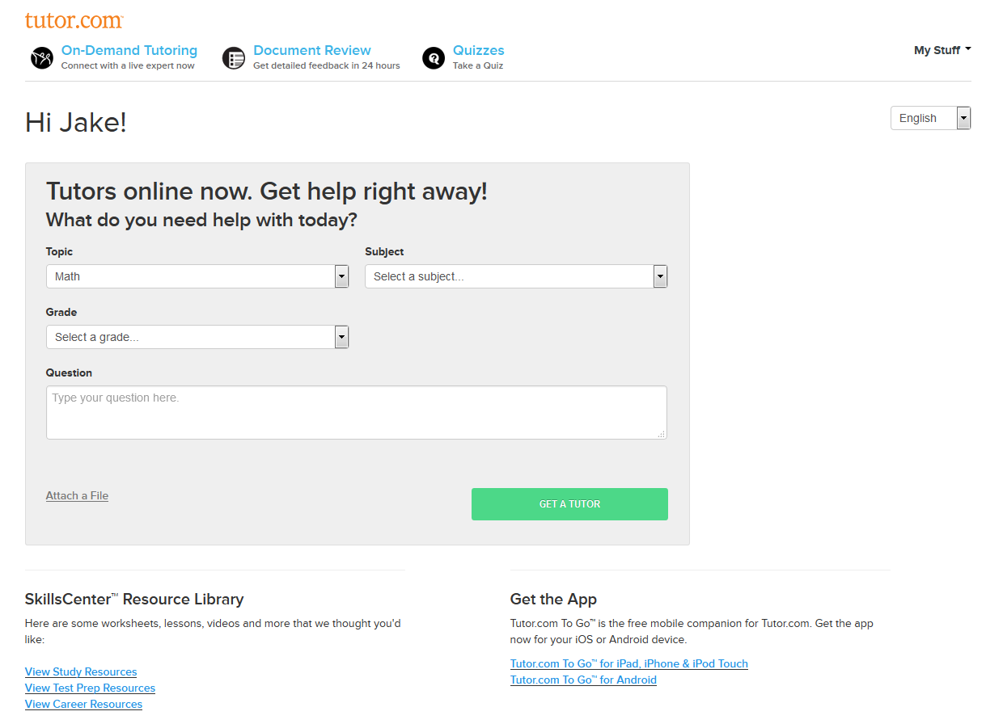



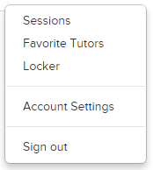
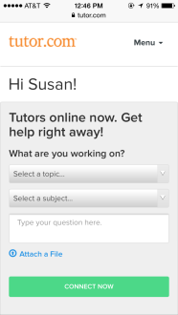
QUICK INTRO
Online Tutoring
24/7 Document Review
Assessment Quizzes
SkillsCenter Resources
  Study Resources
  Test Prep
  Career Resources
Personalized Features
Mobile Apps
  Android
  iOS
Tutor.com ToGo™!
Tutor.com provides access to real-time online tutoring in over 25 subjects for kindergartners all the way through adult learners.
The personalized features such as favorite tutors, previous session reviews and a virtual locker make studying so much easier.
But that's not all! We also offer a drop-off service with overnight reviews of essays, book reports and more.
Our assessment quizzes will help you assess and practice your skills in over a dozen different subjects.
Or you can access thousands of resources like videos and flash cards in the SkillsCenter Resource Library.
Then, to top it all off, all of this is available through any mobile device.
Notes:
Tutor.com provides access to real-time online tutoring in over 25 subjects for kindergartners through adult learners
But, that’s not all. We also offer a drop-off service with overnight reviews of essays, book reports and more.
Our assessment quizzes will help you assess and practice your skills in over a dozen different subjects.
Or, you can access thousands of resources like videos and flash cards in the SkillsCenter Resource Library.
The personalized features such as favorite tutors, previous session reviews and a virtual locker make studying so much easier.
Then, to top it all off, all of this available through any mobile device.

Slide 3
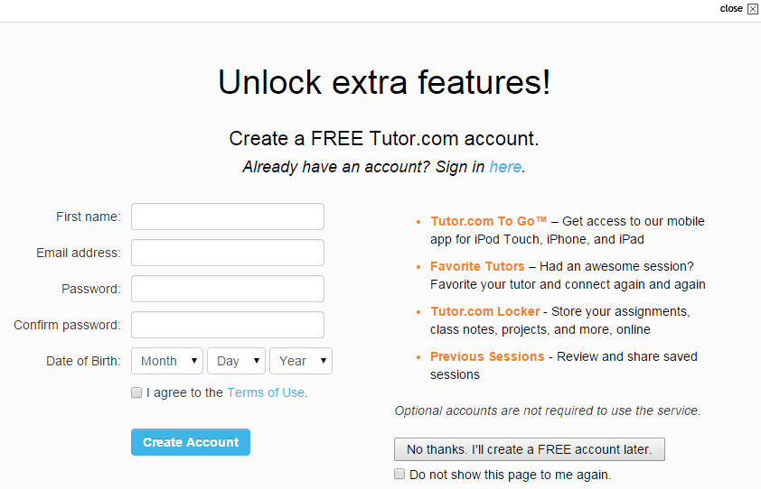
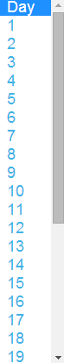
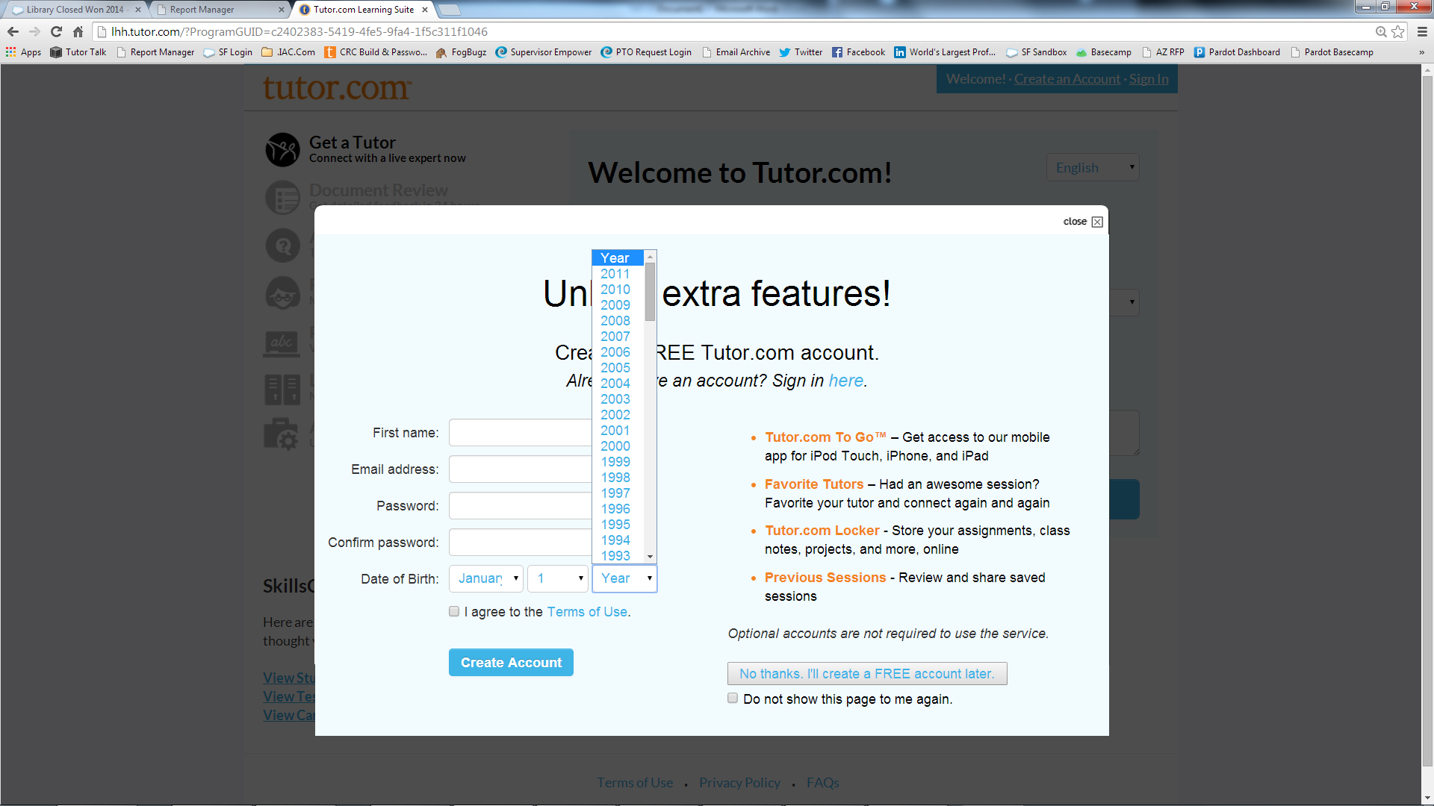
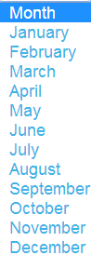
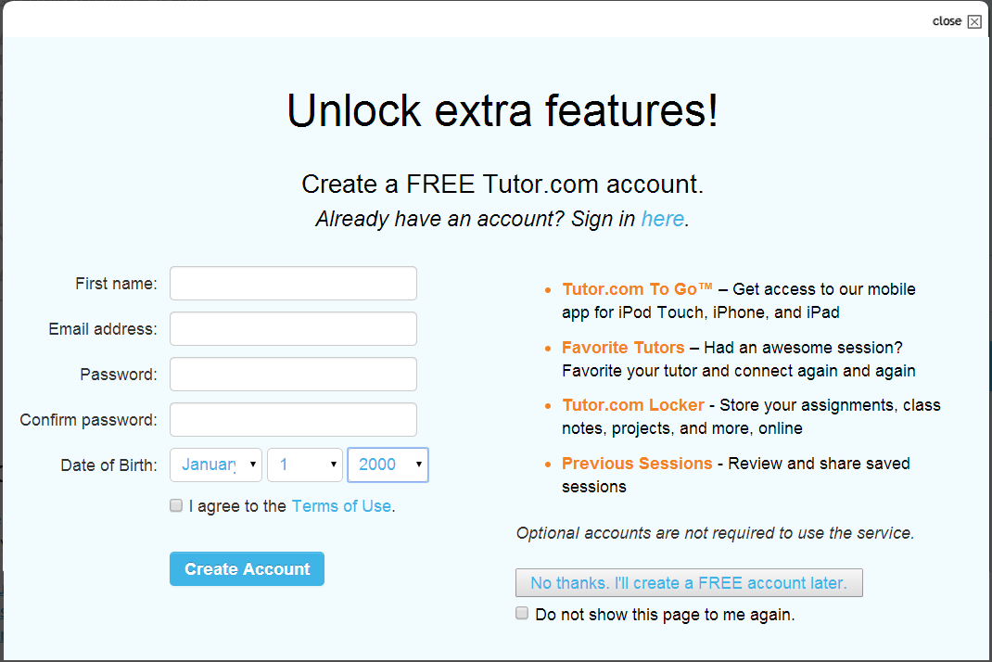
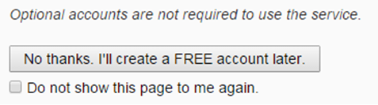

OPTIONAL ACCOUNTS
Susan
email@xyz.com
●●●●●●●●
●●●●●●●●

Once logged in through the library's website, the option to create a free Tutor.com account is presented.
These optional accounts unlock extra, personalized features.
Creating an account is easy, but you may also select "No Thanks" and continue as a guest.
Notes:
Once logged in through the library’s website, the option to create a free Tutor.com account is presented. These optional accounts unlock extra, personalized features. Creating an account is easy, but you may also select “No Thanks” and continue as a guest.

Slide 4
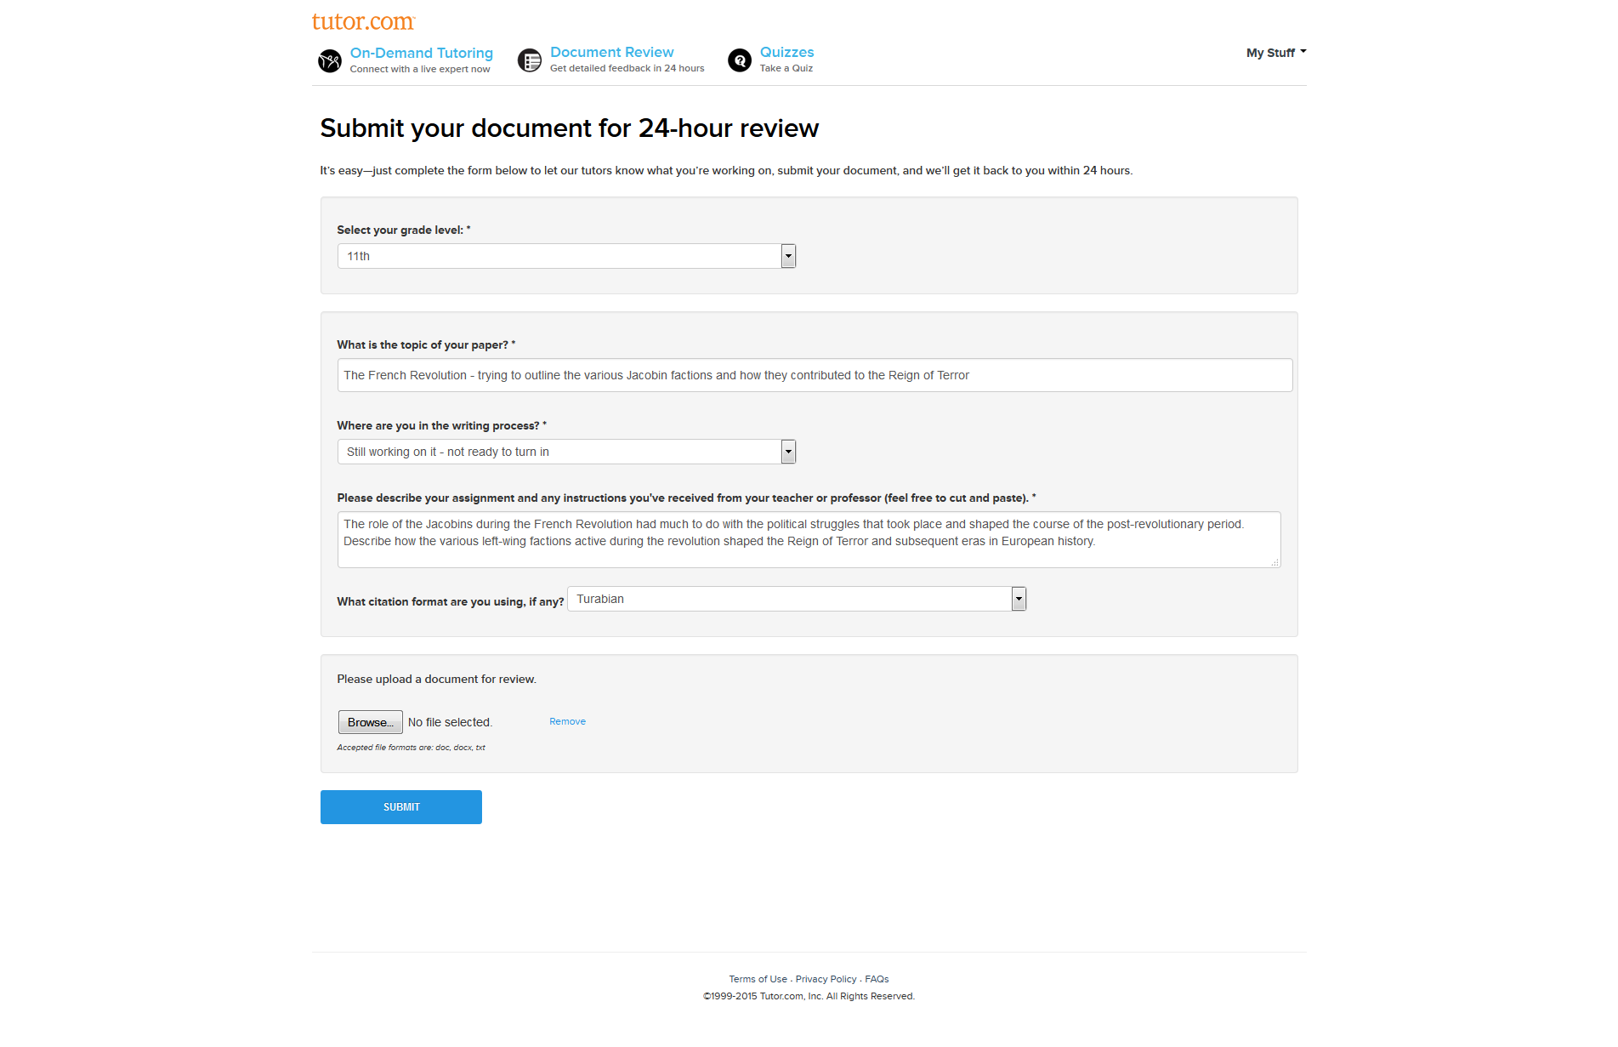



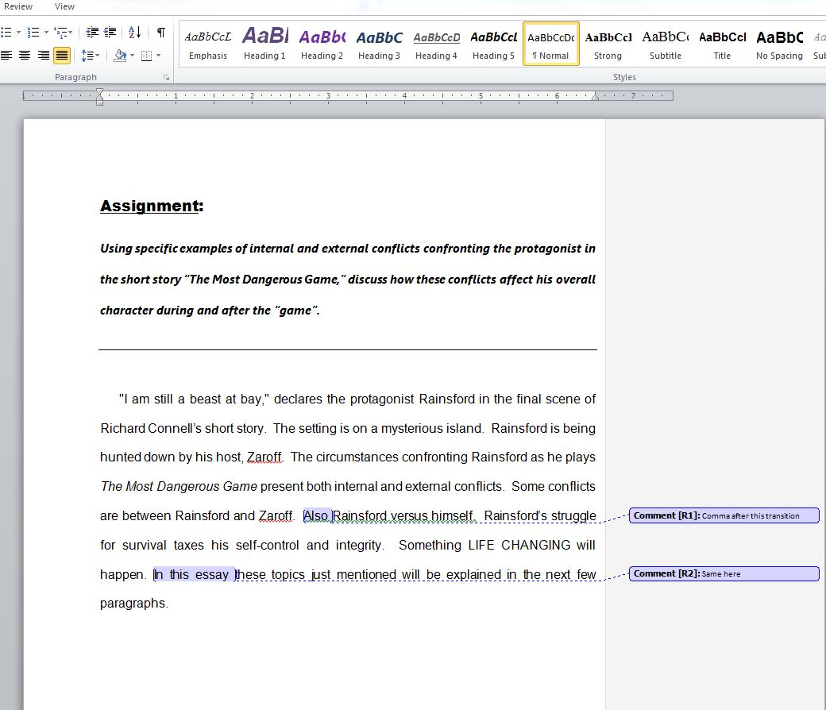

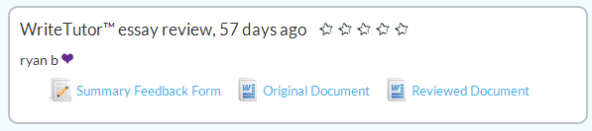
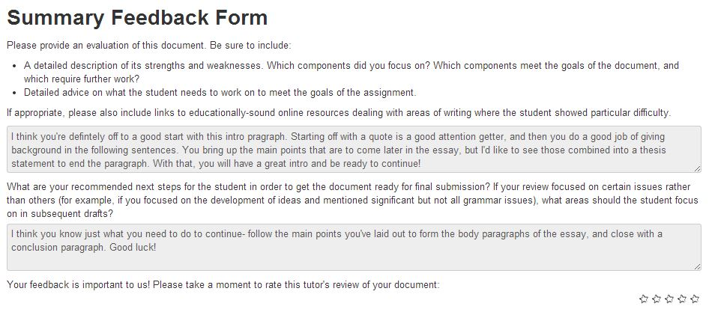
24/7 RESUME & WRITING REVIEW
First up is the 24/7 WriteTutor Review or Drop-Off. You may submit a writing assignment or even a resume for overnight review.
Our tutors will send you a summary with suggestions, along with a marked-up copy of your original document through our secure portal under Previous Sessions.
Once logged in, you'll enter the Tutor.com portal.
The first option is Get a Tutor!, but we're going to take a look at that part a little later.
For now, let's work our way down the menu and explore all of the choices you have for getting help.
This option is great when you have a lot of homework but not a lot of time.
Notes:
Once logged in, you’ll enter the Tutor.com portal. The first option is Get a Tutor!, but we’re going to take a look at that part a little. For now, let’s work our way down the menu and explore all of the choices you have for getting help.
First up is the 24/7 WriteTutor Review or Drop-Off. You may submit a writing assignment or resume for an overnight review. Our tutors will send you a summary with suggestions, along with a marked-up copy of your original document through our secure portal under Previous Sessions. This option is great when you have a lot of homework but not a lot of time.

Slide 5

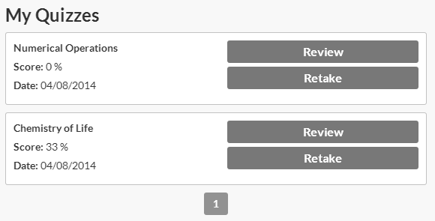
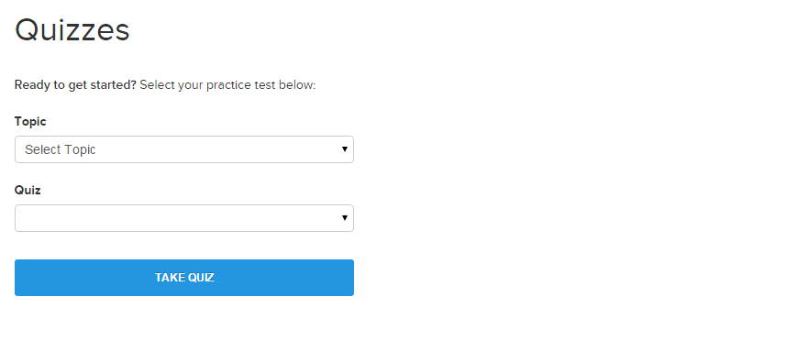
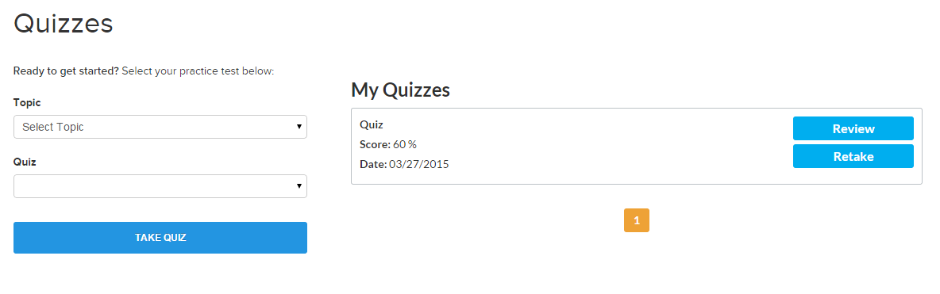
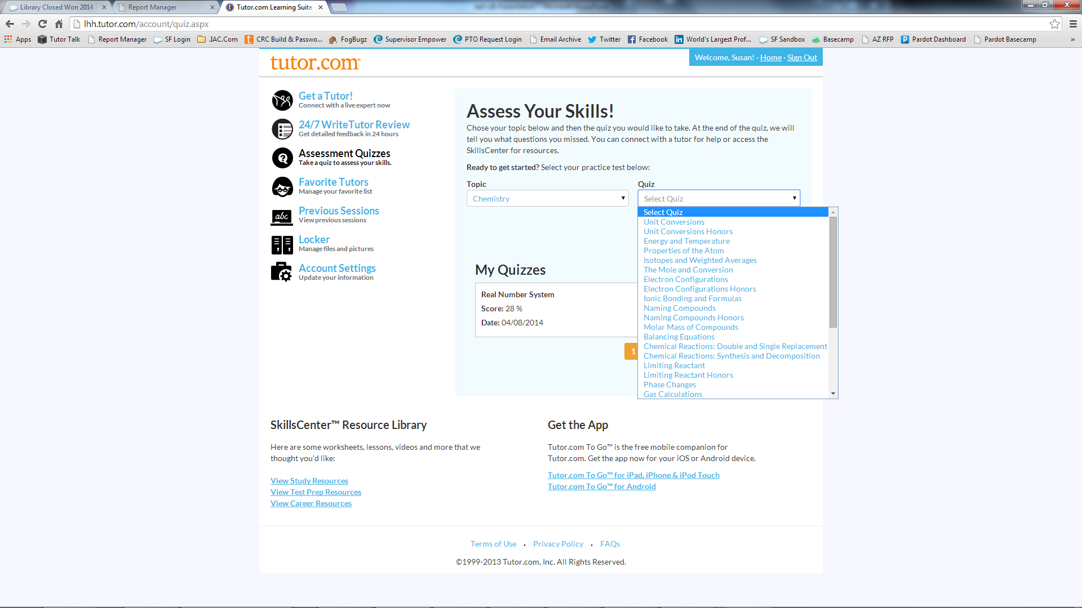
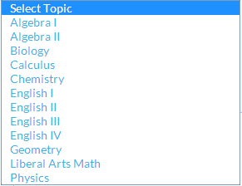
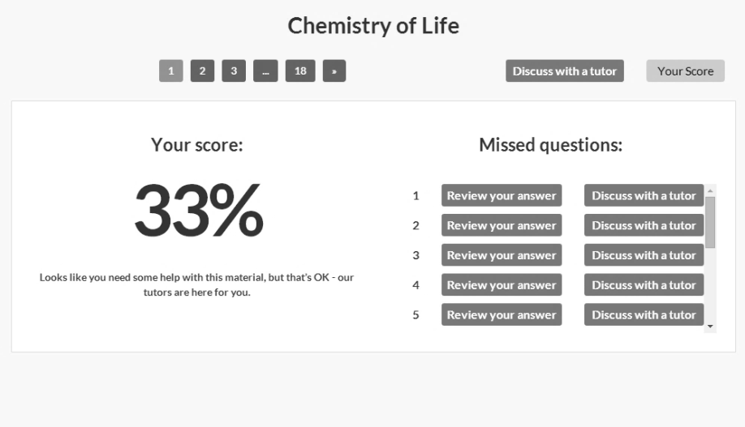
ASSESSMENT QUIZZES
Next up are the quizzes.
These quizzes will help you prepare for a new course, study for a test or just review your skills.
Currently we offer quizzes in math, science and language arts.
Choose a subject and then a topic.
Once completed, Tutor.com will score the quiz.
When reviewing quiz results, you can choose to review online resources regarding the missed questions
or connect with a subject-matter expert tutor for help.
Notes:
Next up are the quizzes. These quizzes will help you prepare for a new course, study for a test or just review your skills. Currently we offer quizzes in math, science and language arts. Choose a subject and then a topic. Once completed, Tutor.com will score the quiz. When reviewing quiz results, you can choose to review online resources regarding the missed questions or connect with a subject-matter expert tutor for help.

Slide 6
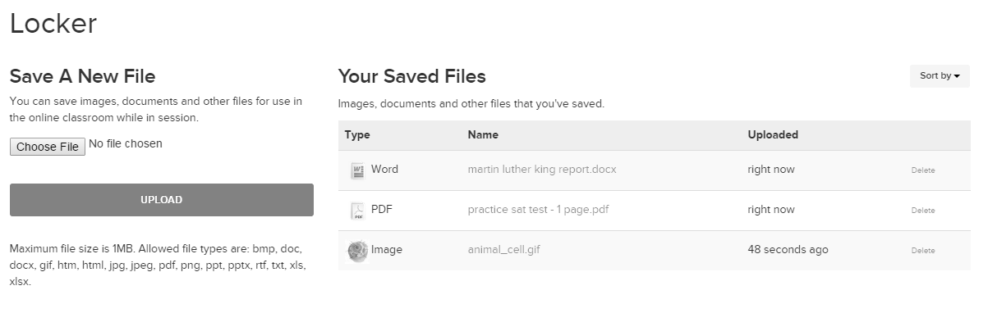
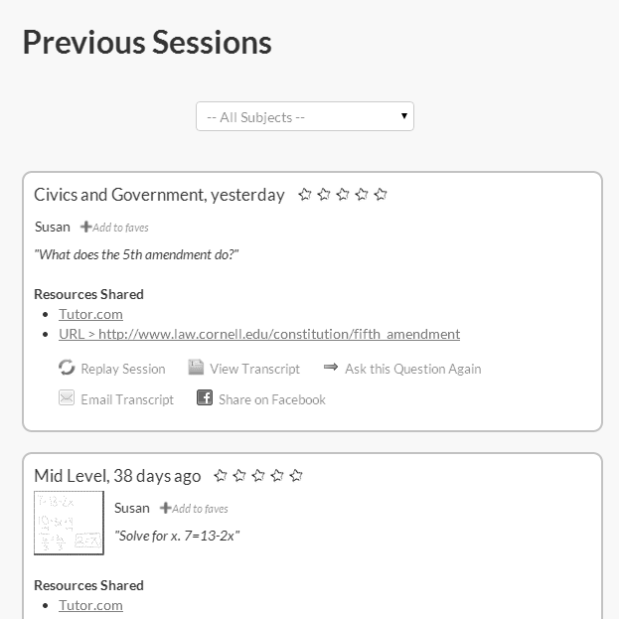
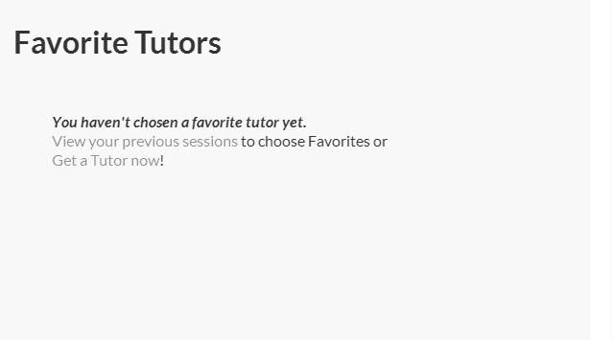
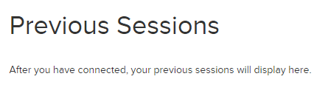
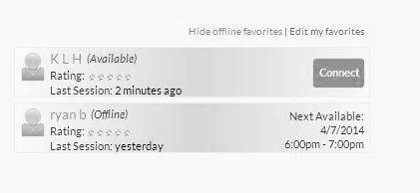
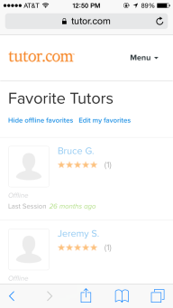
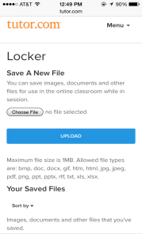
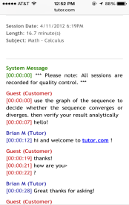
EXTRA FEATURES!
When you have a great session, be sure to tag the tutor as a favorite.
Then, when you want to connect with that tutor again, just check his schedule in your Favorite Tutors tab.
Did you forget how the tutor explained your last problem or need to review something before a test?
When you're signed into a Tutor.com account, you'll find all of your previous sessions available for review and sharing.
And don't lose track of those files you shared with your tutor!
Save a writing assignment, lab data or even a picture of your worksheet in your virtual locker for easy access.
Notes:
When you have a great session, be sure to tag the tutor as a favorite. Then, when you want to connect with that tutor again, just check his schedule in your Favorite Tutors tab.
Did you forget how the tutor explained your last problem or need to review something before a test? When you’re signed into a Tutor.com account, you’ll find all of your previous sessions available for review and sharing.
And, don’t lose track of those files you shared with your tutor! Save a writing assignment, lab data or even a picture of your, worksheet in your virtual locker for easy access.

Slide 7
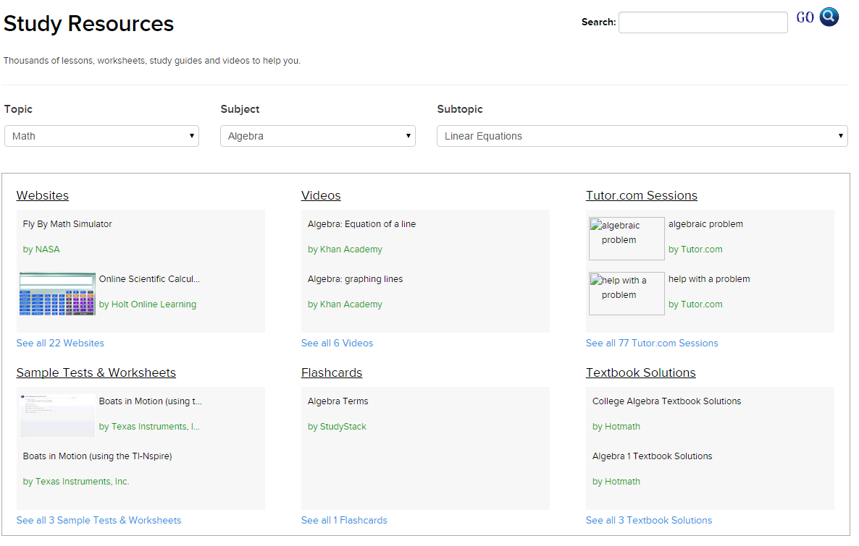
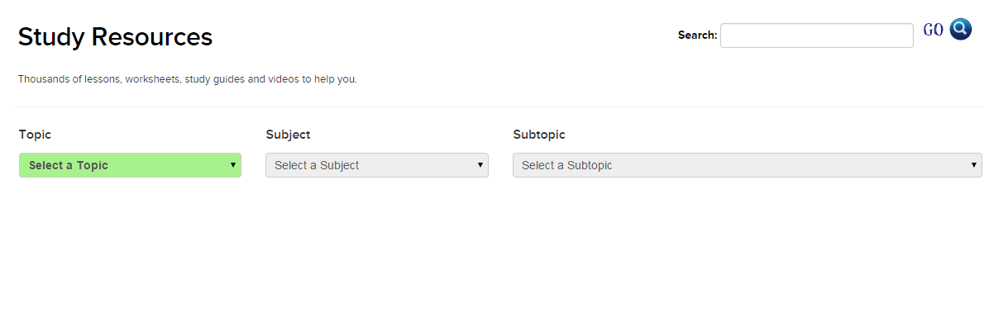
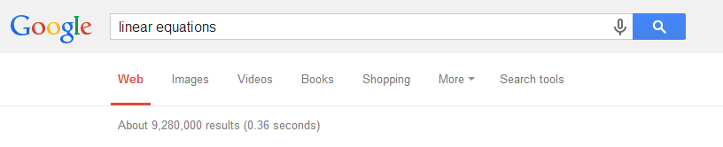
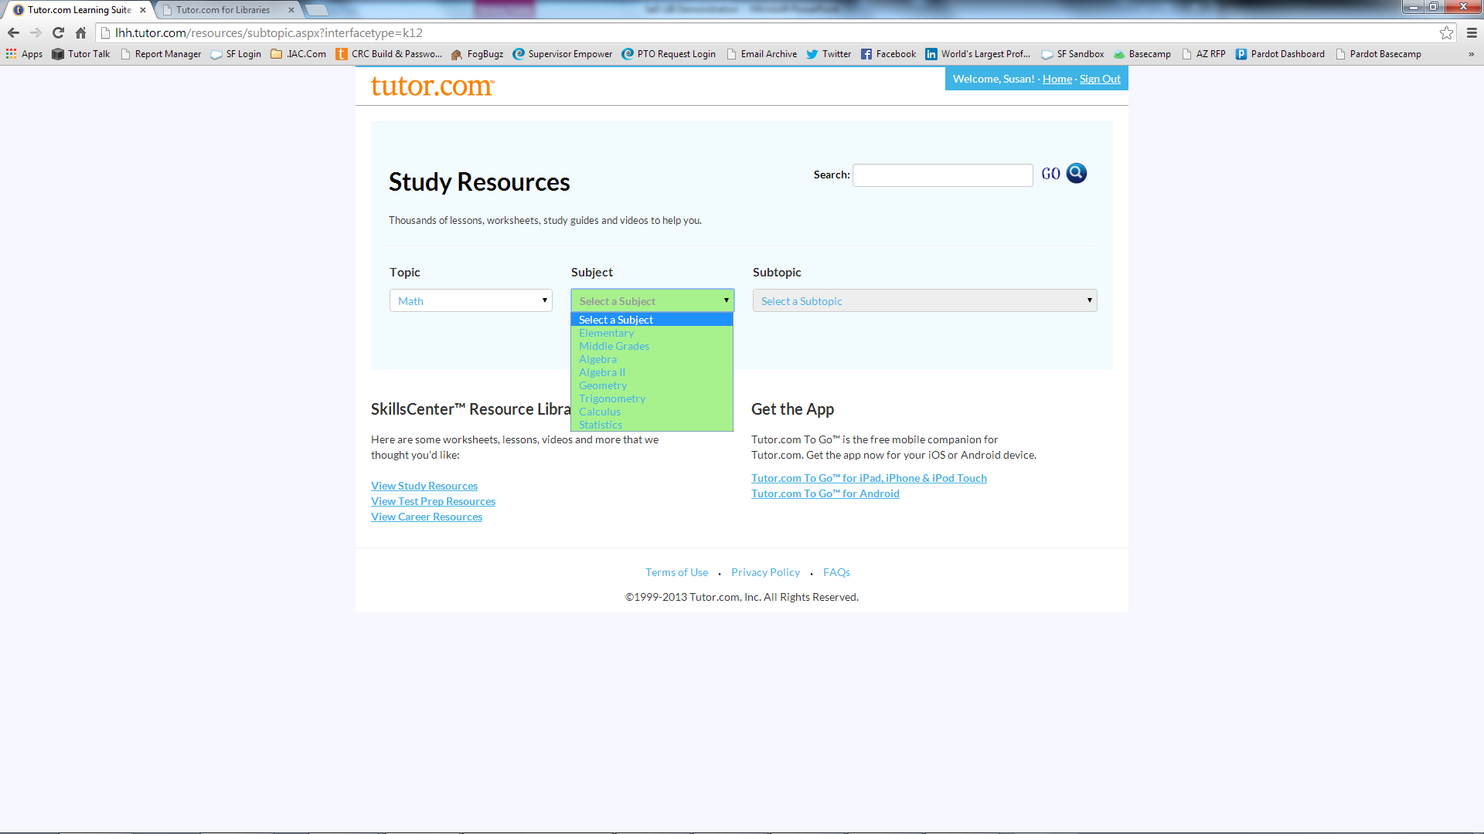
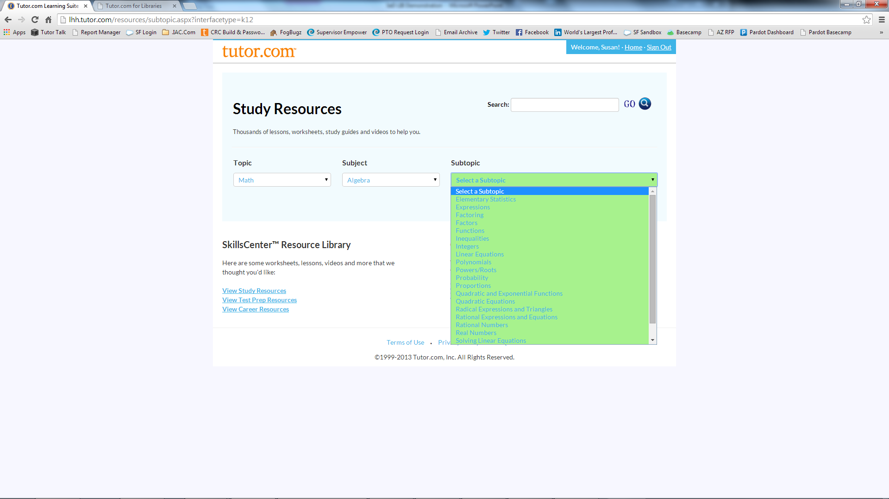
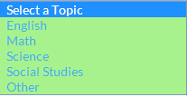
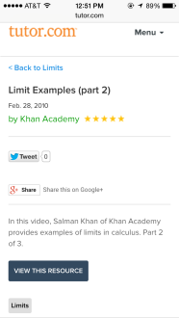
RESOURCES & CONTENT
Linear Equations
Looking for a practice test, flash cards, a geometric formula or math video?
Don't google it and try to guess which result is best.
Use the SkillsCenter Resource Library to find study resources, test prep resources or career resources, like sample resumes.
Everything is arranged in easy-to-find sections and we've already checked each resource to make sure it is trustworthy.
Notes:
Looking for a practice test, flash cards, a geometric formula or math video? Don’t google it and try to guess which result is best. Use the SkillsCenter Resource Library to find study resources, test prep resources or career resources, like sample resumes. Everything is arranged in easy-to-find sections and we’ve already checked each resource to make sure it is trustworthy.

Slide 8
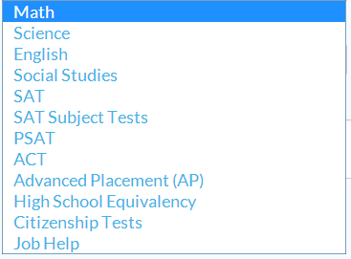
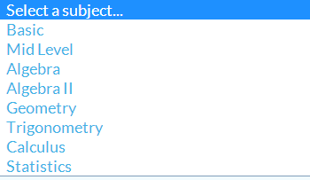
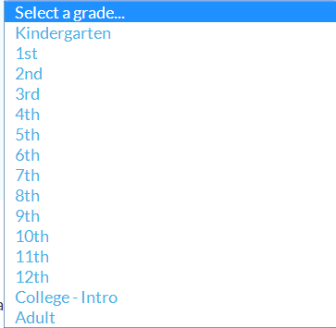

GET A TUTOR!
Solve for x. 4x + 10 = 22
As you can see, Tutor.com provides many different tools you can use to get help.
It's the one-to-one real time tutoring that most learners want.
Let's take a look! From the Get a Tutor! tab on our portal, choose your topic, subject and grade level.
Enter a question for the tutor.
If you want, you can also upload a document such as a picture of a worksheet or an essay you'd like the tutor to review.
Then click, "Get a Tutor!"
Notes:
As you can see, Tutor.com provides many different tools you can use to get help. It’s the one-to-one real time tutoring that most learners want. Let’s take a look. From the Get a Tutor! tab on our portal, choose your Topic, Subject and Grade Level. Enter a question for the tutor. If you want, you can also upload a document such as a picture of a worksheet or an essay you’d like the tutor to review. Then click Get a Tutor!

Slide 9
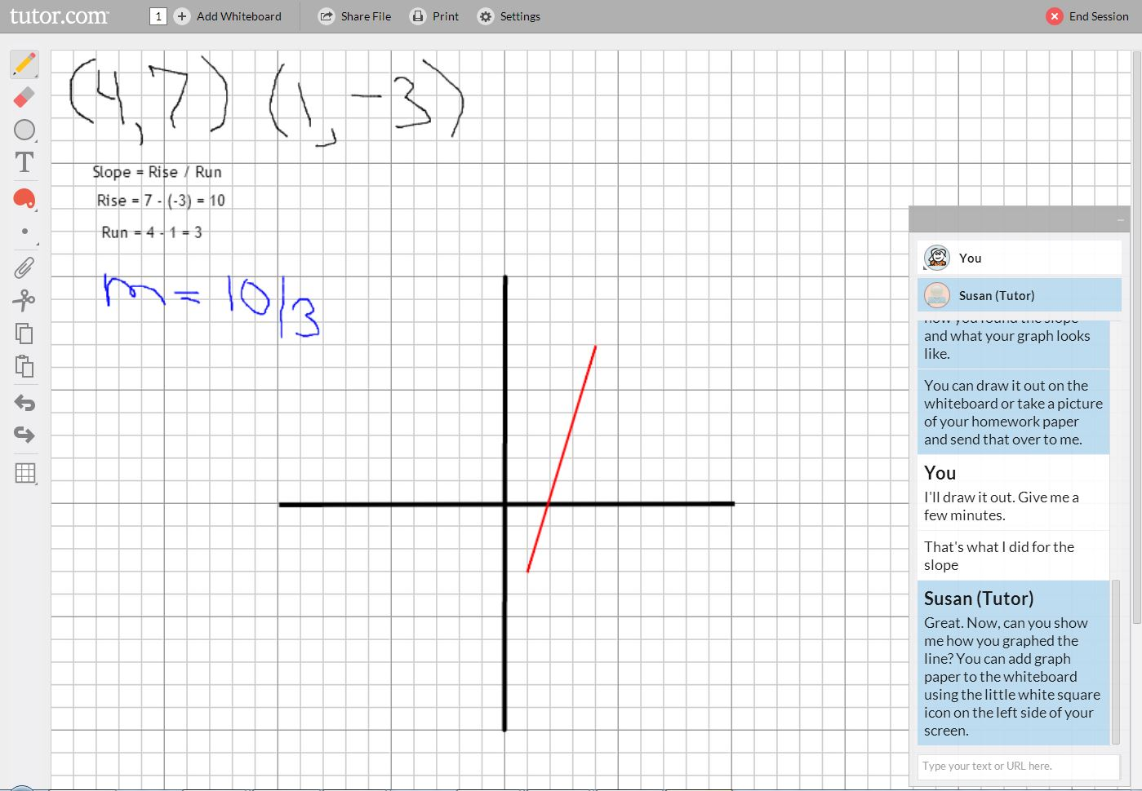
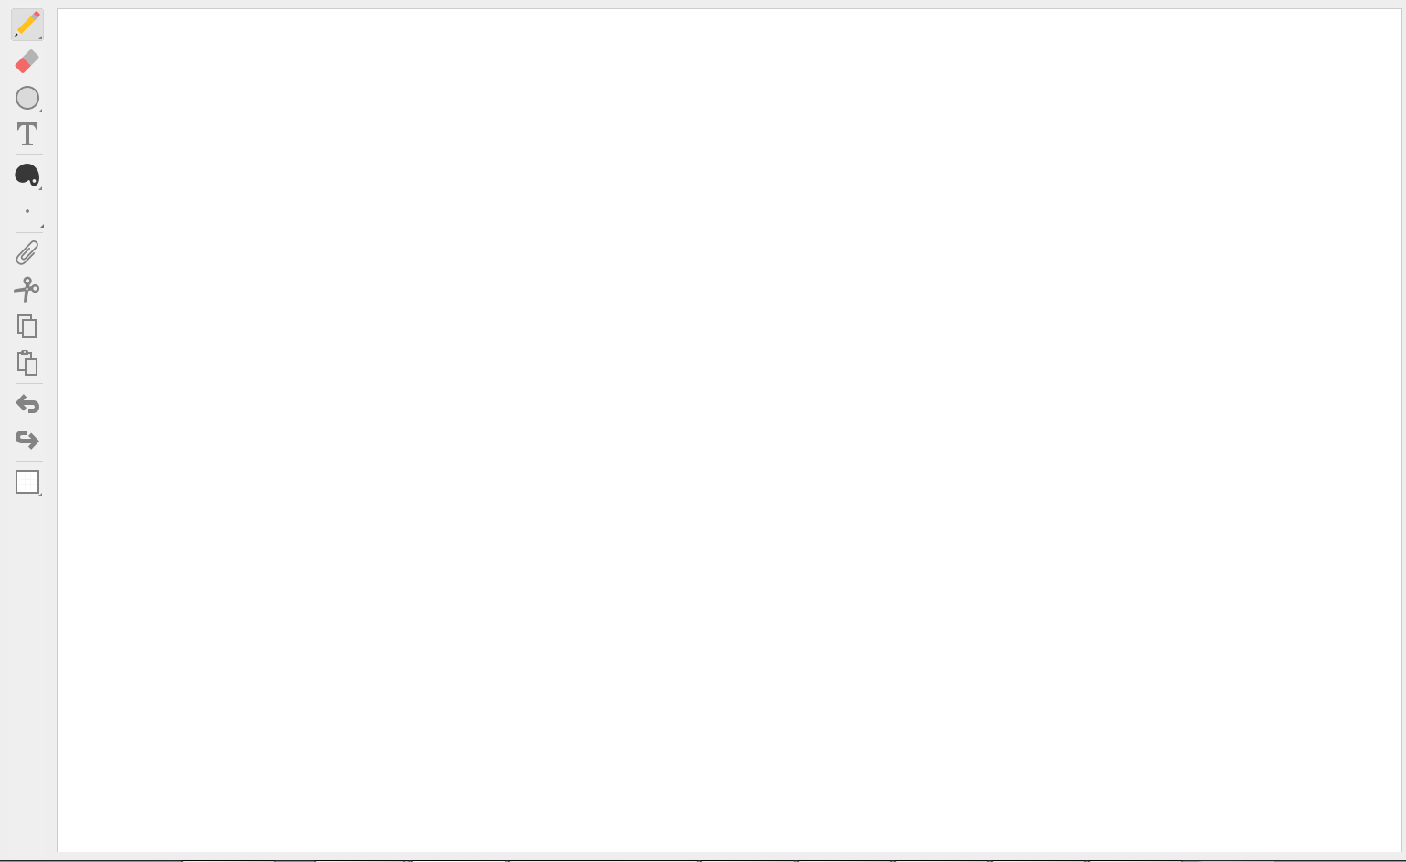
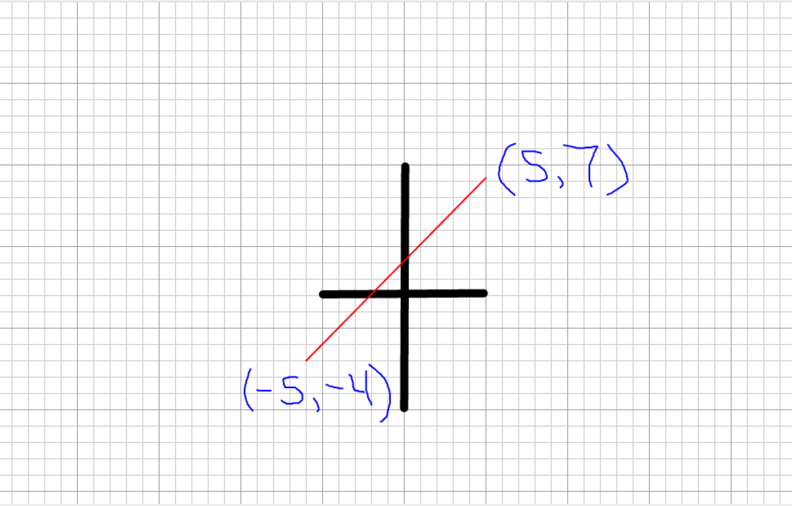
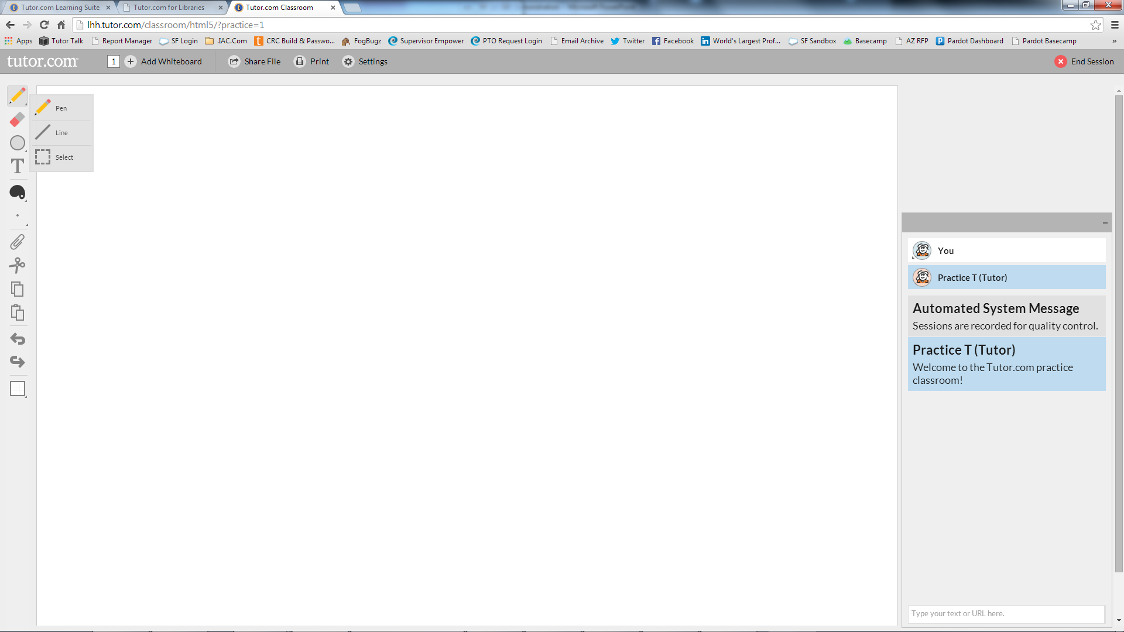
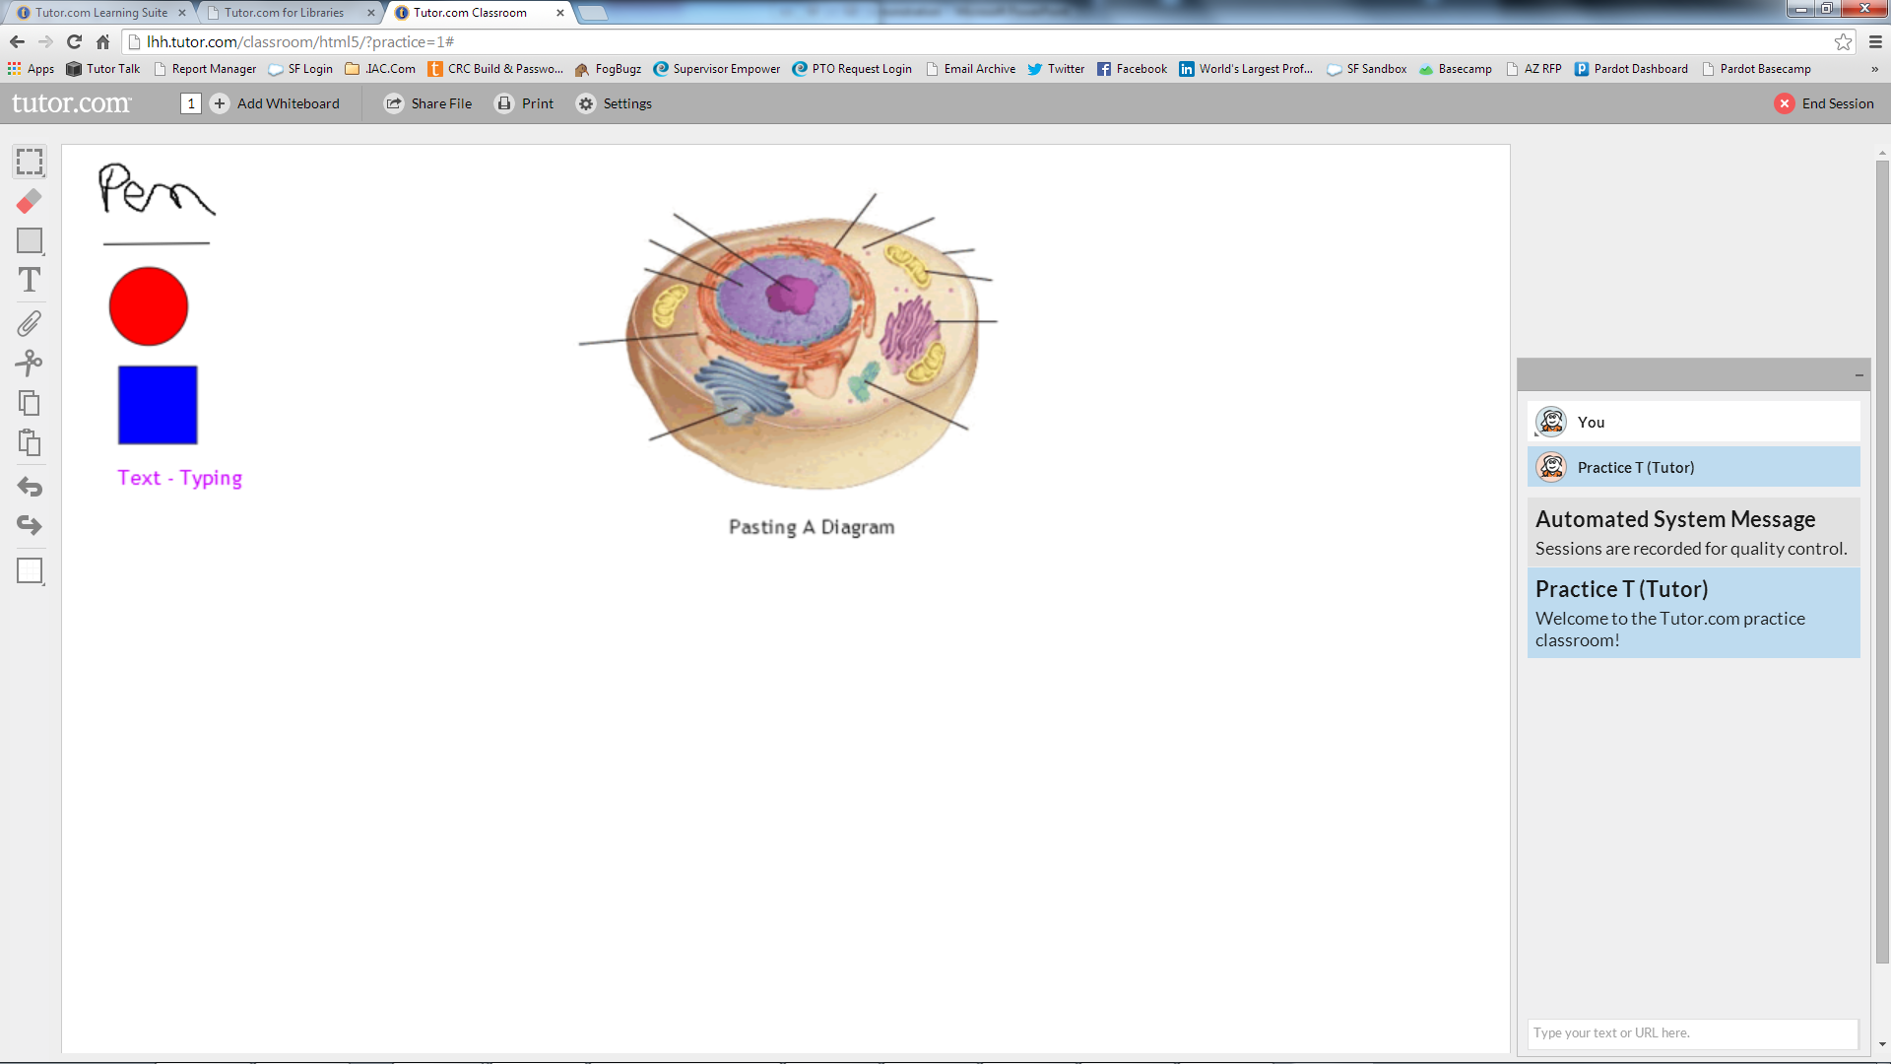
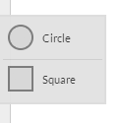
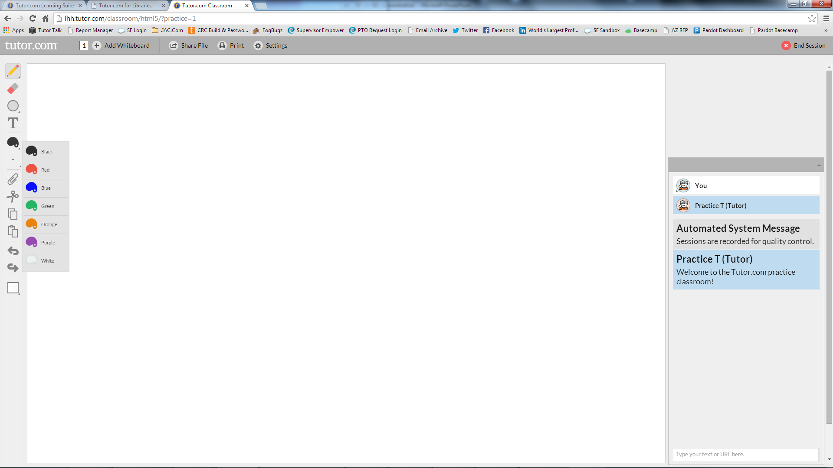
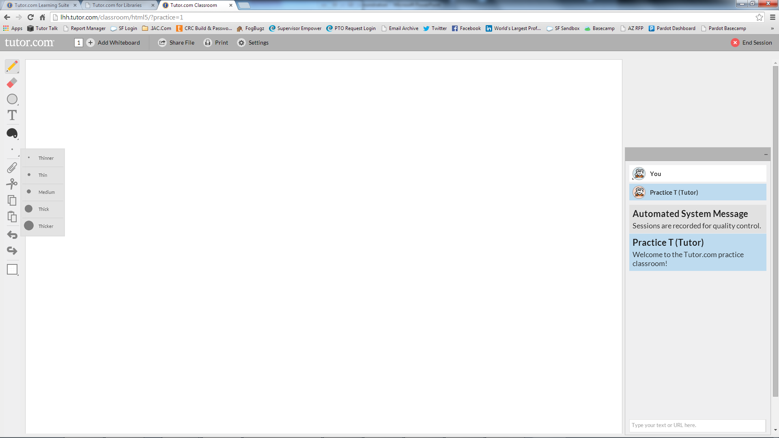
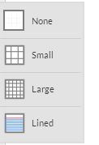
ENGAGING CLASSROOM
Eraser
Typing
Image
Whiteboard Tools
Chat
Images can be pasted on the board such as maps or diagrams and you can even turn the entire whiteboard into graph paper.
Once the classroom opens, you'll be connected to a tutor.
Chat back and forth with your tutor in our chat box.
Use the whiteboard to draw out your problem.
Create an outline or post a picture of your assignment.
Both you and the tutor can draw on the whiteboard using a variety of tools such as pen, line, shape and text.
Colors can be changed to make drawings more dynamic.
Additional whiteboards can be added as needed so that you don't have to erase your work to start on a new problem
Notes:
Once the classroom opens, you’ll be connected to a tutor. Chat back and forth with your tutor in our chat box. Use the whiteboard to draw out your problem, create an outline or post a picture of your assignment. Both you and the tutor can draw on the whiteboard using a variety of tools such as pen, line, shape and text. Colors can be changed to make drawings more dynamic. Images can be pasted on the board such as maps or diagrams and you can even turn the entire whiteboard into graph paper. Additional whiteboards can be added as needed so that you don’t have to erase your work to start on a new problem.

Slide 10
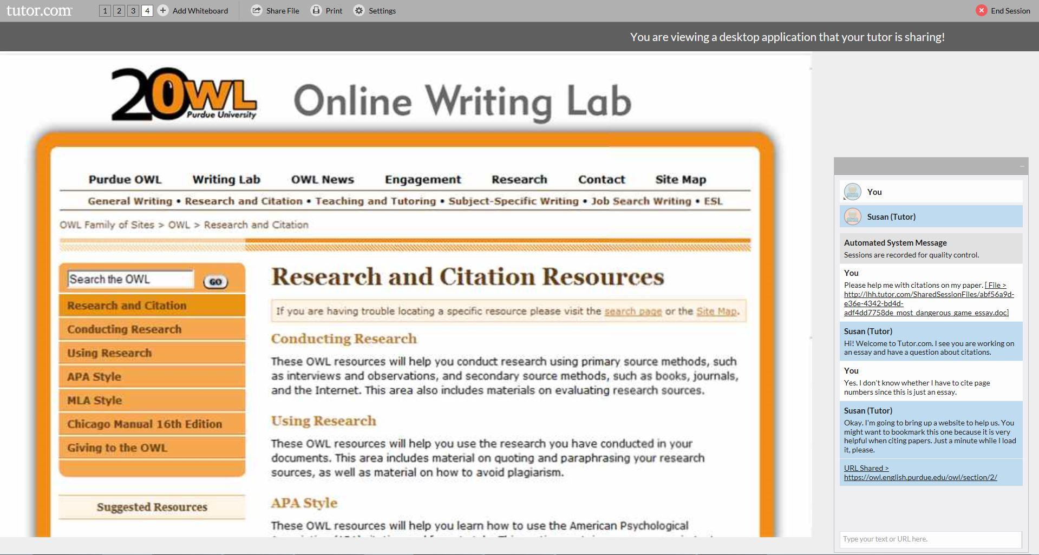
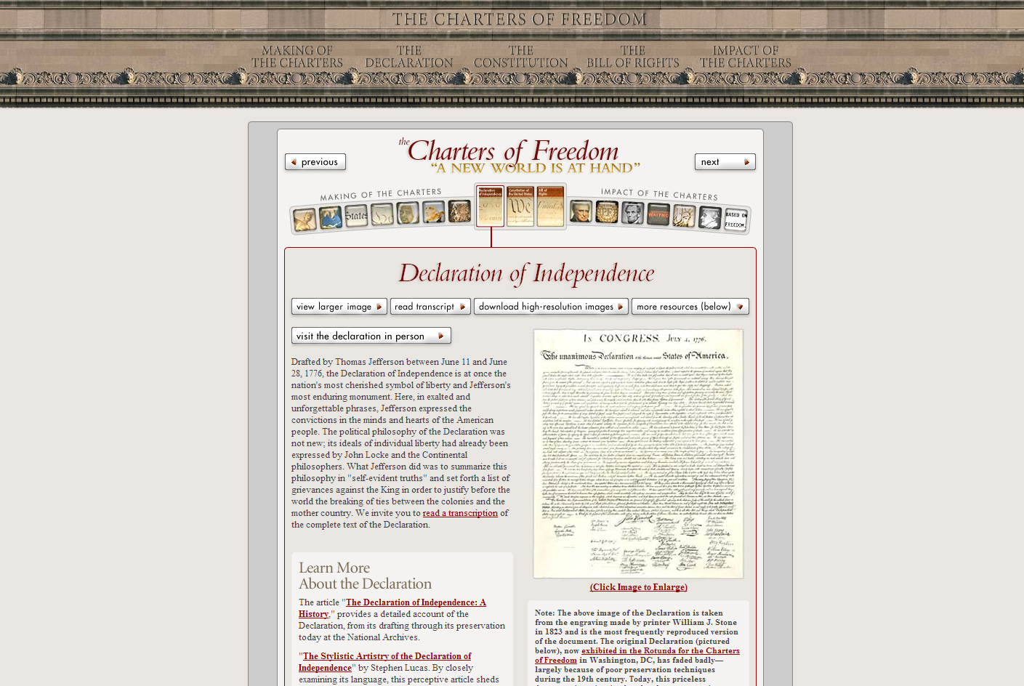
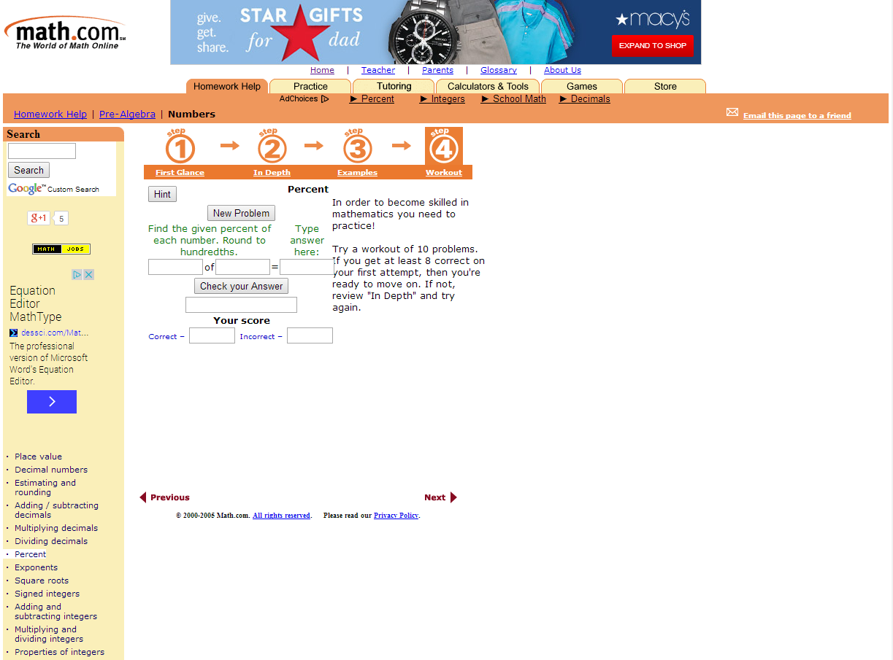
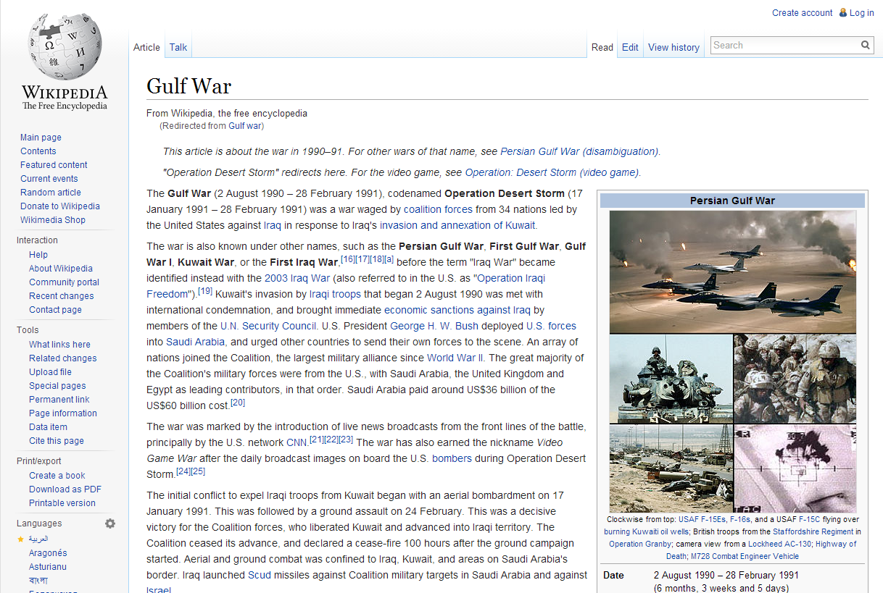


RESOURCE SHARING
Not Wikipedia, Please!
URL Shared>
http://http://www.archives.gov/exhibits/charters/declaration.html
They’ll show you reliable resources to use for your assignments,
Teach you how to find good resources
Or even share additional practice problems with you.
Your tutors can even share web resources with you in the classroom.
Notes:
Your tutors can even share web resources with you in the classroom. They’ll show you reliable resources to use for your assignments, teach you how to find good resources or even share additional practice problems with you.

Slide 11





FILE SHARING
Have an essay or book report for the tutor to review?
Once a file is shared within the classroom, if you have a personal account, the file will be saved in your locker.
Send it over to the tutor to view together in the classroom.
The tutor will highlight areas of the document that need attention, discuss these with you and help with corrections.
The types of files that can be shred include text files, pictures, html-files and MS Office documents.
Notes:
Have an essay or book report for the tutor to review or maybe . Send it over to the tutor to view together in the classroom. The tutor will highlight areas of the document that need attention, discuss these with you and help with corrections. The types of files that can be shared include text files, pictures, html-files and MS Office documents. Once a file is shared within the classroom, if you have a personal account, the file will be saved in your locker.

Slide 12

COLLECTING OUTCOMES
This has really helped through my problems. the tutors are awesome to work with and will teach how to do
your work.
At the end of every session, please tell us how we did. This is really important!
We use the surveys to improve. Good or bad, we want to hear about it.
Share your comments, thanks, praise or suggestions.
The library will get to see these comments too, so let them know that you appreciate the service.
Notes:
At the end of every sessions, please tell us how we did! This is really important. We use the surveys to improve. Good or bad, we want to hear about it. Share your comments, thanks, praise or suggestions. The library will get to see these comments, too so let them know if you appreciate this service.

Slide 13



TRANSCRIPT REVIEW
abc@xyzemail.com
Once you complete the survey, you will have the option to share or review your session.
Email it to yourself or a friend. Send it to mom or dad to say, "See! I really was on the computer for HOMEWORK!"
Print the session transcript to include in your class notes or even replay a video of the session.
Notes:
Once you complete the survey, you will have the option to share or review your session. Email it to yourself or a friend. Send it to mom or dad to say, “See! I really was on the computer for HOMEWORK!” Print the session transcript to include in your class notes or, even replay a video of the session.

Slide 14


GET YOUR SCHOOL WORK DONE!
Now that you know all about Tutor.com at your library, GO!
Get your schoolwork done! Get back to LIFE!
Notes:
Now that you know all about Tutor.com at your library, GO!
Get your schoolwork done! Get back to LIFE!

