Slide 1



Free online
homework help
tutoring and test prep
Make Homework Time a Happy Time
How to use HomeworkLouisiana through
[enter library’s name]
Notes:
Provide a short intro to yourself and your library. Ask some questions to loosen up the crowd. “What’s your favorite subject…and lunch doesn’t count!” “What’s your least favorite subject?” “How many of you work on homework past 9:00?” “Raise your hand if your parents tell you they “don’t know” when you ask for homework help?” You’ll want to use something to show empathy or even a “been there, done that” kind of story about your own school stress. Then, lead into the presentation with something such as “We have help. HomeworkLouisiana, a service provided to you through the library, can make homework time a happy time.”

Slide 2



Turn your frown upside down
Notes:
School can be stressful. Balancing all of your homework and studying with everything else going on in life can seem impossible at times, but the library has help. We’re going to turn your frowns upside down by putting a personal tutor in your pocket. We have a program called HomeworkLouisiana. You don’t have to come to the library to use it. You just need a library card and access to the internet. What I like about HomeworkLouisiana is that you don’t need an appointment to connect with a tutor. Anytime you’re stuck, you can log into the service and get help with whatever schoolwork is troubling you. The program also has a lot of other great tools like video lessons that will let you learn your way.

Slide 3
Delete this slide before presenting
Presenters: Slides 4-14 below are organized based on grade level. Choose the slides most appropriate for your audience.
For elementary students, we suggest slides 4 & 5 only. Typically, a presentation such as this would be directed at the parents of these students, but if you are able to present to older elementary school students (4th-6th), we’ve put together a few slides that can help.
For middle school students, we suggest slides 6, 7 & 8 or 6, 12, 13 & 14 with 12-14 modified to remove job search, AP and SAT/ACT mentions.
For high school or college students, we suggest slides 9, 10 and 11 or 9, 12, 13 and 14.

Slide 4

Focus on K-5th Grade
Notes:
As an elementary school student, it is important to get off on the right foot and build a strong foundation of knowledge and healthy study habits. HomeworkLouisiana is here to help.

Slide 5







On-demand tutoring & homework help
Subjects Available
Basic Math
Basic Science
Language Arts
  Reading
  Writing
  ESL
Social Studies
Spanish
Video Lessons for upper-level elementary students available under “Early Edge” for math and English Language Arts.
Notes:
You can use HomeworkLouisiana to talk to or chat with an actual tutor, online. Your parent or guardian can even connect with the tutors so they can learn how to help you. The tutoring for both student AND parent covers seven different subjects. You can get homework help or tutoring without an appointment in math, science, reading, writing, social students and Spanish as a foreign language. They even offer tutoring in English as a Second Language and provide bilingual Spanish and Vietnamese speaking tutors for math, science and social studies.
Don’t worry, if you’re not a fast typer or if you prefer to talk to your tutor instead of type in the classroom, you’ll want to use the audio option.

Slide 6




Drop-Off Reviews & Self-Study TOols
Drop-Off Reviews
Book reports & essays
Self-Study Tools
Video lessons
SkillsCenter™ Resource Library
Notes:
In addition to the tutoring, you may wish to explore some of the other tools. For example, if there is a book report due or you are learning to write an essay, you can “drop-off” that writing assignment for a tutor to review off-line. The tutor will then send back, through your HomeworkLouisiana account, a summary of feedback with suggestions for improvement and highlights of things done well.
HomeworkLouisiana also offers other study tools. The Learn Your Way video lessons can help you build a strong foundation in math and language arts. And, the SkillsCenter Resource Library provides thousands of educational resources for a large variety of topics. These can include learning games, informational websites, downloadable worksheets, flashcards and more.

Slide 7

Focus on 6th-8th Grade
Notes:
Middle school is a tough time. You are adjusting to so many changes. Throw into the mix more difficult classes and greater expectations from your teachers and parents. Then, it’s understandable why you might dread homework time. But, HomeworkLouisiana can help make things not so stressful. If you remember to use the service anytime you’re feeling confused with your work, you can keep ahead of the stress.
What is important to remember is timing. We’ll provide support and learning opportunities before you feel overwhelmed, and this can help you develop strong study habits. HomeworkLouisiana has tools available 24/7 and the tutors are available during the most critical homework times of Sun-Thu, 2pm – midnight.

Slide 8

On-demand tutoring & homework help
Subjects Available
Math, including algebra
Science
Language Arts
  Reading
  Writing
  ESL
Social Studies
Spanish
Computer Literacy
Notes:
Whether you’re struggling or advanced, HomeworkLouisiana can help. They offer real-time tutoring in several different subjects and levels of learning. Students in 6th-8th grade typically use the service the most for math and writing, but you and your student can also get help in science, reading, social studies, Microsoft Office and Spanish as a foreign language. They even offer tutoring in English as a Second Language and provide bilingual Spanish or Vietnamese speaking tutors for math, science and social studies.

Slide 9
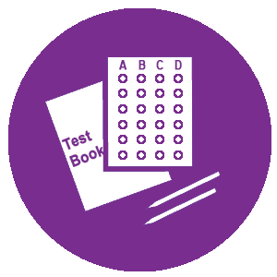
Drop-Off Reviews & Self-Study TOols
Drop-Off Reviews
Writing Assignments
Math Questions
Self-Study Tools
Practice Quizzes
Video Lessons
Notes:
In addition to the real-time tutoring, you may wish to explore some of the other tools. For example, if there is a book report due or you are learning to write an essay, you can “drop-off” that writing assignment for a tutor to review off-line. The tutor will then send back, through your HomeworkLouisiana account, a summary of feedback with suggestions for improvement and highlights of things done well. A similar service is available for algebra questions that are stumping you or your student. Submit the question for review over night and a tutor will send you a thorough explanation of the concepts and solution.
HomeworkLouisiana also offers self-study tools. The Learn Your Way video lessons help students build a strong foundation in math and language arts. Practice quizzes can double as skills drills to help students that are taking more advanced classes like algebra or gifted science. And, the SkillsCenter Resource Library provides thousands of vetted educational resources for a large variety of topics. These can include learning games, informational websites, downloadable worksheets, flashcards and more.

Slide 10

Focus on 9th-12th Grade
Notes:
High school can be fun and exciting. It can be stressful a frustrating. It gives you so many opportunities to grow, but with that growth comes challenges and each of you faces your own challenges. What is great about HomeworkLouisiana is the flexibility and accessibility of support as well as the personalization. Whether you’re struggling and feel left behind or maybe middle of the class and trying to gain some ground, or even advanced and tackling more rigorous coursework, HomeworkLouisiana can help you take your education to the next level.

Slide 11

On-demand tutoring & homework help
Subjects Available
Math, through calculus & statistics
Science, through physics
Language Arts
Social Studies
Spanish
Computer Literacy
ACT®, AP®, PSAT®, SAT®
College Application Essays
Job Search Assistance
Notes:
The tutoring options for high school students cover sixty different subjects and test prep areas, covering all core classes plus Spanish as a foreign language and Microsoft Office. Test prep tutoring is available for the ACT, PSAT, SAT and 14 different AP courses. HomeworkLouisiana even offers tutoring for English as a Second Language and bilingual Spanish or Vietnamese-speaking tutors for math, science and social studies. To round it all out, if you are in search of a part-time job or even a job after graduation, the career coaches can assist you with your online job search, including writing a resume and preparing for an interview.

Slide 12

Drop-Off Reviews & Self-Study TOols
Drop-Off Reviews
Writing Assignments
Résumés & Cover Letters
Math Questions
Self-Study Tools
Practice Quizzes
Fundamentals Video Lessons
AP® Video Courses
SAT/ACT Essentials
Notes:
To add to all of the tutoring options, HomeworkLouisiana provides additional tools to help you Learn Your Way. These tools can help with time management for busy students and provide instruction in different formats. For example, if you’re writing an essay for English or a paper for history, you can “drop-off” that writing assignment for a tutor to review off-line. The tutor will then send back, through your HomeworkLouisiana account, a summary of feedback with suggestions for improvement and highlights of things done well. A similar service is available for math questions from algebra up to calculus. Submit the question for review over night and a tutor will send you a thorough explanation of the concepts and solution.
HomeworkLouisiana also offers self-study tools. The Learn Your Way video lessons can help you build a strong foundation in math and language arts. Practice quizzes can double as skills drills or test preparation tools for math, science and language arts. The AP Video Courses will provide your student with a second “lecture” on 330 topics covered in AP Biology, Calculus AB, US History and World History. And, if you are college-bound or college-hopeful, definitely check out the SAT/ACT Essentials. This is a self-paced test prep course designed by The Princeton Review. It includes practice tests, personalized study recommendations, video lessons, practice drills and college admissions advice.
It’s time to take a look at how this all works! Let’s move into HomeworkLouisiana.

Slide 13






The Tutors
Notes:
You might be wondering who are these tutors? How do I know they’ll be able to help my student? And, is it a safe online environment? Let me start by saying that the Tutor.com, the company that powers HomeworkLouisiana, has almost 20 years of experience with providing online tutoring. They’ve served over 16 MILLION sessions and have a proven track record for both safety and positive educational results.
All tutoring sessions take place in a safe and secure online classroom and students and tutors always remain anonymous to each other. All sessions are recorded for student & tutor safety, as well as for quality control purposes.

Slide 14
Carefully screened & fully monitored
Tutors will not give answers, but are trained to help you understand the concepts.
Tutors may ask questions, especially at the beginning, to measure your level of knowledge.
All sessions are recorded for quality control and student & tutor safety.
Students and tutors are expected to treat each other with respect, avoid profanity in the classroom and only discuss homework or school related topics.
Tutors may not contact you outside of the recorded classroom. Do not share email, social media names or phone numbers.
Notes:
I have to mention this part, too. The tutors will not give answers or do your work for you. Every tutor is there to help you learn and so they’re going to expect you to participate in the conversation and complete your work or draw your own conclusions with their guidance. While we want you to use the service whenever you need help, be careful not to become dependent on it. The tutors won’t be there to help you on your tests or in class, so make sure you use your time with them to learn and not just as a way to get the answer right.
Also, we do expect all students to treat the tutors with respect and courtesy, just as you would your teacher or your librarian. HomeworkLouisiana has a set or rules for use the service called Terms of Use. These include no profanity, no rudeness towards the tutors, no inappropriate questions or comments and also, very importantly, no sharing of your personal information. Tutors can’t accept your email address or phone number. They won’t give you theirs, either. They can’t even know your last name. HomeworkLouisiana is a safe, anonymous place for all students to get the help they need. Please help us keep it that way by respecting the rules.

Slide 15

The Instruction
Notes:
While safety is the #1 priority at HomeworkLouisiana, quality of the learning experience is a very close second. Tutor.com uses a very specific method of instruction to tailor your learning experience to your needs. Tutors are guided by six principles of student-centered learning.

Slide 16
Student-centered instruction
Tutors instruct based on what you know and what you need to know. They’ll slow down if you need it or speed up for you. | Have class notes or examples ready to share with the tutor when you have specific instructions from your teacher. | Be prepared to think and do the work. The tutors will demonstrate if needed and then guide you through your questions.
Learn through listening, watching, doing and chatting. When you approach a problem multiple ways, you’ll learn better. | Don’t wait until it is too late. You don’t need an appointment, so log in before you get frustrated or stressed. We’re here to help. | The tutors are encouraging and patient. They don’t mind if you “don’t get it” on the first or even second try and they don’t think your question is “dumb.”
Notes:
Again, instruction is tailored to the YOUR needs and knowledge level. This level of one-to-one attention is something that a lot of teachers do not have time to provide in class and for many parents are unable to provide. Tutor.com works to identify your individual learning needs for each session and then uses a variety of instructional tools to help you understand and complete your own work, all while offering patient guidance and encouragement. You’re expected to remain engaged with the tutor throughout the session and work to build a better understanding of the material. While there is no set time limit for an individual session, the average session runs 20-25 minutes, sometimes shorter if you demonstrate understanding, sometimes longer if you need additional guidance. The goal of each session, though, is to make the student self-sufficient in your work, so bare in mind that tutors will not work through an entire worksheet or assignment with you.
So, now we ask, what are the different ways this service can help? Let’s look at what HomeworkLouisiana has to offer.

Slide 17
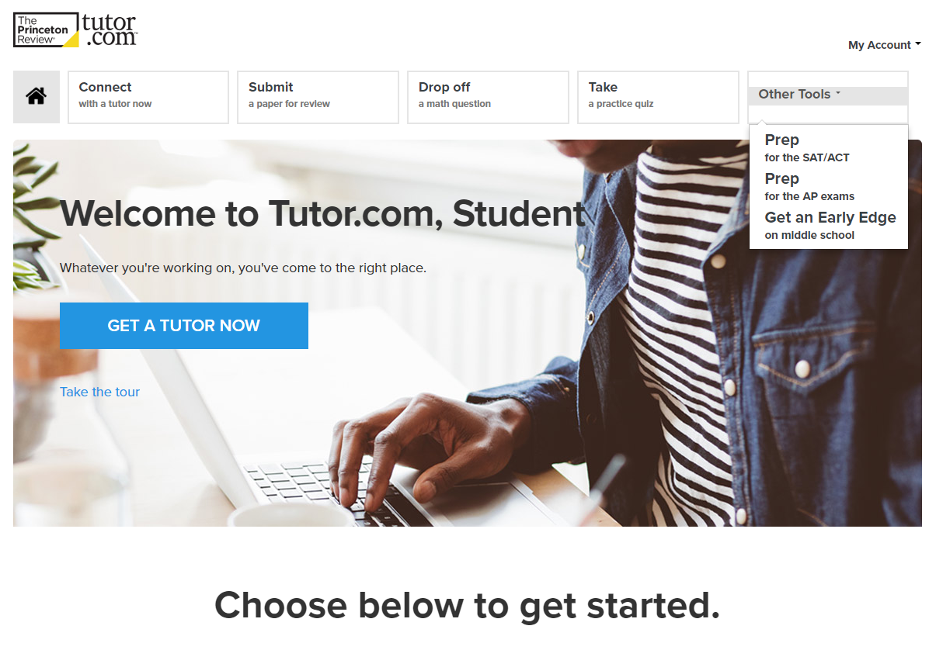
Getting Started
Notes:
Getting started is easy. You need a library card and an internet connection. You can even use the browser on your smartphones to access HomeworkLouisiana and get connected to the help you need.

Slide 18
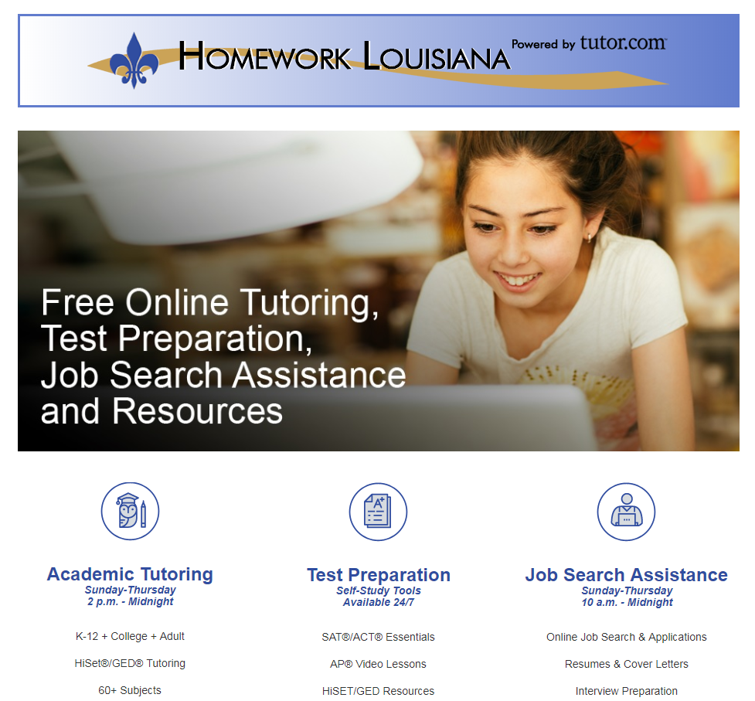
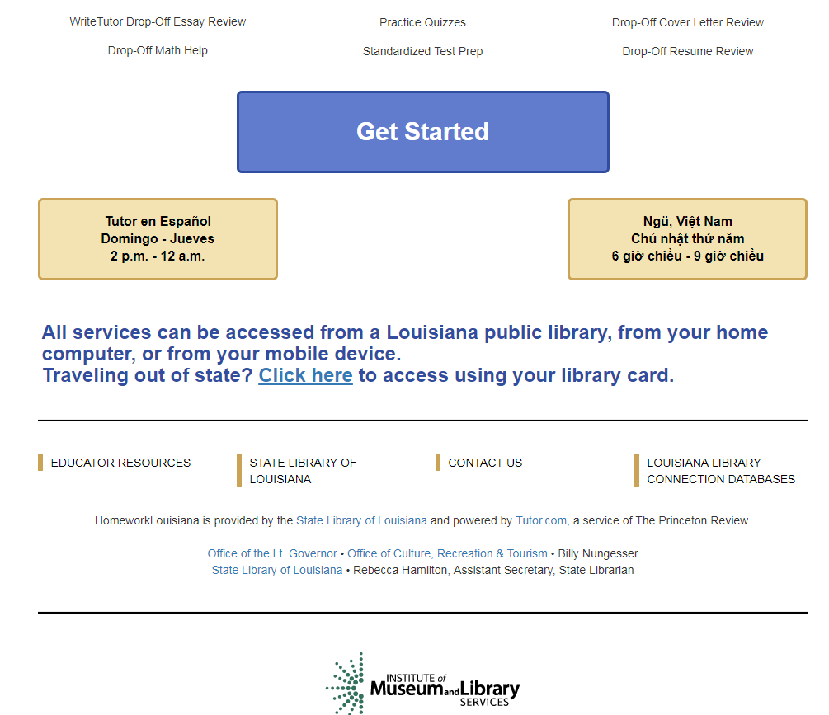
Logging in
Go to www.homeworkla.org
Do not go directly to HomeworkLouisiana’s website. Always go through the library’s website or homeworkla.org.
Notes:
To access the service, you can either go through the library’s website or go directly to www.homeworkla.org. Once on the HomeworkLouisiana page, scroll down to the “Get Started” button. If you would like to connect with a bilingual Spanish speaking tutor or a bilingual Vietnamese tutor, please use the yellow buttons for each language. Spanish speaking tutors are available for math, science and social studies, Sun.-Thu. from 2pm until midnight. Vietnamese speaking tutors are available for math, science and social studies from Sun.-Thu. from 6pm until 9pm.

Slide 19
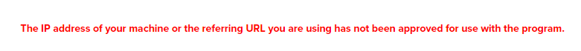
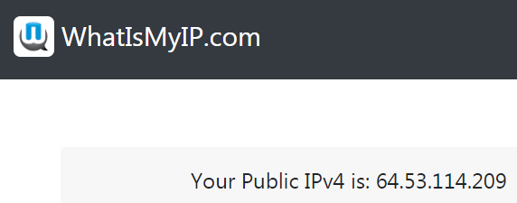

authentication
If you receive an error when logging in like this one, there are two solutions.
1. Return to the HomeworkLA.org page. Use the link for library card access.
2. If you don’t have a library card or you don’t know your login, go to whatismyip.com. Copy the IP address and email LibrarySupport@HomeworkLouisiana. Ask them to add your IP to the HomeworkLouisiana program for access.
3. Once you do get logging in through either of these methods,
Be sure to create a HomeworkLouisiana account. We’ll go over that next. When you have a HomeworkLouisiana account, you can always the “Sign In” button at the top of any of their pages to log in without your library card or IP address.
Notes:
HomeworkLouisiana is available for all residents of Louisiana. For most students, once you click “Get Started,” you’ll be able to enter the HWLA program. Sometimes, though, you might receive an error and it won’t let you into the program. [READ SLIDE TO AUDIENCE]

Slide 20
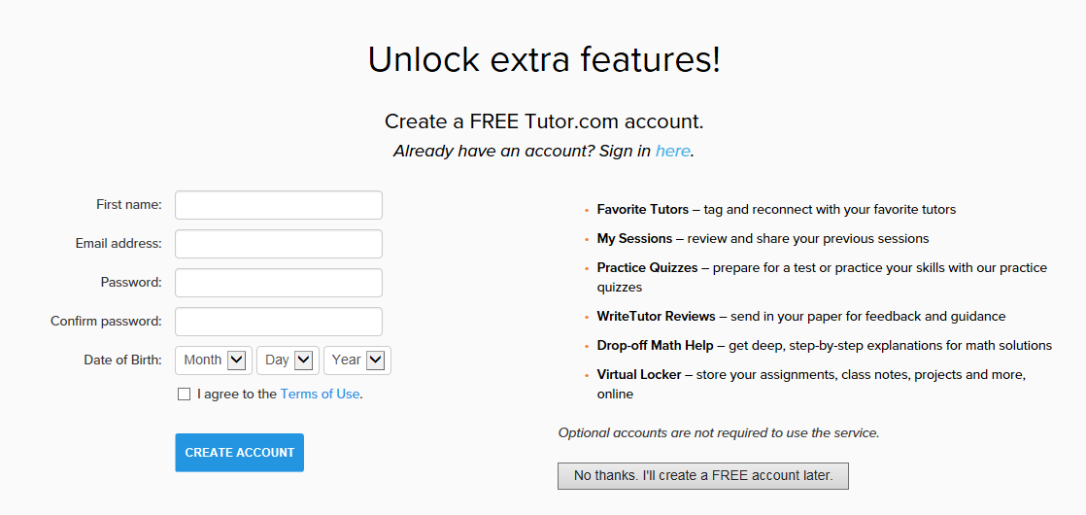
Creating an account
Personalized accounts are free.
Students still remain anonymous to tutors.
Birth Date is NOT saved, but is required for COPPA compliance.
If child is under 13, parents should create the account for full features.
Extra features and tools unlocked with account include
  Access to previous sessions
  Tag and reconnect with favorite tutors
  Store documents in virtual locker
  Use drop-off review services
  Use practice quizzes & SAT/ACT Essentials
Notes:
About those accounts now…
Whether you experienced a login error or not, everyone that accesses HomeworkLouisiana will be asked to create an account. Accounts are free, anonymous and optional. If you are under 13 years old, please have your parent create this account using their information. Otherwise, the extra features will not be available for you.
If you don’t want to create an account, just click “No thanks,” but doing so will limit the features available. You’ll only be able to connect with a tutor for the live, on-demand tutoring, view video lessons or access the SkillsCenter Resource Library. You will not be able to use the drop-off review service, practice quizzes, or SAT/ACT Essentials and you won’t have access to your favorite tutor list, previous sessions or virtual locker.

Slide 21
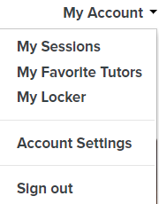
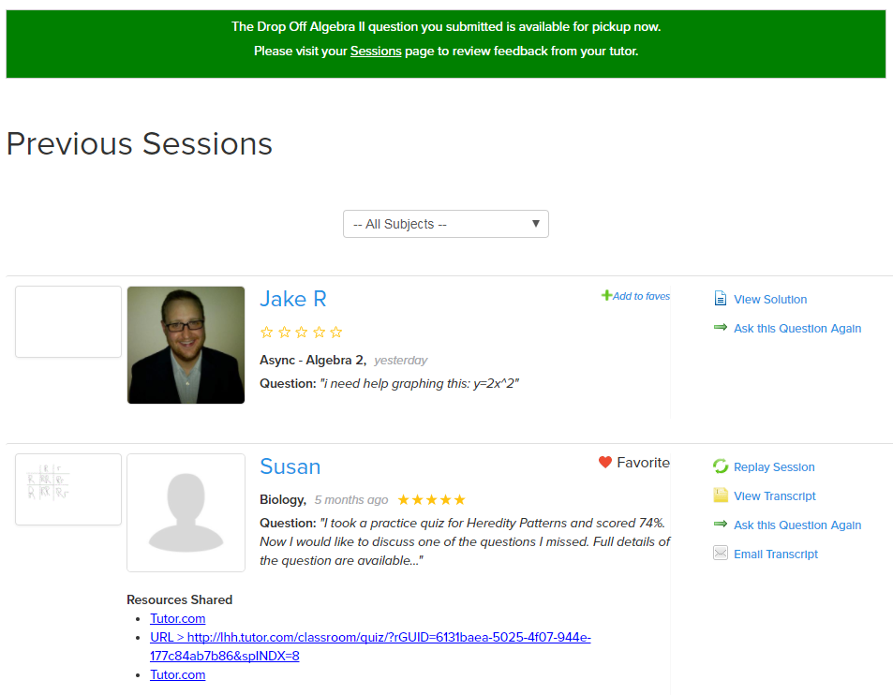
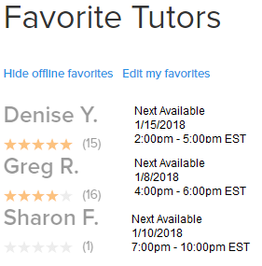
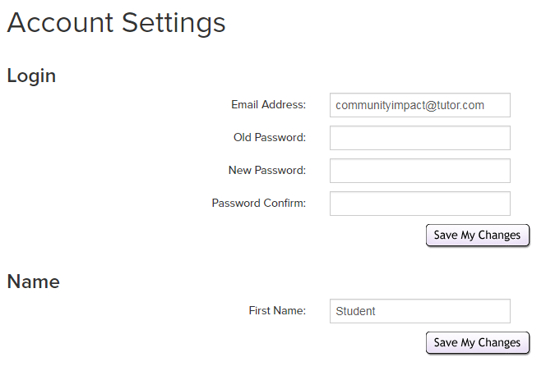
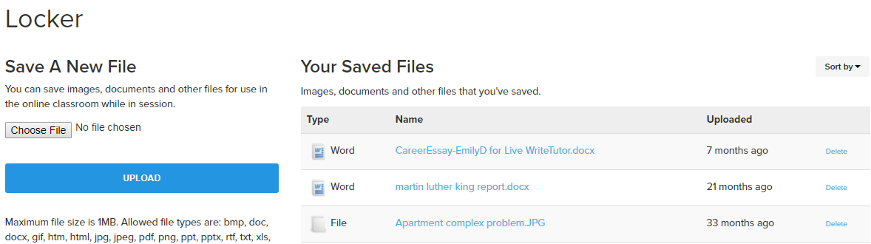
Reviewing child’s work
Parents can review their child’s work through “My Account.”
  Previous sessions
  Favorite tutors
  Stored documents in locker
Password can be changed in “My Account.”
Email address can be updated in “My Account.”
Families can share accounts, but it is not recommended for older students, as they will want to store and review their self-study progress.
Notes:
To review any of your HomeworkLouisiana sessions, log into your account and go to “My Account.” Here you will see options to review previous sessions, tag and reconnect with favorite tutors and access all of the documents you’ve shared within their sessions. This is also where you’ll go to retrieve the results from your Drop-Off Reviews. This library of previous sessions and documents can be a great help to students who are reviewing for upcoming tests or would like to “see it one more time,” because each real-time session record includes a video playback option and an audio transcript if they chose to use voice-chat.

Slide 22
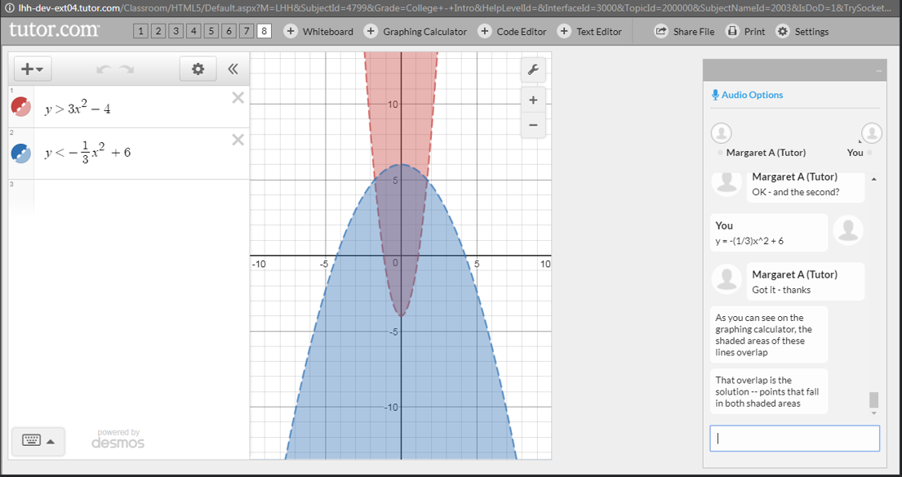
Using the tools
Notes:
Now, you’re signed in and you’ve setup your account. Let’s look at the tools that are available and where to find them.

Slide 23
Delete this slide prior to presentation
When presenting to parents/teachers of K-5th grade students, show the following tools or slides:
Choose your tool, connect with a tutor, classroom tools, post-session review, skillscenter
When presenting to parents/teachers of 6th-8th grade students, show the above tools or slides plus:
Drop-off reviews, practice quizzes, early edge video lessons
When presenting to parents/teachers of 9th-12th grade students, show all tools or slides.

Slide 24
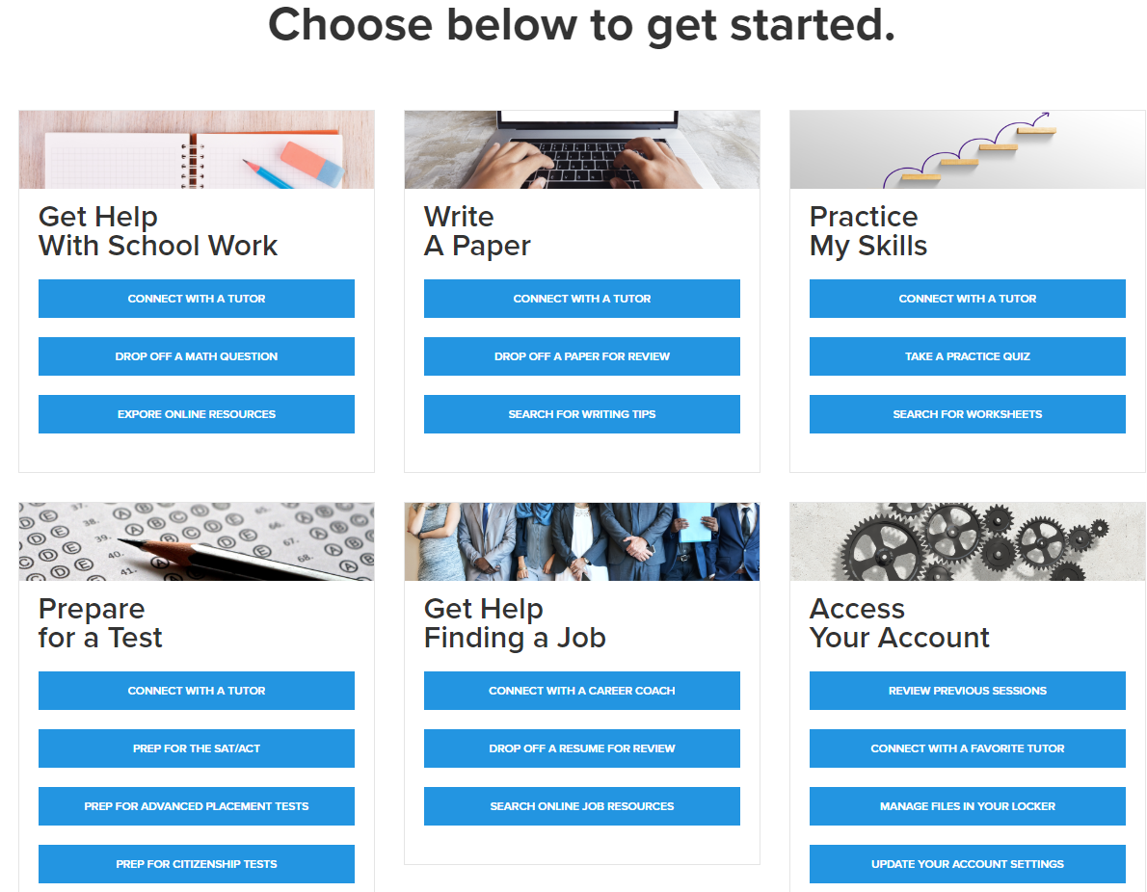

Choose your tool
Notes:
The HomeworkLouisiana landing page is designed for ease of use, highlighting the different tools available for each task with which you may need help. You can either use the quick links on top to choose your tool or, you can scroll down to the “toolboxes” that show the different learning tools available for the task at hand. Anytime you wish to return to this page, just click the little house icon in the top left corner. Now though, we’ll start with the most frequently used tool, connecting with a tutor. Just click on Connect with a Tutor.

Slide 25
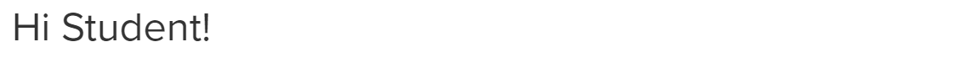
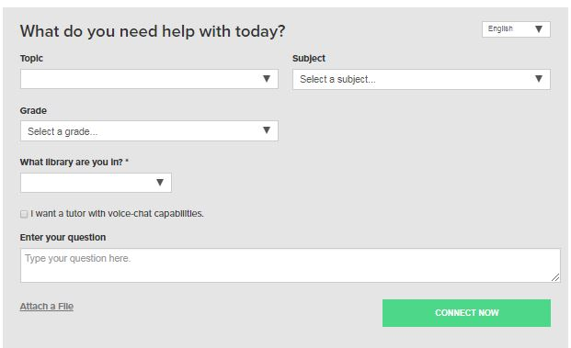
Connect with a tutor
Tutors are available Sun. – Thu., 2pm – midnight
Spanish & Vietnamese speaking tutors are available for math, science and social studies.
To allow a voice connection in the classroom, be sure to check the box for “voice-chat capabilities.”
Average wait time to connect is under 2 minutes.
Average session length is 20-25 minutes, but might be shorter or longer depending on student’s needs.
Notes:
Connecting with a tutor is easy! Our Library’s tutors are available Sun-Thu, 2pm-midnight. To get connected, just answer the few questions that are in the pre-session connection box. It is always helpful if you include your full question instead of just “HELP,” as HomeworkLouisiana uses this information to connect you with the most appropriate tutor for your question. Also, if you think you might want to use the voice/audio option while in session, be sure to check the box. You’ll still have the option to turn on audio once in the classroom, but checking this box makes sure that option is available to you.
To connect with a bilingual Spanish speaking tutor, just use the language toggle in the upper right corner of the questionnaire.
Once you click “Connect Now,” the average time to connect with a tutor in the classroom is under 2 minutes.

Slide 26
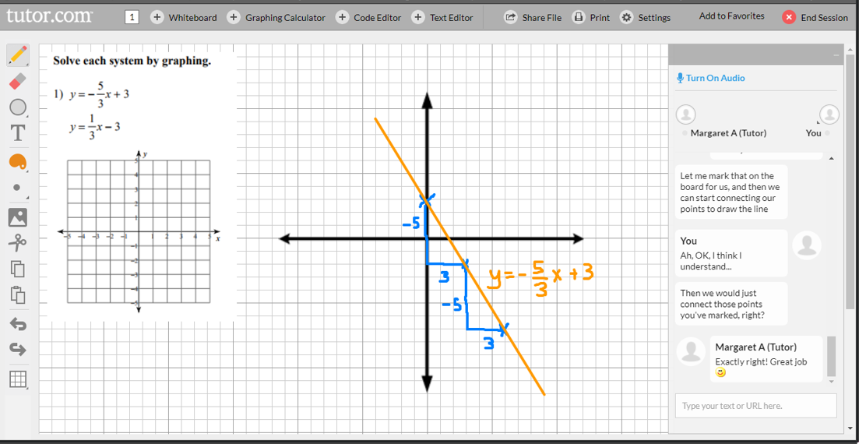
Classroom tools
Chat and voice
Interactive whiteboard with drawing tools
Graphing calculator
Text editor
File sharing
Online resource sharing
Print from classroom
Change font size in settings
Notes:
Once in the classroom, you and the tutor use the chat box to instant message back and forth or turn on audio to speak with a tutor. You will also use the interactive whiteboards where both you and your tutor can draw out problems, type an outline, graph an equation and much more. The tutors can also share educational online resources in the classroom to supplement the discussion. Tutors review all websites for appropriate material before launching. Also, the links to all shared resources are available in the post-session transcript for bookmarking and review.
Access all of these extra tools using the plus-sign buttons on the top of the classroom.

Slide 27
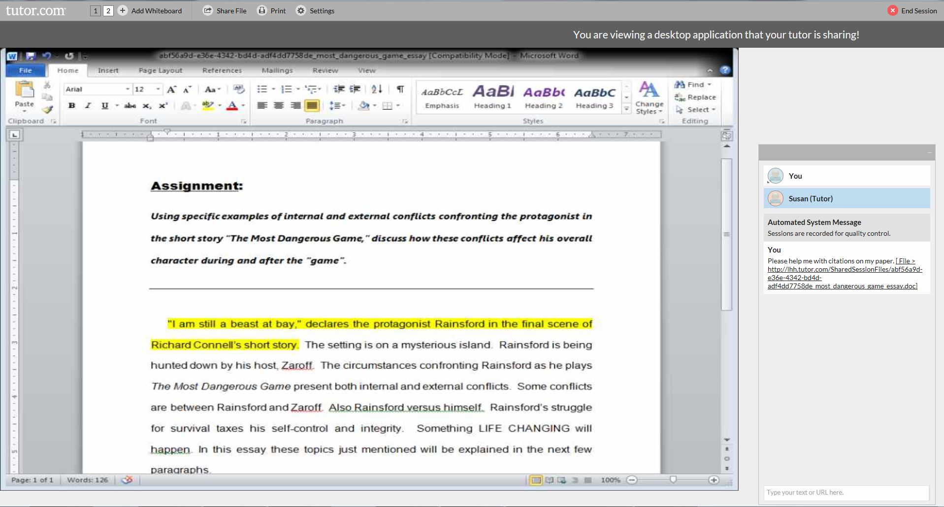
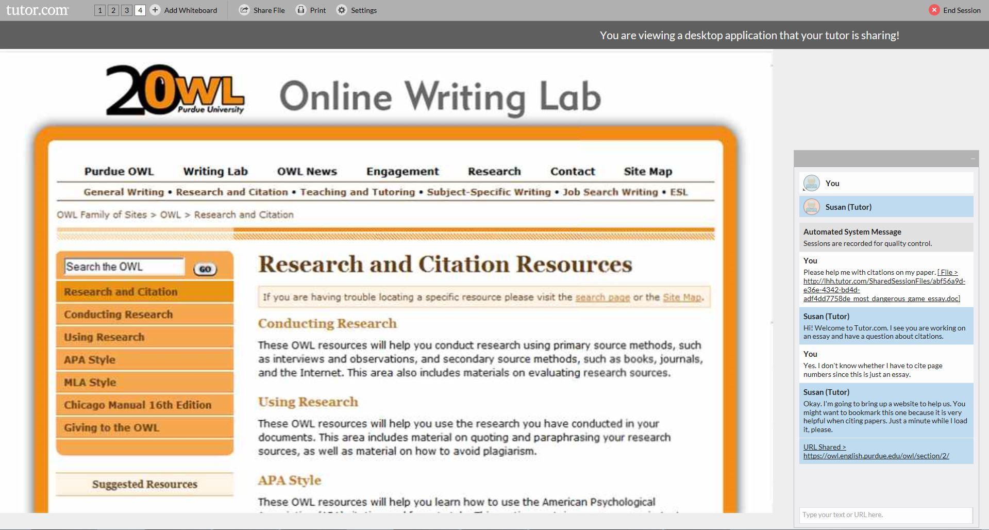
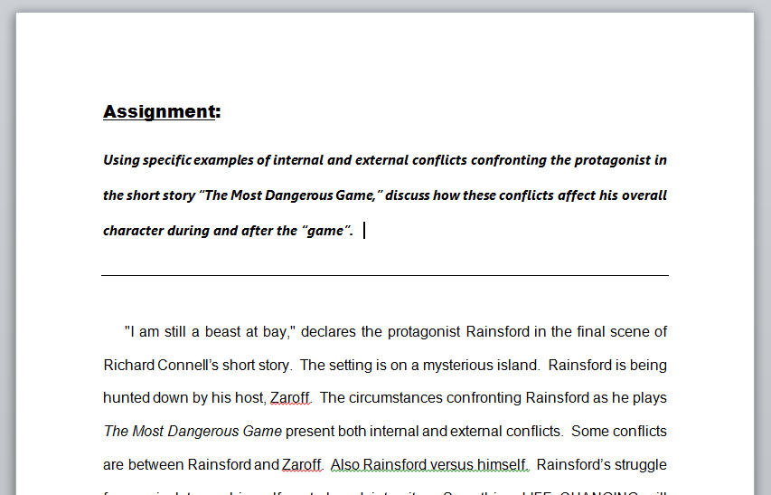
Classroom tools
Shared viewing of files & applications
Writing assignments
Lab reports
Class presentations
Résumés & cover letters
Learning Microsoft Office®
Word®
Excel®
PowerPoint®
Notes:
Another great feature in the online classroom is the ability to share and simultaneously view files such as Microsoft Word, Excel and PowerPoint files or PDFs. This feature allows you and your tutor to discuss the file while both being “on the same page.” Also note that when sharing files, the actual software is viewable, like we see the MS Word controls in this example. This allows the tutors to show you how to use the software tools to format their papers, create charts for a lab report, animate a presentation for speech class and more.

Slide 28
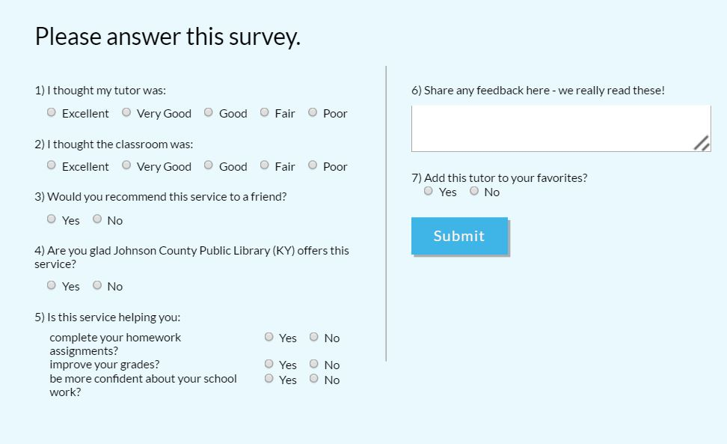
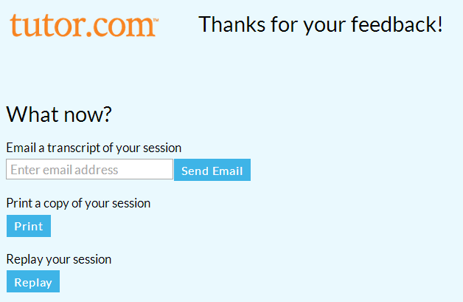
Post-session review
Please complete survey every time. It is used as part of the quality control process.
After session, you may email the session transcript, print it or replay a video of the session.
Notes:
Lastly, once a session has ended, please complete the survey and review your session. All survey results are shared with the library and HomeworkLouisiana uses these survey results and student comments for quality control purposes.
If you did not create an account, the session transcript review is very important because once you close this window, the session is no longer available without an account. You can email a copy of the session, print it or replay a video of the session.
[this is a good time to pause for questions before getting into the other tools]

Slide 29
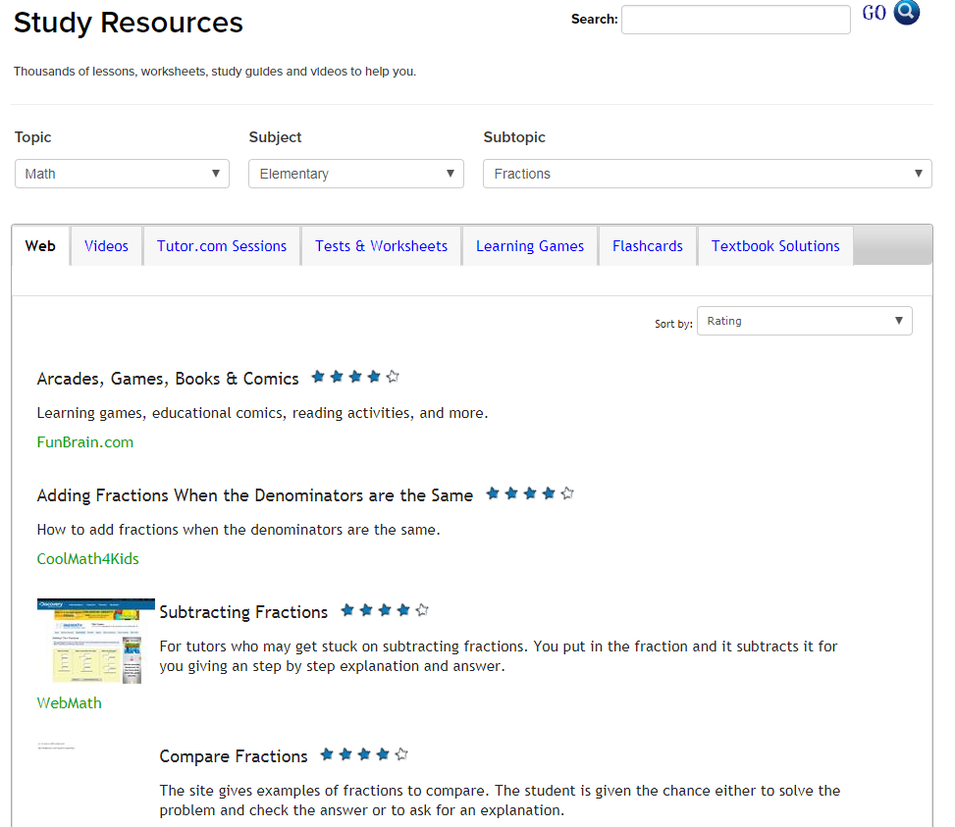
SkillsCenter™ Resource Library
Access from landing page
  “Explore online resources”
  “Search for…”
Or, access from bottom of “Connect with a tutor” page
Thousands of vetted, educational resources
  Websites
  Videos
  HomeworkLouisiana Sessions
  Sample Tests & Worksheets
  Learning Games
  Flashcards
  Textbook Solutions
Notes:
Next, let’s take a look at the SkillsCenter Resource Library. This is available 24/7 and you can access the SkillsCenter from the Task with Tools page or at the bottom of the Connect with a Tutor Page and includes three sections: Study Resources, Test Prep Resources and Career Resources. The SkillsCenter can be searched using key words or a drop-down navigation tree. It includes thousands of online resources from education companies and career experts. Depending on the topic searched, you can find informational websites, instructional videos, previously recorded HomeworkLouisiana sessions, sample tests & worksheets, customizable flashcards and learning games. The SkillsCenter Resources are available 24/7.

Slide 30
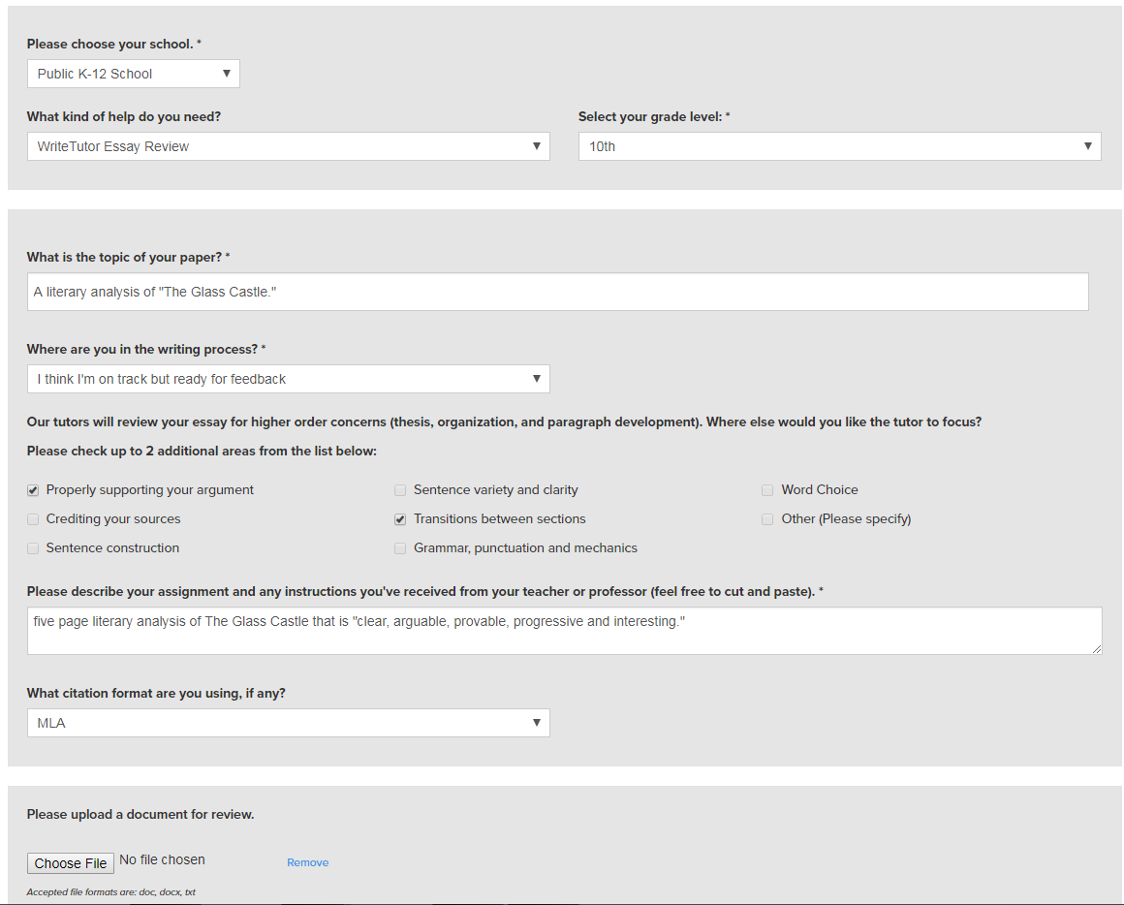
Drop-off Reviews
Available for writing assignments, single math questions (algebra and up) and cover letters/résumés.
Writing & Job Search open 24/7 for submission
  Turn-around time under 12 hours.
  Limited to 5,000 characters per submission.
Math open during regular tutoring hours for submission.
  Turn-around time under 24 hours.
  Limited to one problem at a time.
Complete the pre-session questionnaire and upload your document.
Reviews returned to the “My Sessions section” once completed. Email notification sent.
Notes:
Moving onto the next tool, we have the drop-off reviews. Drop off reviews are a fantastic way to get feedback and guidance from a subject matter expert without having to connect for a real-time session. This is great for students who are pressed for time or who may nervous about a real-time conversation with a tutor.
The writing and resume drop off service is open 24 hours/ 7 days a week and the turn around time for feedback on a piece of writing is under 12 hours. This is for K- adults and there is a 5,000 character limit per submission. Students will get back a detailed feedback form and suggestions on the document itself offering tips, kudos, and suggestions for next steps.
The math drop off service is open during tutoring hours and is for algebra through calculus. There is a one problem at a time limit and the turn around time is 24 hours. This tool is especially helpful for students that prefer words & pictures instead of numbers & symbols when learning math, and for anyone looking for another way of having the concepts presented. A good example for when to use the drop-off math review service is if you miss a question on a quiz and you know it is coming up on a test and you just can’t understand why you missed it.

Slide 31
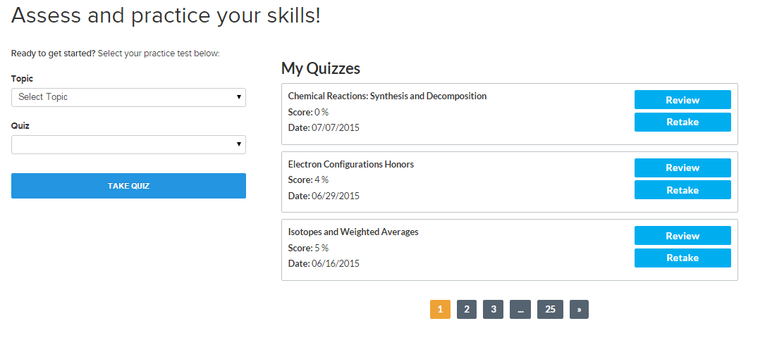
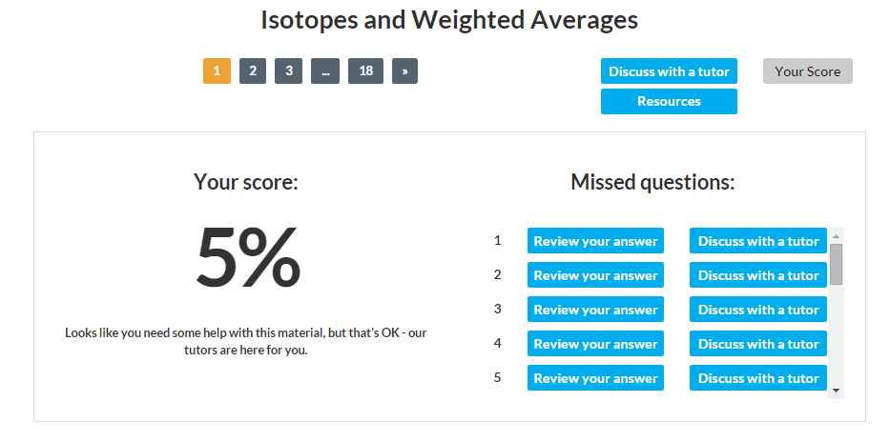
Practice quizzes
Middle School/High School/College
  Math Fundamentals
  Algebra I
  Geometry
  Algebra II
  Calculus
  Biology
  Chemistry
  Physics
  English/Language Arts
Use as skills builders or to prepare for an end-of-chapter test.
Notes:
Next on the list are practice quizzes. These can double as skills drills, too. Practice Quizzes will help you prepare for upcoming end-of-chapter tests or practice your skills in particular areas of math, science and language arts. These quizzes are geared for late middle school, high school and early college levels. Each quiz is about 15-30 questions long, depending on the depth of the topic. You’ll receive a score report after completing the quiz that includes a list of all missed questions. Then, you have the option of reviewing the correct answer, opening a resource related to that topic or discussing the question with a tutor.

Slide 32
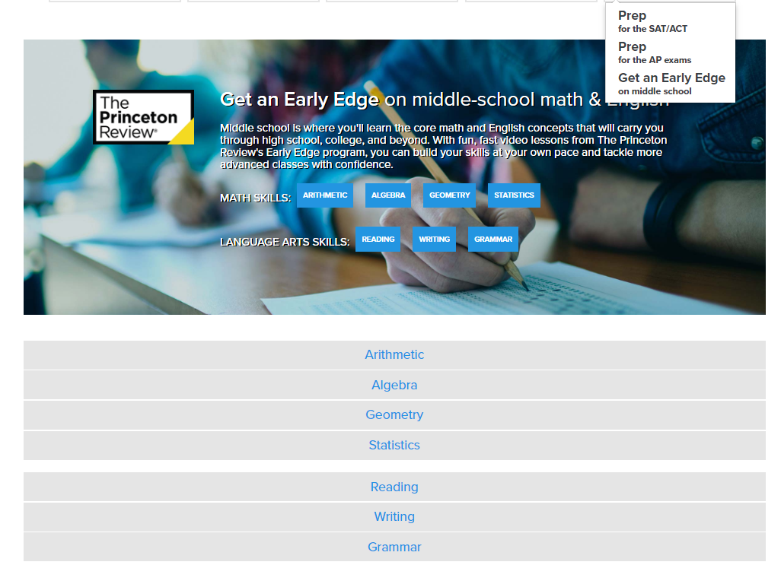
Early edge video lessons
Middle School/High School/College
  Math Videos (65 lessons)
    Arithmetic
    Algebra
    Geometry
    Statistics
  English Language Arts (37 lessons)
    Reading
    Writing
    Grammar
Each video is about 5 minutes long.
Use as skills builders or to prepare for an end-of-chapter test.
Notes:
Having a strong foundation of knowledge and skills is necessary for any student to succeed, yet there are many students that are missing the fundamentals. The Learn Your Way video lessons created by The Princeton Review were designed to help students learn and review the fundamentals needed to tackle more advanced classes. Each video is less than five minutes long and presents just one concept. Students from around 4th grade and up can use these videos to be introduced to new concepts or to review a concept. When used in combination with the Practice Quizzes we just saw and with the tutors, students are able to build the skills they need at their own pace and tackle more advanced classes with confidence.

Slide 33
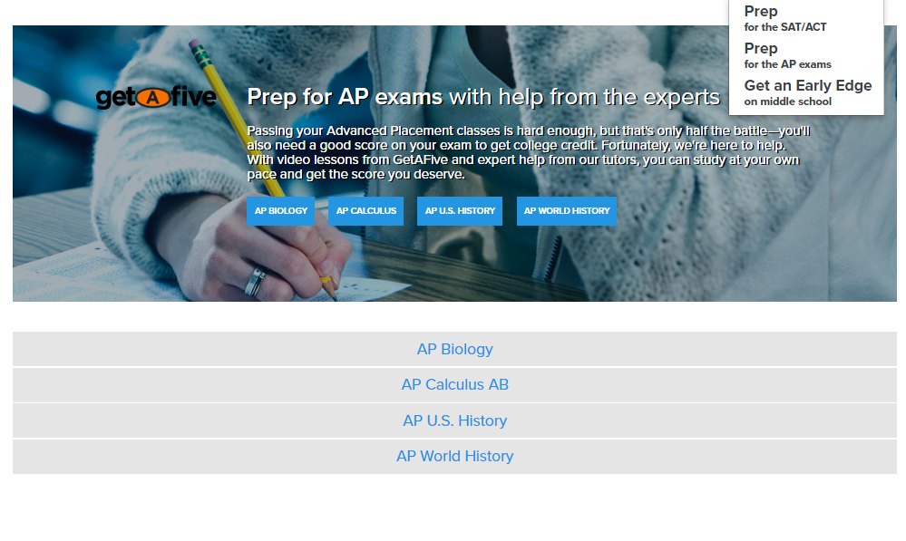
AP® Video Courses
High School/College Level
Advanced Placement Courses
  Biology (107 lessons)
  Calculus AB (54 lessons)
  U.S. History (102 lessons)
  World History (70 lessons)
Each video is less than 15 minutes long.
Broken down into chapters/topics.
330 videos in total.
Don’t forget, tutors are available for on-demand tutoring in 14 AP subjects.
Notes:
Speaking about those advanced classes, Advanced Placement courses have a lot of great advantages. Students can earn college credit if they perform well on the AP test. AP course grades are often weighted higher than regular courses. Universities look for students that have taken multiple AP or “rigor” courses. These courses can help prepare students for fast paced, more difficult college courses. But…these classes can also be risky. If students take them before they are ready, before they have the foundational knowledge and skills, reaping the benefits is impossible. HomeworkLouisiana includes 330 videos created specifically for AP course material to help students truly grasp the concepts and ace their AP course and test. The video libraries include biology, calculus, U.S. history and world history.

Slide 34
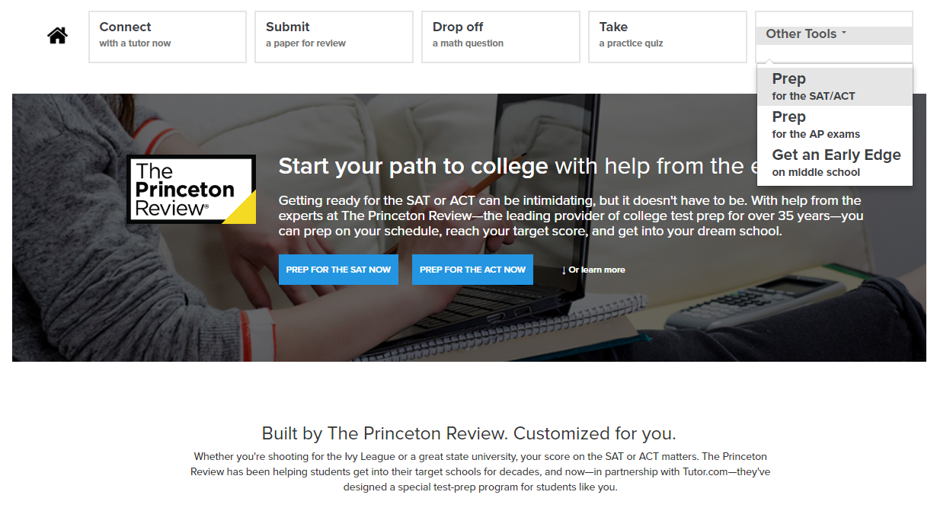
Sat/act essentials – test prep
Created by The Princeton Review
SAT and/or ACT Prep
Full-length practice tests
Comprehensive score report with “Areas of Focus”
Video lessons & practice drills
College Admissions Advice and Resource
Notes:
Lastly, I want to show you the SAT/ACT Essentials. This tool is truly Essential for any high school student with dreams of going to college. Good scores on the SAT and ACT can not only help a student get into the school of their dreams, but also help them earn scholarship money. This self-study course from The Princeton Review can help your students prepare for the tests and raise their score. Students can choose to prep for the SAT, the ACT or both. Prep for the SAT can also help 10th and 11th grade students prepare for the PSAT/NMSQT if they plan to shoot for a National Merit Scholarship. To get started, students click on “Prep for the SAT/ACT” and then choose the test they’d like to take. Of course, Louisiana students will all want to prepare for the ACT since it is a requirement for our 11th grade students.

Slide 35
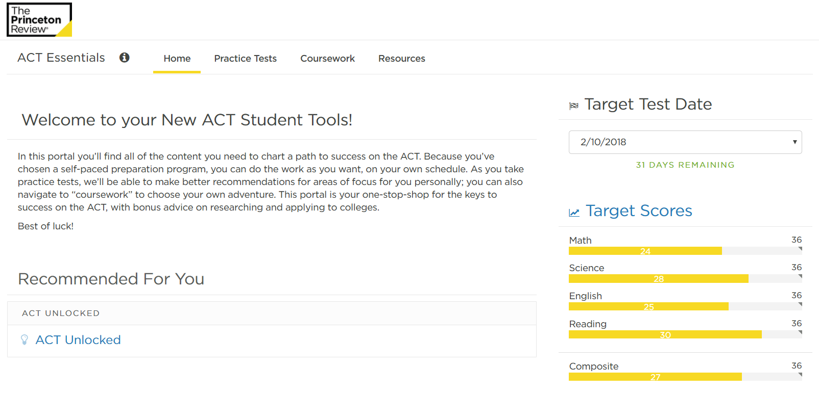
Sat/act essentials – test prep
Start by setting targets and watching the introductory video on Home page.
Notes:
Once the test is chosen, the homepage presents an introductory video for the test, briefing students on strategy. From there, they set their target test date and scores so that they can track progress toward goal.

Slide 36
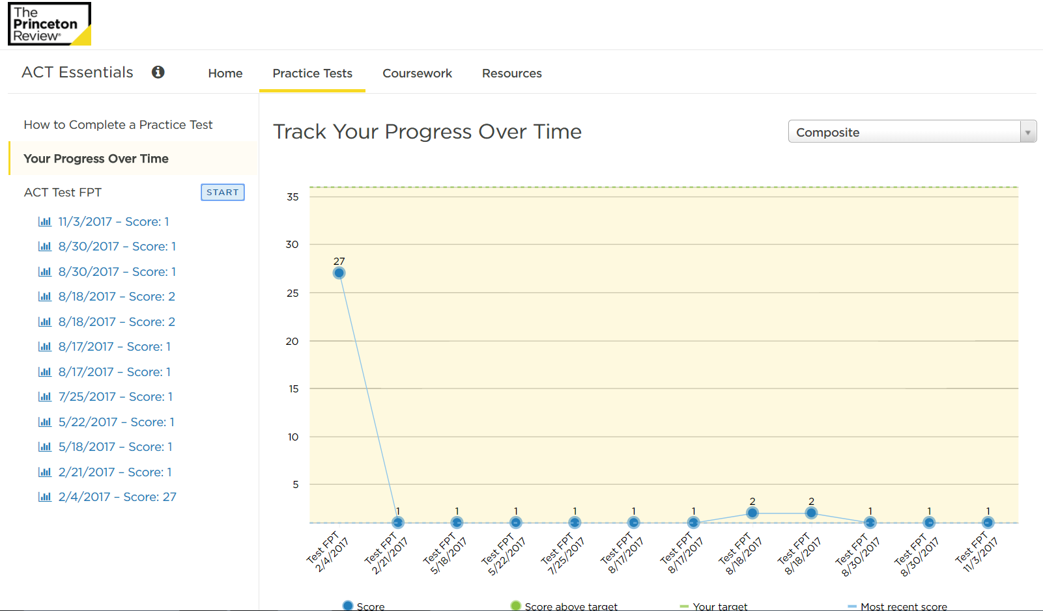
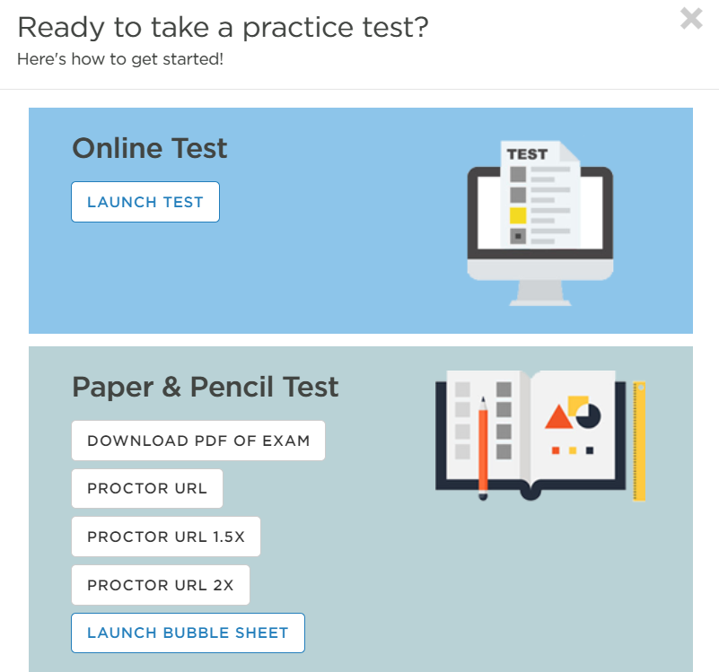
Sat/act essentials – test prep
Take practice test
  Online or download test and bubble sheet
  Choose format
    Timed, time-and-a-half, double-time, untimed
  May end test after one section to score just that section
Notes:
Click on the practice test tab to get started. Practice tests are full length tests that mimic the actual tests, using the same number of questions as the real test and timed in the exact same way. Students can choose to take the tests online or download a paper version. If your student uses the paper version, they will have to transfer their answers from the bubble sheet into the online system to retrieve their score. Once the student completes the test, they’ll receive a full score report.

Slide 37
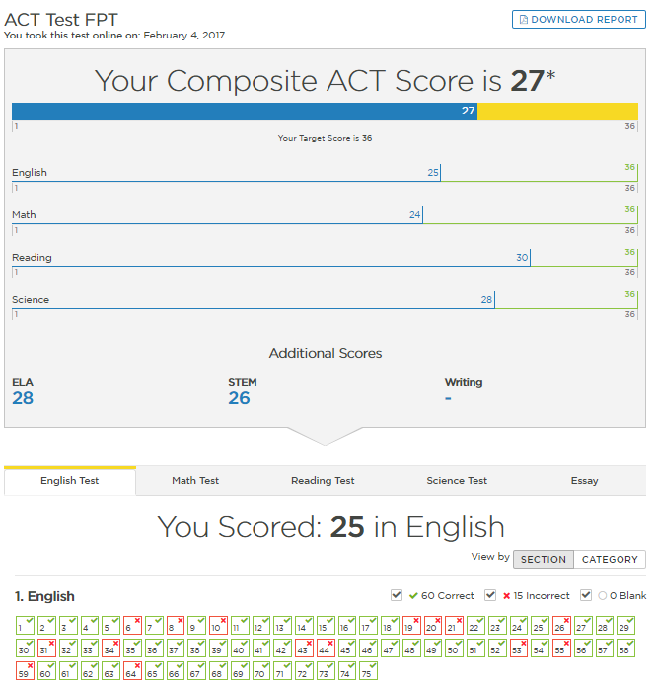
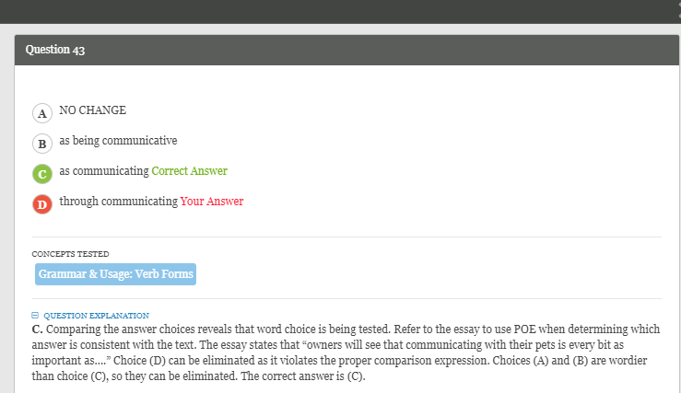
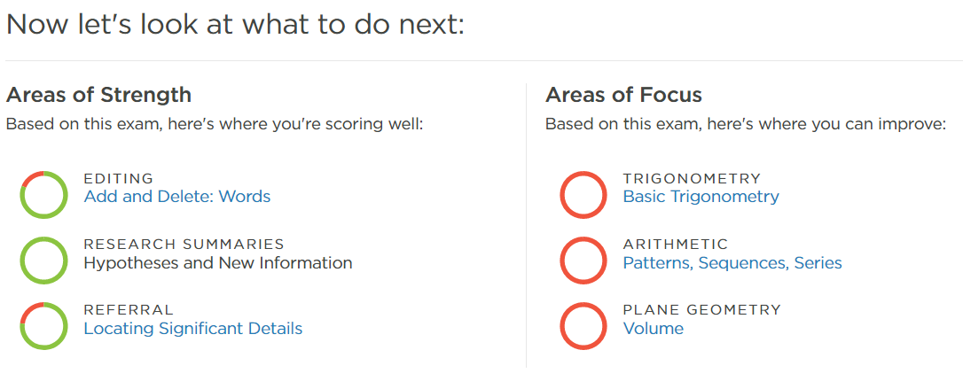
Sat/act essentials – test prep
Use Score Report to review missed questions and receive explanations of concepts.
Use Areas of Focus to best improve score.
  Each area of focus has a video lesson and practice drill.
Notes:
The score reports show what the student would have scored on an actual test, breaking the results down into sections as well as giving question by question results. Students can click into each question to see the correct answer and an explanation for the question. Most importantly on the score report, your student will be provided with Areas of Focus. These areas of focus show the concepts students should master to improve their score the most. Clicking into each area of focus will provide a video lesson and practice drill for that concept.

Slide 38
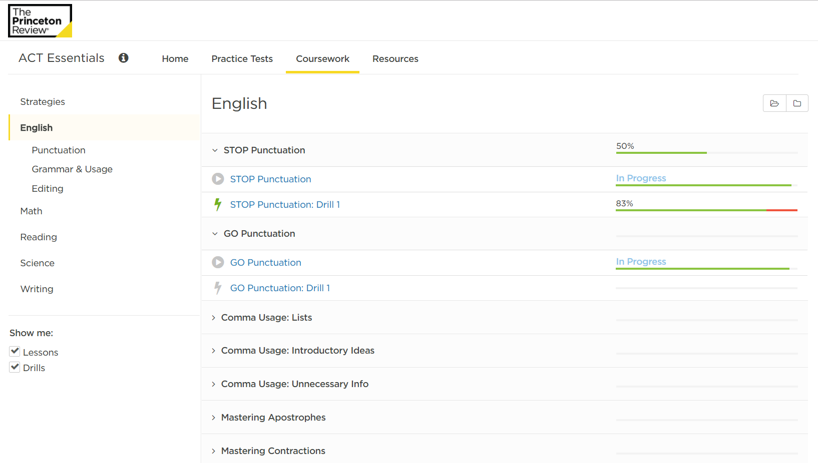
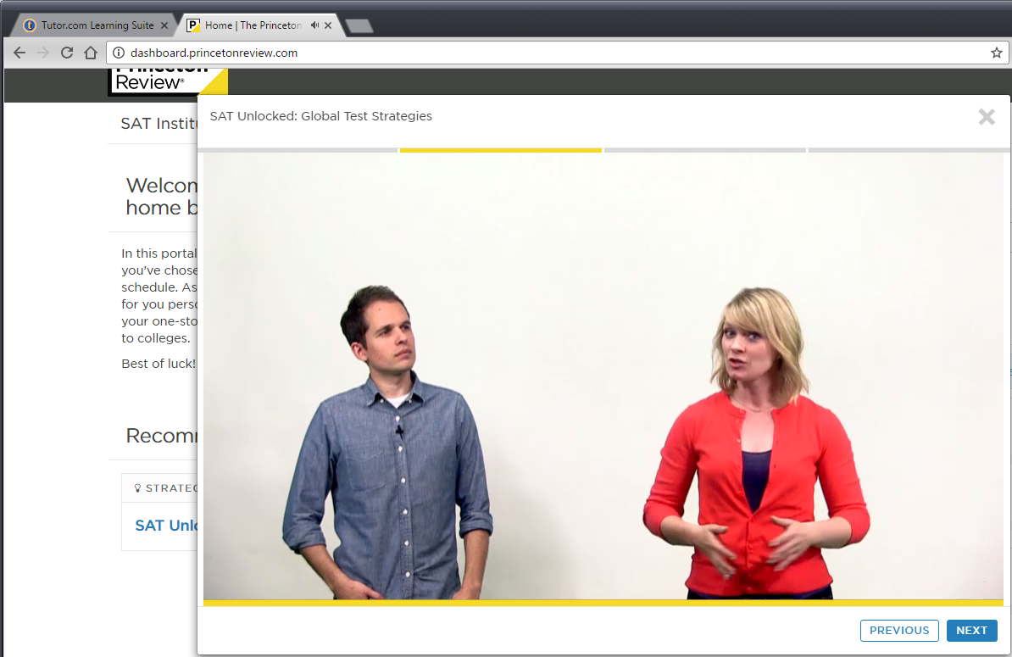
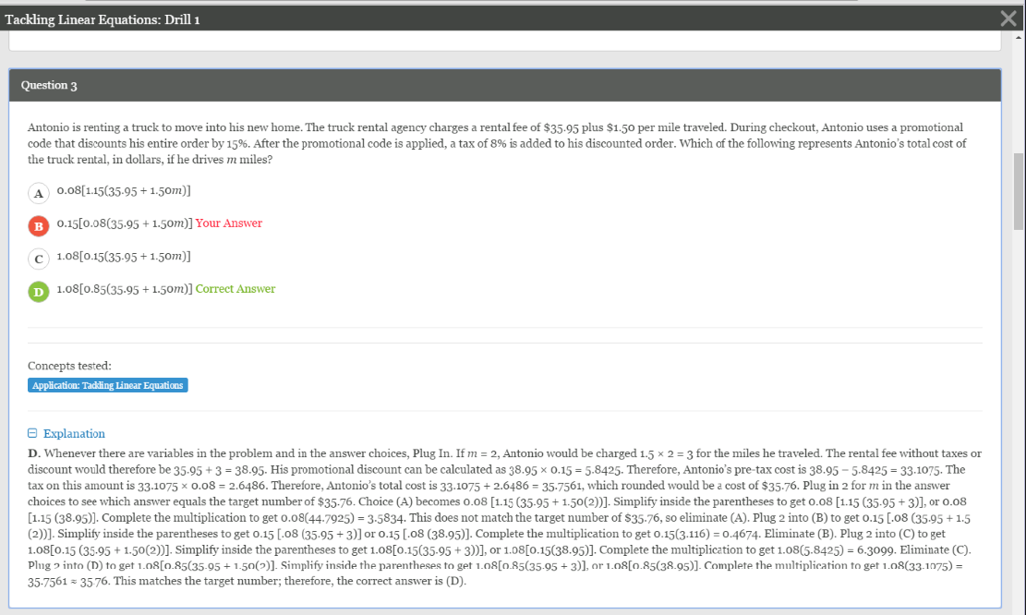
Sat/act essentials – test prep
Additional prep available on Coursework tab
90 ACT Lessons
90 SAT Lessons
Video & Drill for Each
Connect With a Tutor
Flip Back to HomeworkLouisiana tab in your browser for help from an on-demand, subject-matter expert if you don’t understand any questions or concepts from the video lessons or practice drills.
Videos & Drills
Notes:
After working on the areas of focus, students can choose to retake the practice test to receive new areas of focus or they can click into the Coursework tab to find video lessons and practice drills for every single concept that is covered on the tests. There are 90 different video lessons and practice drills for each test. Remember, if your student ever gets stuck on a concept and needs more help, they can flip back to HomeworkLouisiana home page and connect with a subject matter expert to help them understand the concepts.

Slide 39
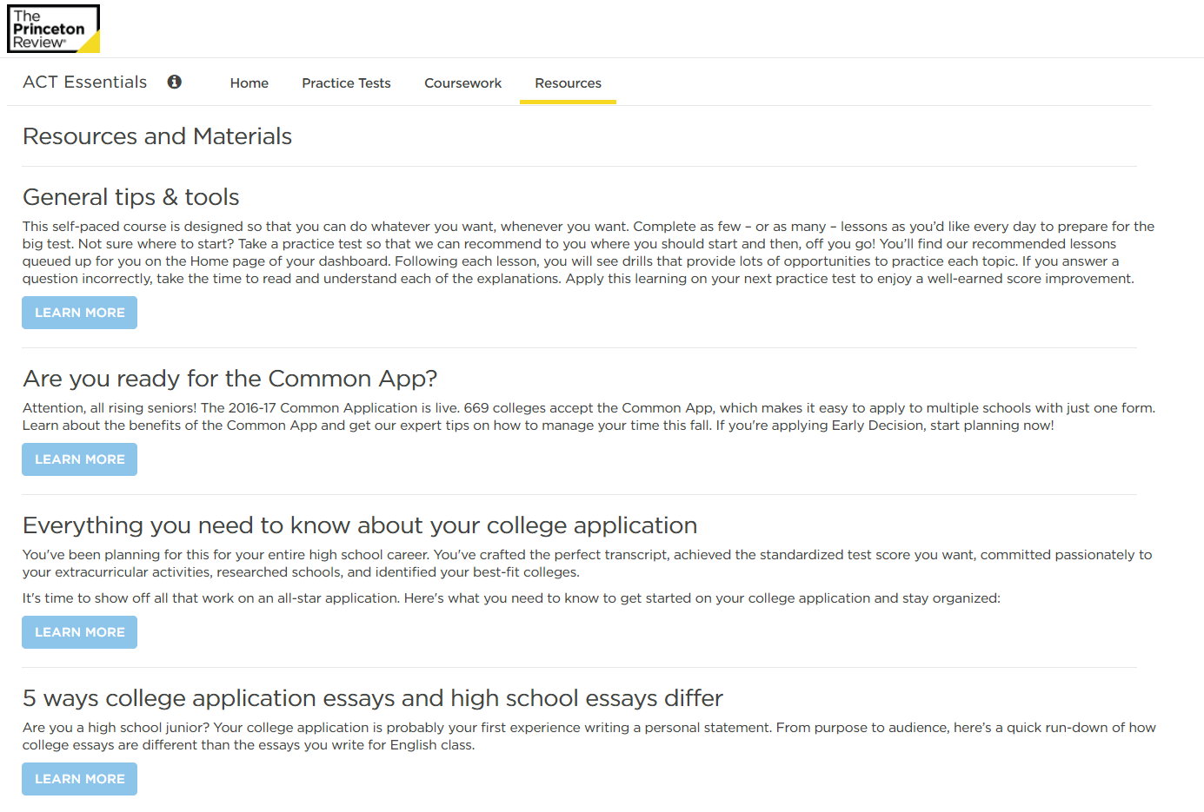
Sat/act essentials – admissions advice
College admissions advice from The Princeton Review available on the Resources tab.
The Common App
Applications
Writing Your Essays
Choosing Your School
Choosing Your Major
Financial Aid
Test Strategies
GPA & High School Classes
Notes:
In addition to good test scores and grades, the college admissions process can also include a lengthy application, required essays and, of course, financial aid. The Resources tab in SAT/ACT Essentials provides advice from The Princeton Review college admissions experts on how to navigate the college application process. Be sure to check it out!

Slide 40



Questions & contact
[Insert the contact information for the library]
HomeworkLouisiana is provided by the State Library of Louisiana, your local public library, and the Institute of Museum and Library Services, powered by Tutor.com.
The Princeton Review is not affiliated with Princeton University.
All test names and Microsoft product names are registered trademarks of their respectful owners.
Notes:
That was a lot of information! HomeworkLouisiana truly is a great resource for students of all ages. By providing instruction and tools in so many different formats and subject areas, it appeals to many learning styles and provides the one-to-one support that most students cannot get today from school or home. Do you have any questions about the Learning Suite that I can answer for you now?

