Slide 1


HomeworkAlabama.org
For Your Students
Alabama Public Library Service
Live Homework Help®
WriteTutor™ Coaching
Test Prep & Tutoring
Online, Just-in-Time

Slide 2





Would You Rather…
Struggle all night with homework?
OR
Get Back to Your Life!

Slide 3







HomeworkAlabama.org Can Help!
K-12th + College Level + Adult Learner + Job Seekers
3:00 p.m. – 10:00 p.m., Every Day (closed Jan. 1, Jul. 4, Thanksgiving, Christmas)
Live Tutoring + Career Coaching + WriteTutor Drop Off + SkillsCenter® Resource Library
Math* | Science* | Social Studies* | Languages | Writing | Test Prep | Job Search
Basic I & II | Basic | History | English | Real-time | AP® Test | Job Searches
Algebra I & II | Earth Science | Government | -Grammar | & Drop Off | PSAT | Applications
Geometry | Biology | Geography | -Literature | Essays | ACT | Cover Letters
Trigonometry | Chemistry | Political Science | -Vocabulary | Creative Writing | SAT | Résumés
Calculus | Physics | Citizenship | -Reading Comp. | Book Reports | GED | Interview Prep
Statistics |  |  | -ESL & ELL | Short Stories | Citizenship
*Bilingual Spanish speaking tutors available |  |  | Spanish | Research Papers
Advanced Placement® level tutoring available in most subjects.
“I am usually a student who can be pretty doubtful about if I did a problem correctly. This service provides me with confidence and what I need to reach my dreams! Thank you!” Tutor.com User
Notes:
HomeworkAlabama.org is an online tutoring and homework help service where student connect to an expert tutor for a real-time learning session. Tutors support students with difficult homework problems, writing assignments, test preparation and concept reviews in the core subjects of math, science, social studies, English, writing, Spanish as a foreign language and college entrance exams. They cover all levels from Kindergarten through intro-level college including Advanced Placement levels. The En Espanol service which is included with our standard program includes bilingual Spanish speaking tutors for all subjects in math, science and social studies which is especially helpful to parents who only speak Spanish. Tutors are online and availble, no appointment needed, from 3 pm to 10 pm, seven days per week. The service is only closed on four major holidays. There are also asynchronous features available such as a 24-hour writing review service and a robust SkillsCenter Resource Library with thousands of fully-vetted, online educational resources such as Khan Academy videos and customizable flash-cards.

Slide 4
For any question
Can you help me learn the states?
Can you read my essay for this scholarship?
I don’t understand Newton’s 1st Law of Motion
What are the 3 branches of government?
I need help graphing an equation!
What is atomic mass?!
Geometry proofs are killing me!
4

Slide 5

Who Are The Tutors?
Ken F. – PhD. Physicist and Tutor.com Tutor
Retired high school and college physics teacher
Award-winning author
Graduate of Harvard and Princeton
Retired Director of American Institute of Physics
Pilot of small planes and gliders
http://www.tutor.com/our-tutors
What is the most rewarding part of tutoring?
“The VARIETY. Every session is different, and most are challenging. It’s wonderful when the student “gets it” and shows appreciation.” Ken F. Tutor.com Physics Tutor
Notes:
Ken F. is a great example of one of the tutors with whom you might connect. Ken graduated from both Harvard and Princeton, has a PhD in physics and has been very active in his profession. He is also a retired teacher of both high school and college physics. Before settling down to retired life, he used to pilot small planes and gliders. Now, he spends his days writing books about flying and physics and tutoring math and physics students online. Students rate nearly all of Ken’s sessions 5 out of 5 and he’s just one of over 3,100 tutors with whom you could connect. Visit tutor.com/our-tutors to see more tutor profiles.

Slide 6

HomeworkAlabama.org
Notes:
To get started, simply go to www.HomeworkAlabama.org and click the “I am a student” button. If you prefer a Spanish-speaking tutor to discuss math, science and social studies, they should click, “Hablo Espanol.” Because Tutor.com also offers a special service to some military-affiliated students, if you have an active duty or deployed parent, should select, “I am military-affilitated” and check the eligibility requirements.
In some small areas of Alabama, you may receive an error when you click, “I am a student” that says their IP address has not been approved for use with this service. If you receive this, please see the instructions on the bottom of the HomeworkAlabama.org main page.
Let’s watch a short demonstration video of the service, now.

Slide 7
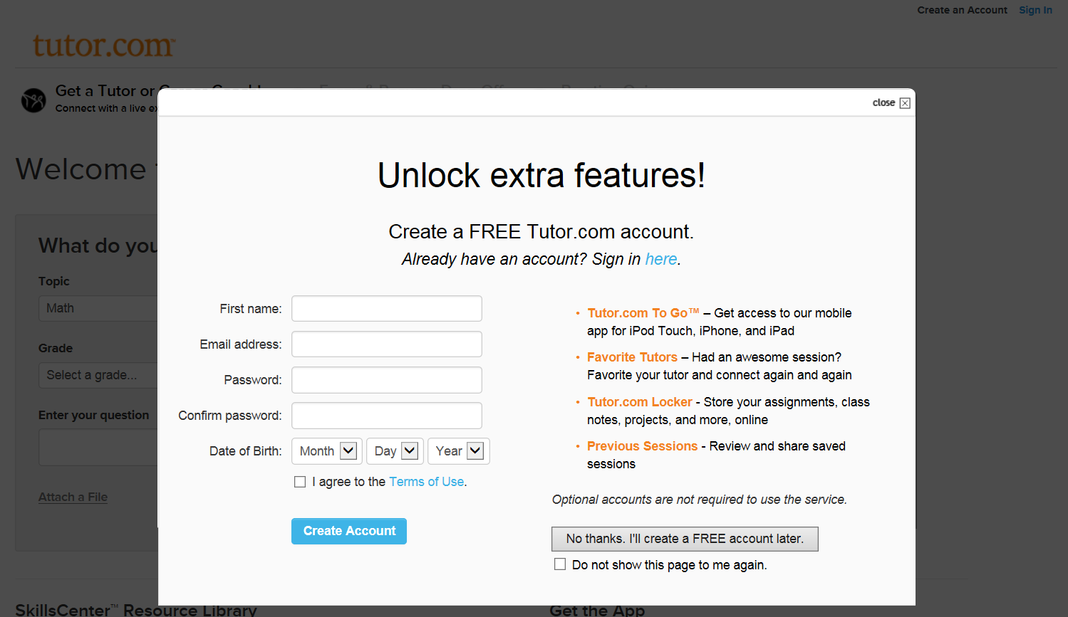

HomeworkAlabama.Org
Just go to HomeworkAlabama.org and choose your center. No library card number or password is needed, though you will have the option to create a free Tutor.com account.
Notes:
Just go to HomeworkAlabama.org and choose your center. No library card number or password is needed, though you will have the option to create a free Tutor.com account.

Slide 8
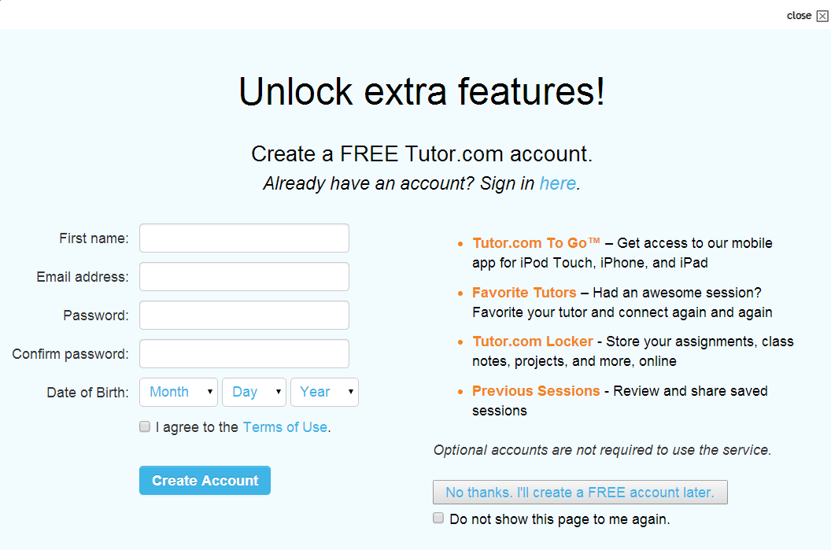
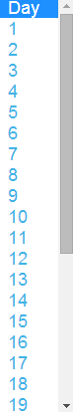
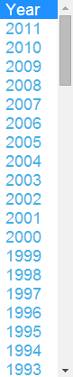
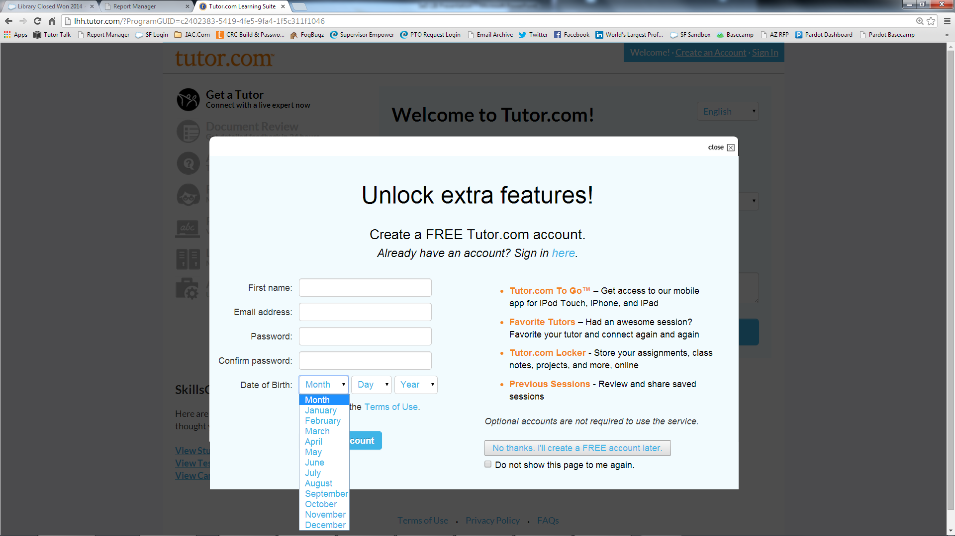
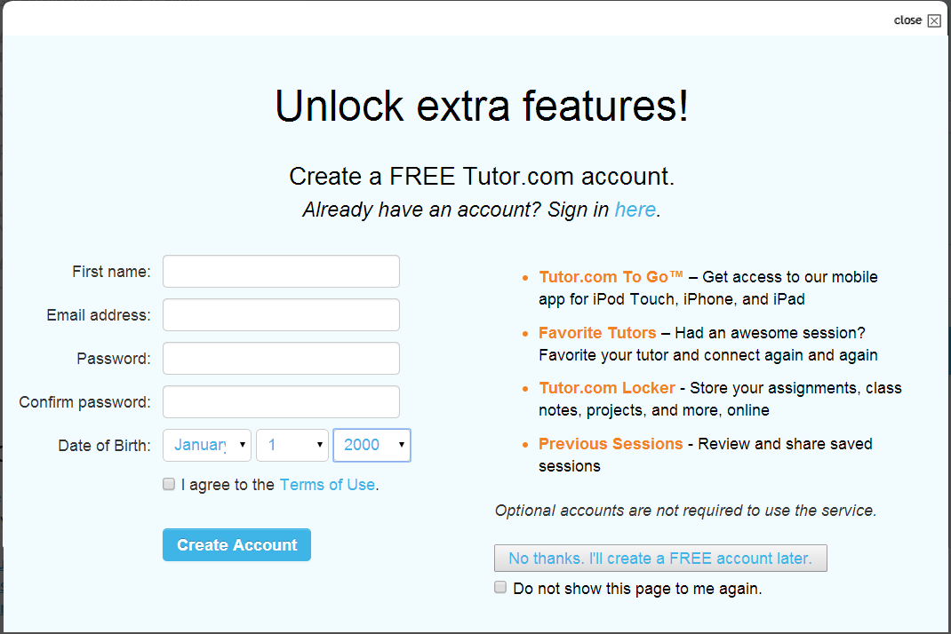


Susan
email@xyz.com
●●●●●●●●
●●●●●●●●

Create an optional Tutor.com account to unlock extra, personalized features.
Creating an account is safe and easy, but you may also select "No Thanks" and continue as a guest.
Notes:
Create an optional Tutor.com account to unlock extra, personalized features. Creating an account is safe and easy, but you may also select “No Thanks” and continue as a guest.

Slide 9
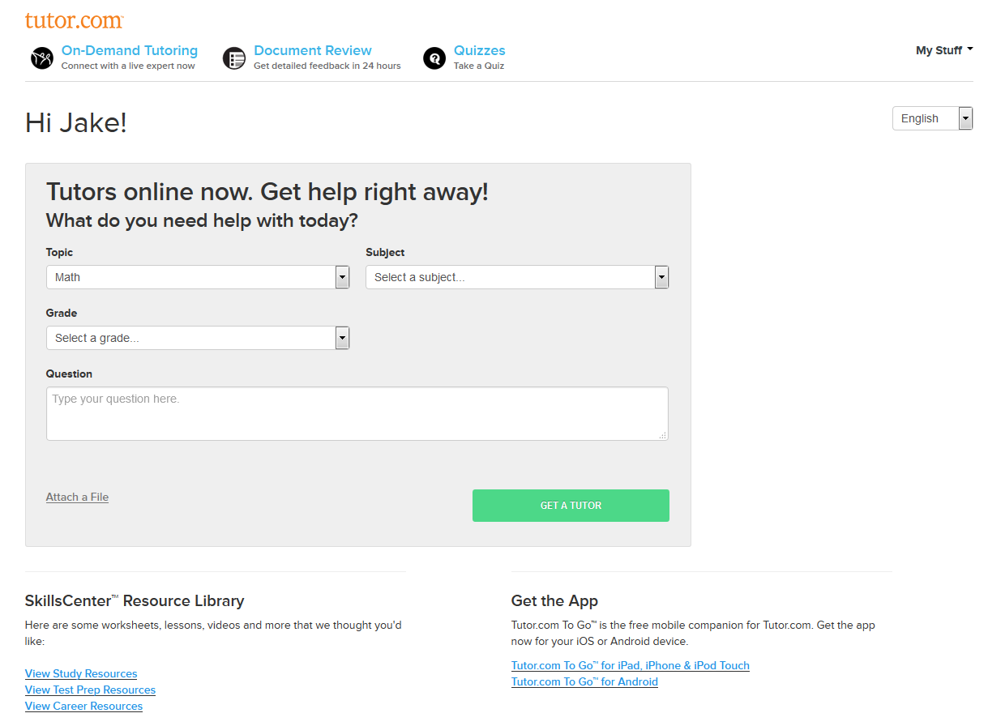



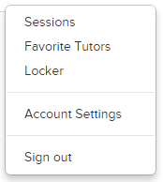
If you have created an account, you will have many options after logging in.
choose to connect with a favorite tutor or even review your previous work.
You can submit an essay for review, assess or practice your skills with quizzes,
Notes:
If you have created an account, you will have many options after logging in. You can submit an essay for review, assess or practice your skills with quizzes, choose to connect with a favorite tutor or even review your previous work.

Slide 10
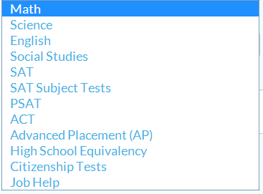
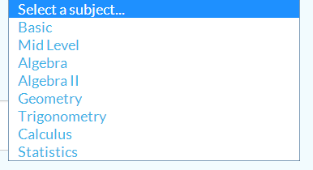
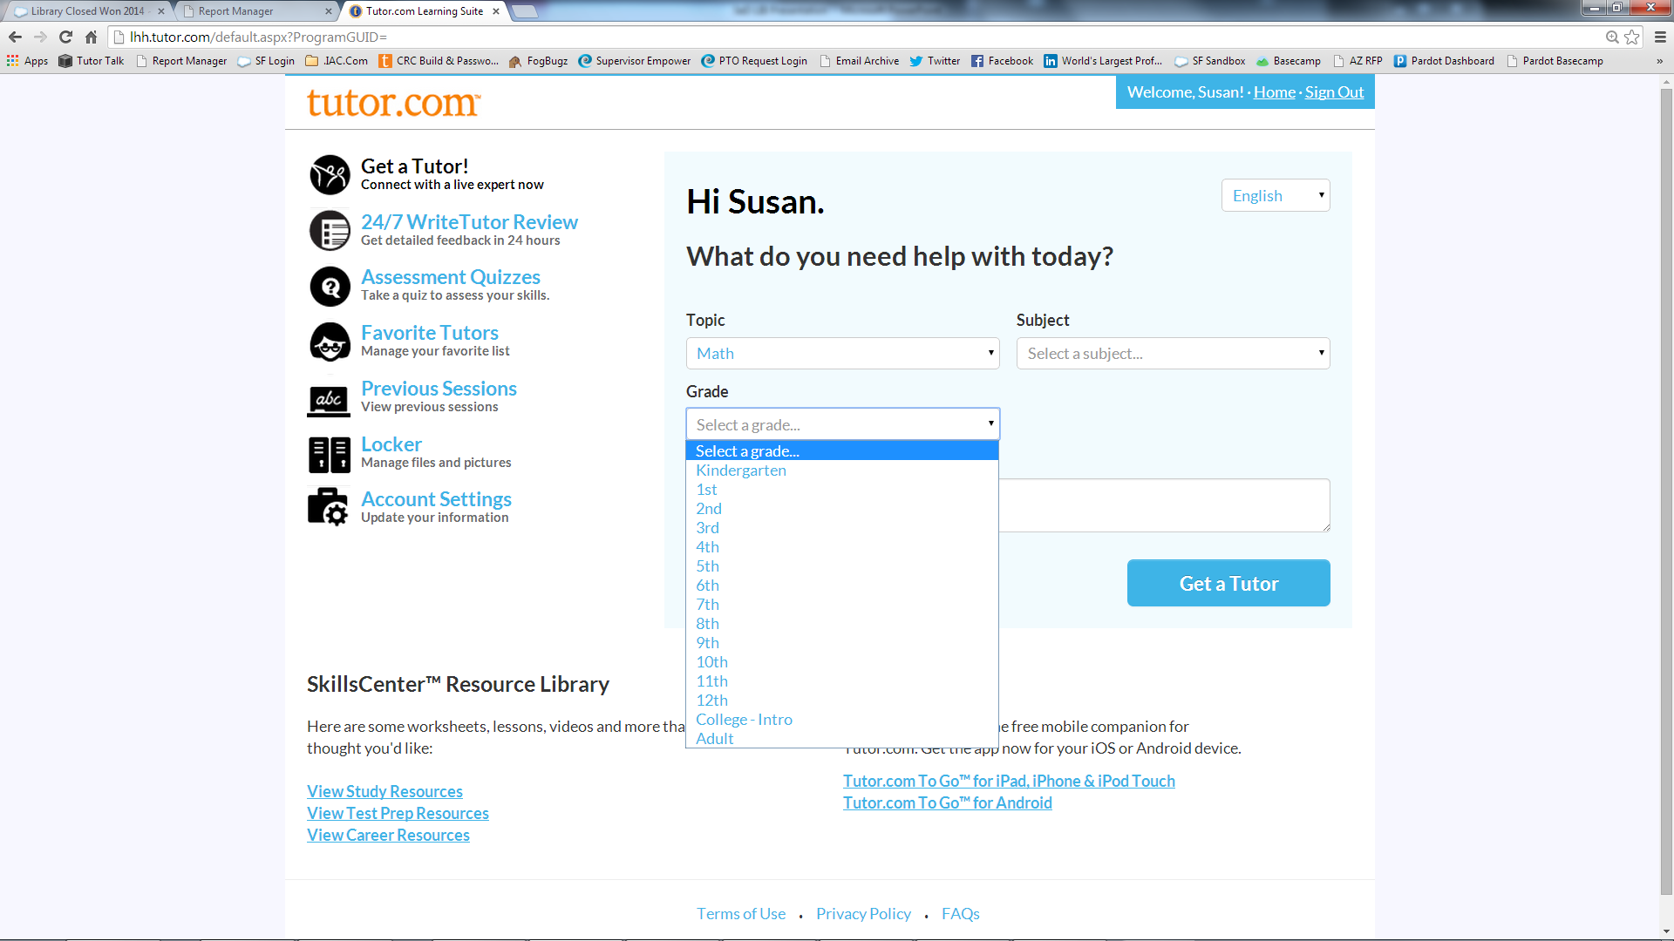
Solve for x. 4x + 10 = 22
Let's take a look at the online classroom. From the Get a Tutor! tab on our portal,
answer a few short questions about the help you need. Then click Get a Tutor! to get connected.
Notes:
Let’s take a look at the online classroom. From the Get a Tutor! tab on our portal, answer a few short questions about the help you need. Then click Get a Tutor!

Slide 11
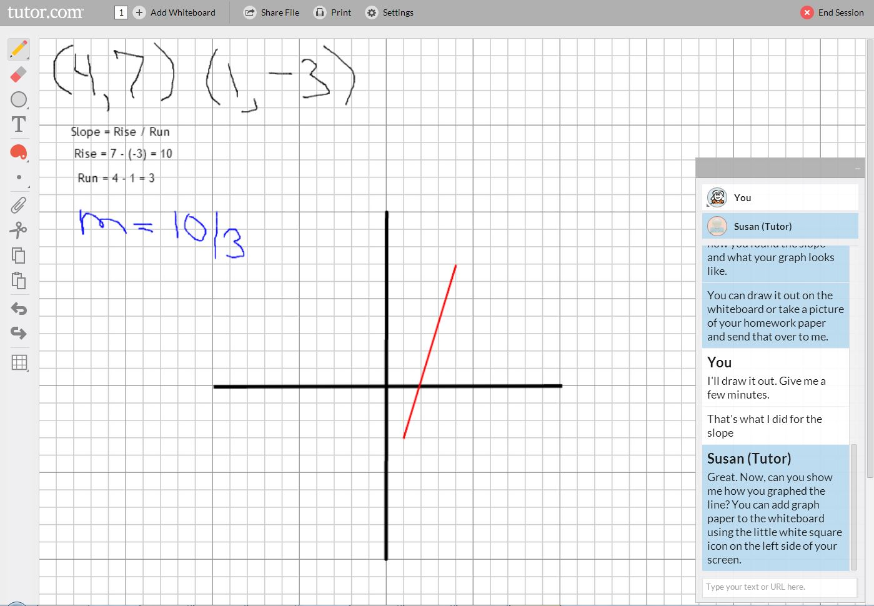
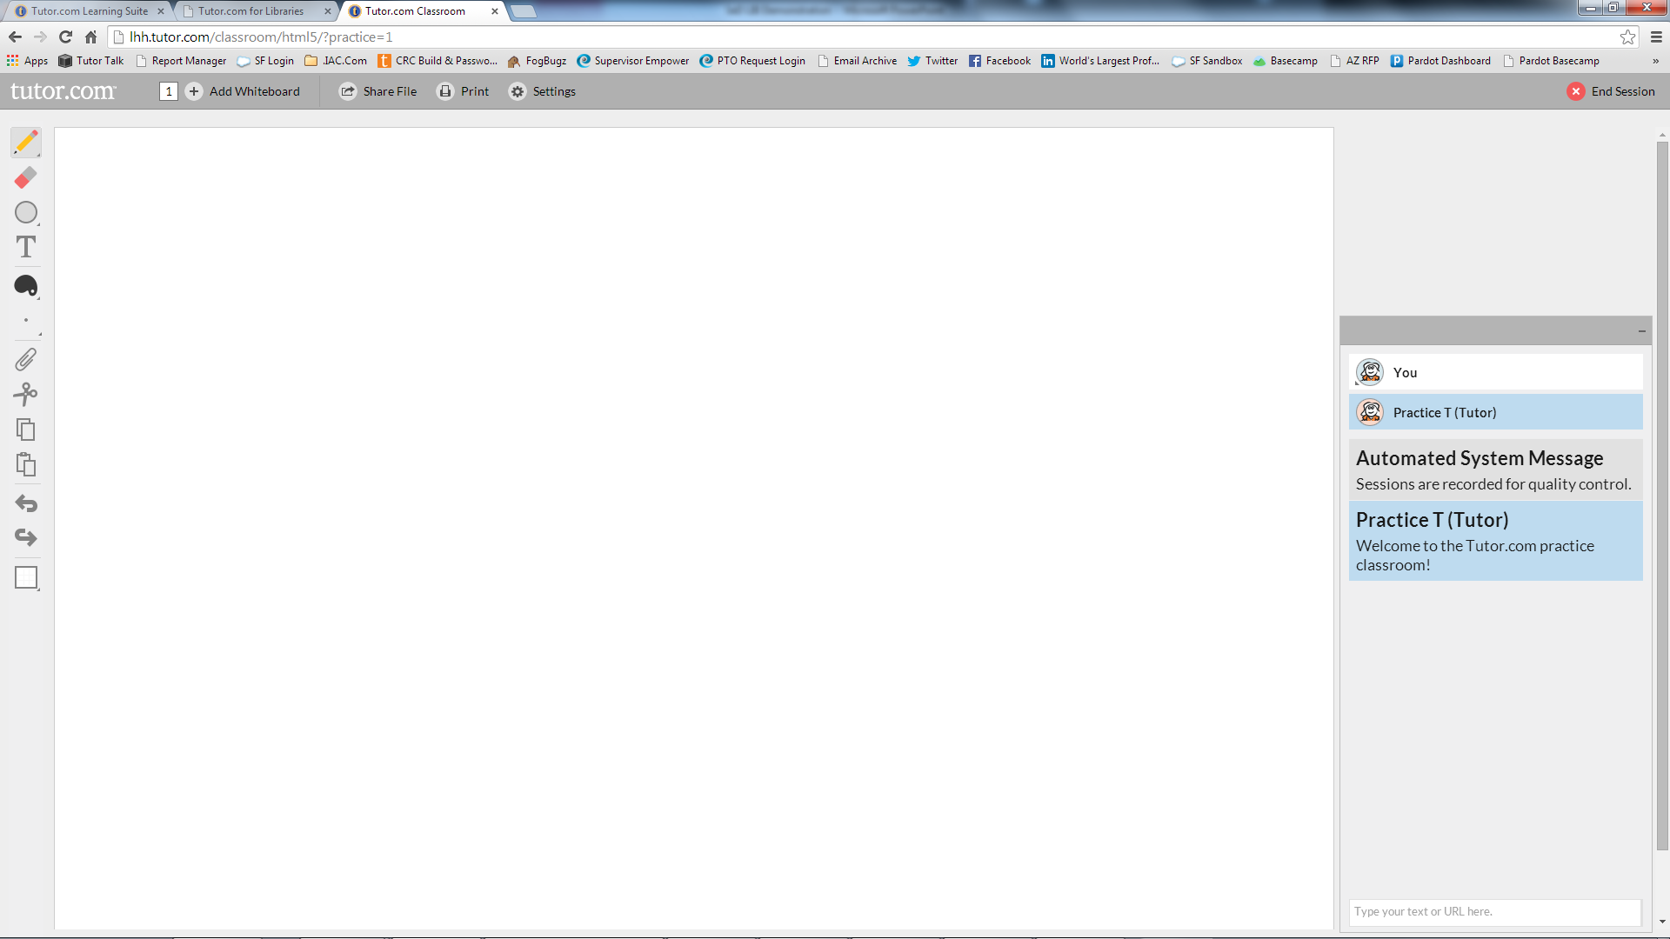
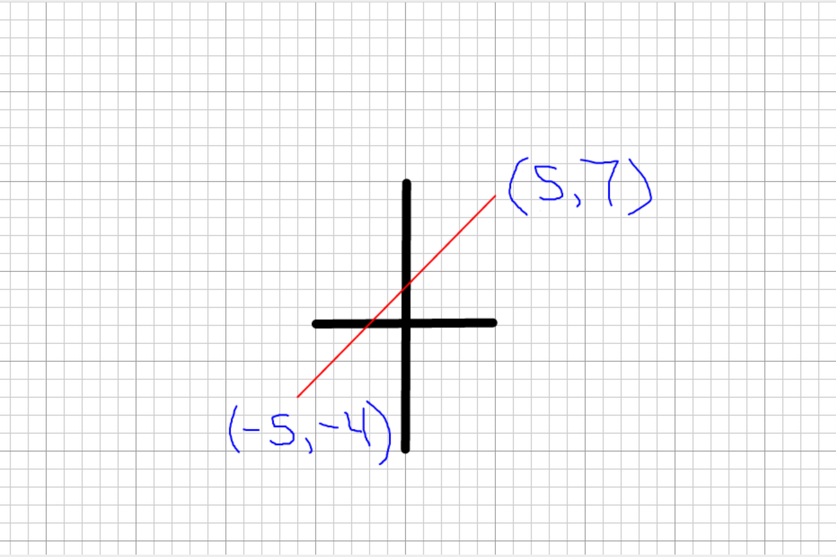
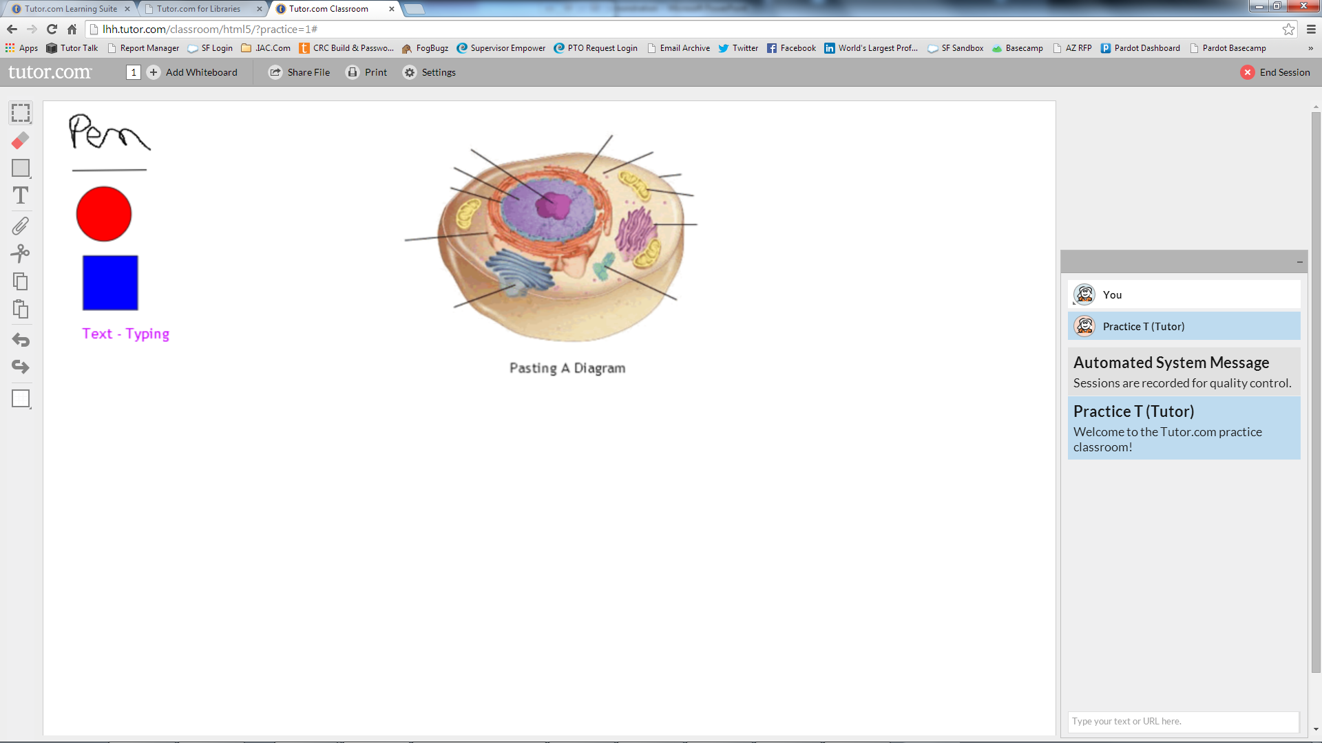
Whiteboard Tools
Chat
Once the classroom opens, you'll be connected to a tutor.
Chat back and forth with your tutor in our chat box.
Use the whiteboard to draw out your problem, create an outline or post a picture of your assignment.
You can even turn the whiteboard into graph paper if needed.
Notes:
Once the classroom opens, you’ll be connected to a tutor. Chat back and forth with your tutor in our chat box. Use the whiteboard to draw out your problem, create an outline or post a picture of your assignment. You can even turn the whiteboard into graph paper if needed.

Slide 12
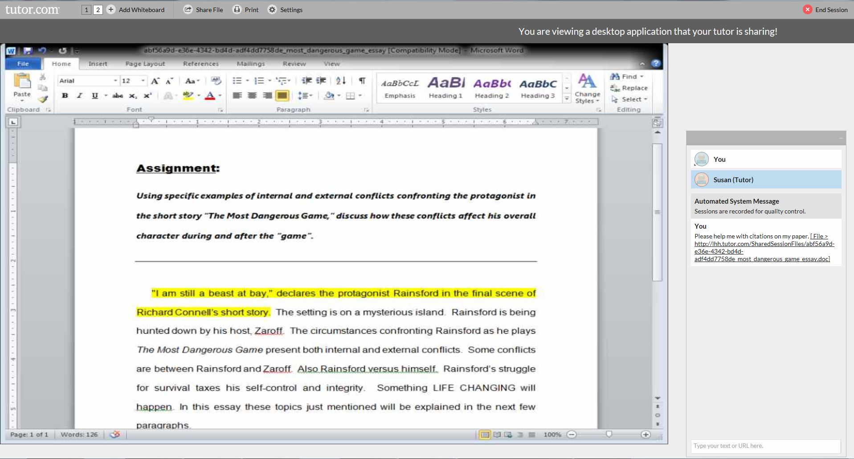
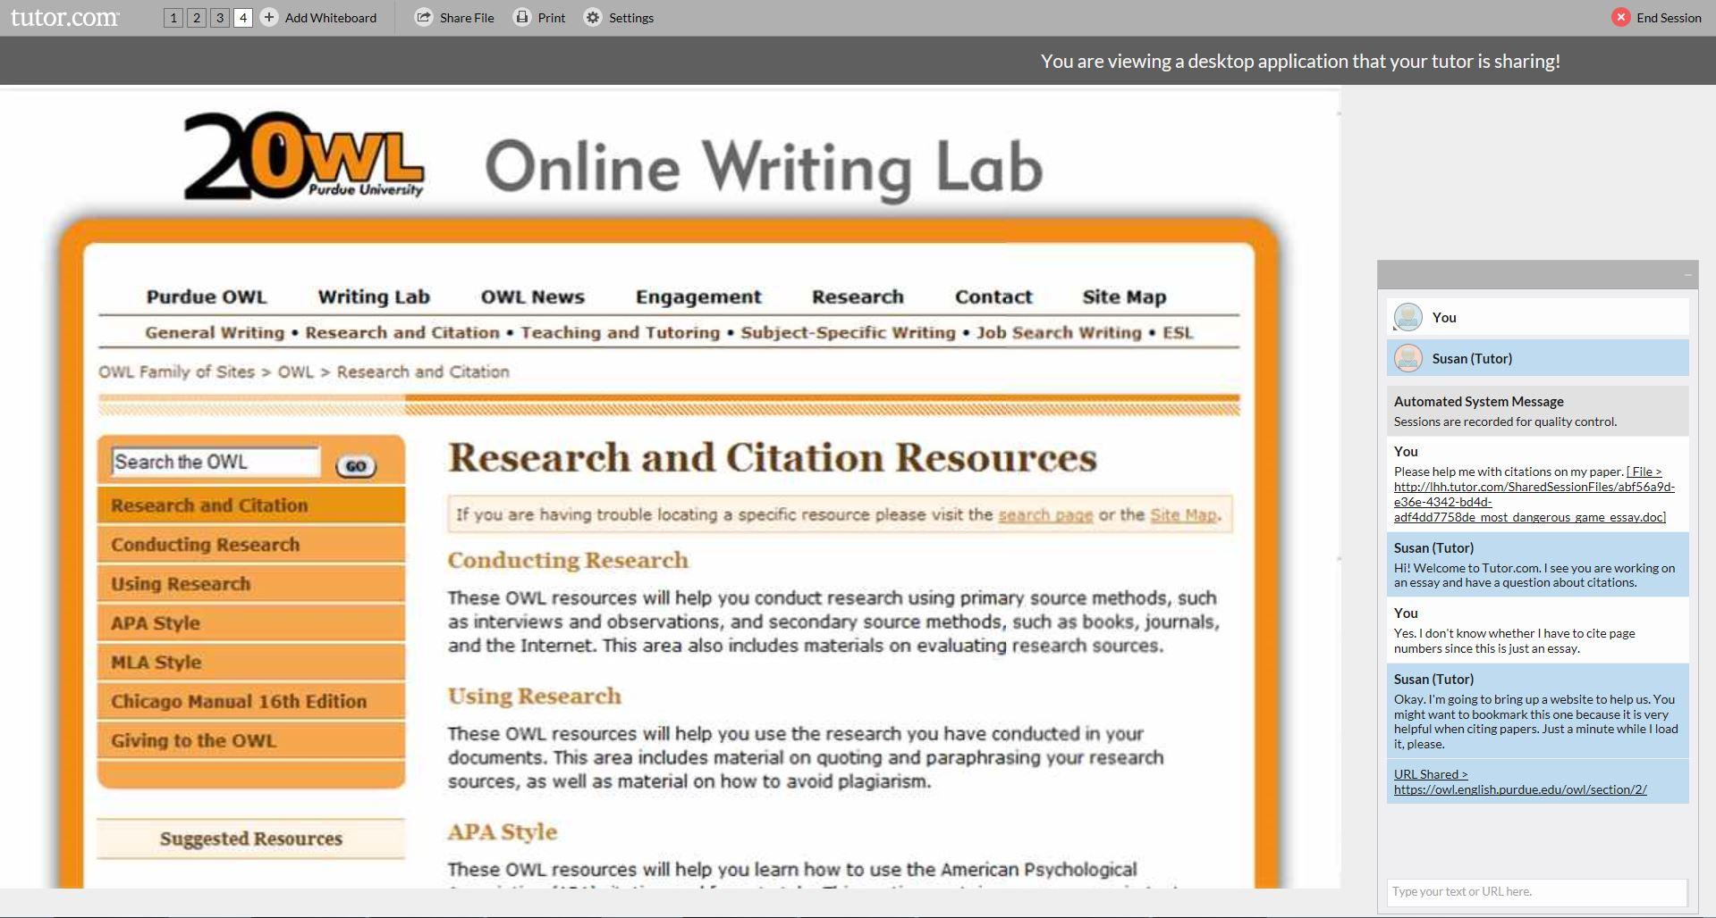
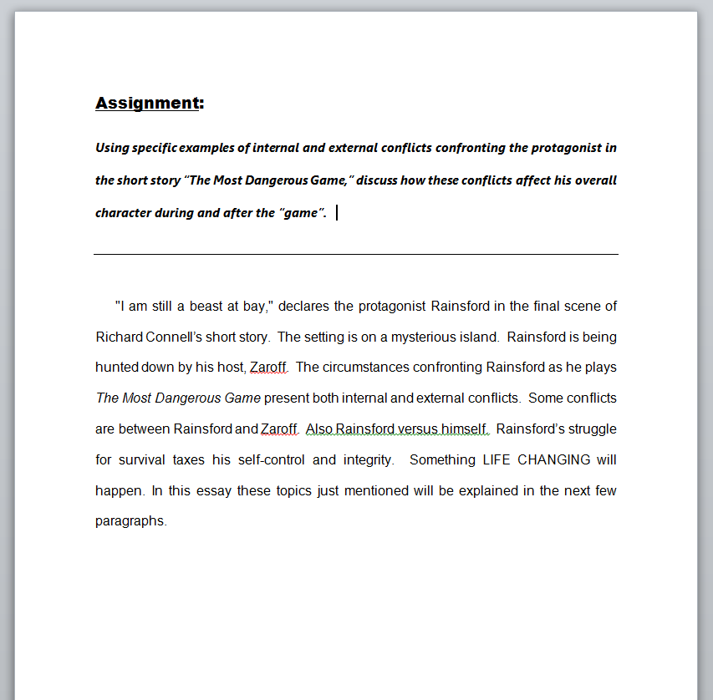
The tutor will highlight areas of the document that need attention, discuss these with you and help with corrections.
Have an essay or book report for the tutor to review? Upload it in the classroom to view with the tutor.
Notes:
Have an essay or book report for the tutor to review? Upload it in the classroom to view with the tutor. The tutor will highlight areas of the document that need attention, discuss these with you and help with corrections.

Slide 13
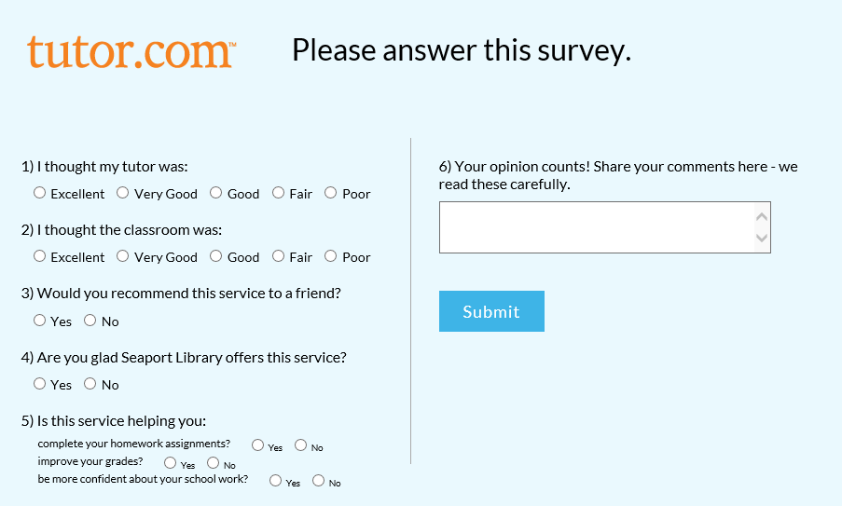
This has really helped through my problems. the tutors are awesome to work with and will teach how to do
your work.
At the end of every session, please tell us how we did. We use the surveys to reward our tutors and to improve our service.
Notes:
At the end of every session, please tell us how we did! We use the surveys to reward our tutors and to improve our service.

Slide 14
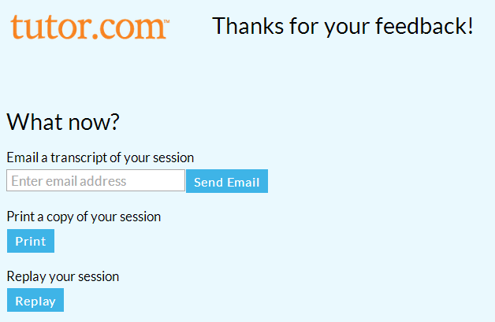
Once you complete the end of session survey, you will have the option to share, print or review your session.
Notes:
Once you complete the end of session survey, you will have the option to share, print or review your session.

Slide 15
HomeworkAlabama.Org
Get Your HOMEWORK Done.
Get Back to Your Life!
Use HomeworkAlabama.org to get your homework done first. Then, get back to your life!
Provided by Alabama Public Library Service. Powered by Tutor.com
Notes:
Get started today at tutoring.mdpls.org. Contact the Miami-Dade Public Library System for more information.

