Slide 1
HomeworkAlabama.org For Your Students
Alabama Public Library Service
Live Homework Help®
WriteTutor™ Coaching
Test Prep & Tutoring
Online, Just-in-Time

Slide 2
What Is HomeworkAlabama.org?
K-12th + College Level + Adult Learner + Job Seekers
3:00 p.m. – 10:00 p.m., Every Day (closed Jan. 1, Jul. 4, Thanksgiving, Christmas)
Live Tutoring + Career Coaching + WriteTutor Drop Off + SkillsCenter® Resource Library
Math* | Science* | Social Studies* | Languages | Writing | Test Prep | Job Search
Basic I & II | Basic | History | English | Real-time | AP® Test | Job Searches
Algebra I & II | Earth Science | Government | -Grammar | & Drop Off | PSAT | Applications
Geometry | Biology | Geography | -Literature | Essays | ACT | Cover Letters
Trigonometry | Chemistry | Political Science | -Vocabulary | Creative Writing | SAT | Résumés
Calculus | Physics | Citizenship | -Reading Comp. | Book Reports | GED | Interview Prep
Statistics |  |  | -ESL & ELL | Short Stories | Citizenship
*Bilingual Spanish speaking tutors available |  |  | Spanish | Research Papers
Advanced Placement® level tutoring available in most subjects.
“I am usually a student who can be pretty doubtful about if I did a problem correctly. This service provides me with confidence and what I need to reach my dreams! Thank you!” Tutor.com User
Notes:
HomeworkAlabama.org is an online tutoring and homework help service where student connect to an expert tutor for a real-time learning session. Tutors support students with difficult homework problems, writing assignments, test preparation and concept reviews in the core subjects of math, science, social studies, English, writing, Spanish as a foreign language and college entrance exams. They cover all levels from Kindergarten through intro-level college including Advanced Placement levels. The En Espanol service which is included with our standard program includes bilingual Spanish speaking tutors for all subjects in math, science and social studies which is especially helpful to parents who only speak Spanish. Tutors are online and availble, no appointment needed, from 3 pm to 10 pm, seven days per week. The service is only closed on four major holidays. There are also asynchronous features available such as a 24-hour writing review service and a robust SkillsCenter Resource Library with thousands of fully-vetted, online educational resources such as Khan Academy videos and customizable flash-cards.

Slide 3
Who Is Tutor.com?
An education technology company
Providing online tutoring , homework help and test prep since 2001
Through over 2,200 public libraries, state libraries, K12 schools, colleges & universities, and the U.S. military
With over 3,100 fully qualified expert tutors
Has served over 13 million live, one-to-one sessions and counting
Recognized by:
American Assoc. of School Administrators
Homeschool.com
Parents’ Choice
Bill & Melinda Gates Foundation
Microsoft Gold Partner
SIIA Education Technology CODiE Awards
Recently acquired The Princeton Review & Get A Five! AP® Test Prep
"When students need extra help with schoolwork, Tutor.com is available…as a convenient and valuable resource for students, parents and teachers.”
AASA Executive Director, 2009
Notes:
Alabama Public Library Service has partnered with Tutor.com since 2004 to provide this HomeworkAlabama.org. Tutor.com is a trusted partner in education and has been for over 15 years. They have served over 13 million sessions and have a satisfaction rating of over 95%! Over 90% of student users report that the service has helped them improve their grades and give them confidence in the classroom. The Tutor.com team of over 3,100 expert tutors provides online tutoring through over 2,200 public libraries, K12 schools, colleges and universities and 5 statewide programs. They also provide tutoring through the U.S. Department of Defense to all active duty and deployed military personnel and their families. In addition to being recognized through strong client partnerships, Tutor.com has also received many awards and been recognized by organizations such as the American Association of School Administrators, Parent’s Choice, Homeschool.com and the Bill & Melinda Gates Foundation.

Slide 4
How Are Tutors Selected?
Teachers, professors, grad students, professionals in their field
Thoroughly tested and monitored for subject matter expertise
Full background check and education verification
Carefully and constantly monitored
In 2014, Tutor.com had 140,000 tutor applicants
Only 1,500 were accepted.
Many of the rejected applicants held PhD or Masters degrees, but still could not meet our strict standards.
Notes:
To ensure the safety and sound educational experience for every student, all Tutor.com tutors are carefully screened and vetted. Before ever connecting with a student, tutors must demonstrate their full understanding of the subject matter, ability to communicate effectively in an online learning environment and understanding of all Tutor.com methods, procedures and policies. They all must also go through an extensive, third-party background check that includes a 7-year local, State and Federal background check, which is then repeated at least once a year.

Slide 5
Who Are The Tutors?
Ken F. – PhD. Physicist and Tutor.com Tutor
Retired high school and college physics teacher
Award-winning author
Graduate of Harvard and Princeton
Retired Director of American Institute of Physics
Pilot of small planes and gliders
http://www.tutor.com/our-tutors
What is the most rewarding part of tutoring? “The VARIETY. Every session is different, and most are challenging. It’s wonderful when the student “gets it” and shows appreciation.” Ken F. Tutor.com Physics Tutor
Notes:
Ken F. is a great example of one of the tutors with whom your students may connect. Ken graduated from both Harvard and Princeton, has a PhD in physics and has been very active in his profession. He is also a retired teacher of both high school and college physics. Before settling down to retired life, he used to pilot small planes and gliders. Now, he spends his days writing books about flying and physics and tutoring math and physics students online. Students rate nearly all of Ken’s sessions 5 out of 5 and he’s just one of over 3,100 tutors with whom your student could connect. Visit tutor.com/our-tutors to see more tutor profiles.

Slide 6
What Methods Do They Use?
Build off of the student’s foundation.
Provide instruction relevant to student.
Let the student think it through and do it.
Tutors begin each session by identifying students’ existing knowledge and identifying gaps in student learning.
Clarify & utilize methods used in classroom so instruction is aligned to curriculum and standards.
Tutors use leading questions and examples do demonstrate key concepts—students do the work.
Present information in multiple formats.
Stop the stress before it begins.
Create a positive learning experience.
Tutors leverage the Online Classroom’s chat, whiteboard and sharing tools to provide multi-modal instruction
Tutors are available with no appointment needed, from any internet connection when students need them most.
Tutors build students’ confidence while addressing gaps in knowledge, encouraging them to try and showing them it’s possible.
“Thanks so much for having this service. It is always a pleasure working with these people and they don't just give you the answers but they help you work them out. I am still in school because of this program.” Tutor.com User
Notes:
HomeworkAlabama.org is not an answering service that students can use to get a quick or easy “A.” The tutors use time-tested and scientifically researched pedagogy that has been proven effective through third-party researchers in multiple studies. The six core principles are used to individualize every session to the student’s needs and provide an educationally sound environment. The first principle, “Build off of the student’s foundation” explains why our tutors start each session with questions such as “Do you know where to start” or “Can you tell me what this means?” The tutors gage the student’s current level of knowledge so they can connect the new material to something the student already knows. If she’s learning how to add fractions with different denominators, but doesn’t know what a denominator or even a fraction is, then the student does not have the necessary foundation upon which to build. So our tutors start by helping the student fill in those knowledge gaps first. This ties into the second principle that tutors provide instruction that is relevant to the student. This particular principle has become essential in the world of Common Core instruction. Students are learning new methods in math and going deeper into non-fiction reading analyses than ever before! Even with the Common Core standards, methods of teaching can vary between schools and even teachers, so the tutors work with each individual student to identify the learning goals and methods being used. For example, the tutors might ask “Do you have an example problem from your book or from class?” allowing her to address the student’s question in a way that will make sense when she gets back to class. Moving onto the third principle, “Let the student think it through and do it.” We hear this all the time in the form of Practice makes Perfect, right? Students need to be active participants in their learning and it’s not just the doing part, but also the thinking part. Tutor.com tutors keep the students engaged and thinking throughout the session. They don’t just tell them the steps to solve a problem. They ask them what the next step will be. If the student doesn’t know, then they prod with a leading question or offer a bit of instruction to help them understand. Throughout the entire session, the student is engaged and doing the work, thinking through the problem.
We all think differently, right? We all learn differently, too, so our tutors have to follow the next principle that says, “present information in multiple formats.” The tutors must be prepared to present information in a variety of ways. It’s why we use both visual and auditory delivery models in presentations and instruction. The fact that I’m showing you something visually while also speaking about it helps your brain better absorb and retain the information. The tutors do the same thing by using multi-modal instruction, utilizing chat, whiteboard and sharing tools in our classroom.
The last two principles go hand in hand. Stress impedes learning and a lack of self-confidence impedes everything! A student that doesn’t think she can learn, won’t, so mindset in the Tutor.com classroom is crucial. If you are stressing out about the 20 things sitting on your desk that you know you need to complete before the end of the day, then you’re not hearing much of what I have to say. Stress builds up over time and can easily overwhelm a student instead of the student having to wait until their parents can help or wait until they get to school the next day, Tutor.com is available with no appointment needed at the times when most students are working on their homework or studying after school. Also, the tutors are trained to set a positive tone. We all know that if a student doesn’t think she can succeed, she won’t try and if she never tries, she definitely won’t do it, so confidence and mind-set are crucial. “It’s okay. We’ll do this together.” “Give it a try. I’ll help you.” “Great job!” and smiley faces are all things you’ll see in our Tutor.com transcripts.
These six core principles allow Tutor.com to individualize instruction and support for students that can be impossible in a large classroom setting. Students are able to not only complete their homework assignments, but also review the concepts so that they can come to class the next day ready to learn something new.

Slide 7
Where Do They Connect?
HomeworkAlabama.org
Notes:
Students simply go to www.HomeworkAlabama.org and click the “I am a student” button. If the student prefers a Spanish-speaking tutor to discuss math, science and social studies, they should click, “Hablo Espanol.” Because Tutor.com also offers a special service to some military-affiliated students, if the student has an active duty or deployed parent, they should select, “I am military-affilitated” and check the eligibility requirements.
In some small areas of Alabama, students may receive an error when they click, “I am a student” that says their IP address has not been approved for use with this service. If they receive this, please see the instructions on the bottom of the HomeworkAlabama.org main page.
Let’s watch a short demonstration video of the service, now.

Slide 8
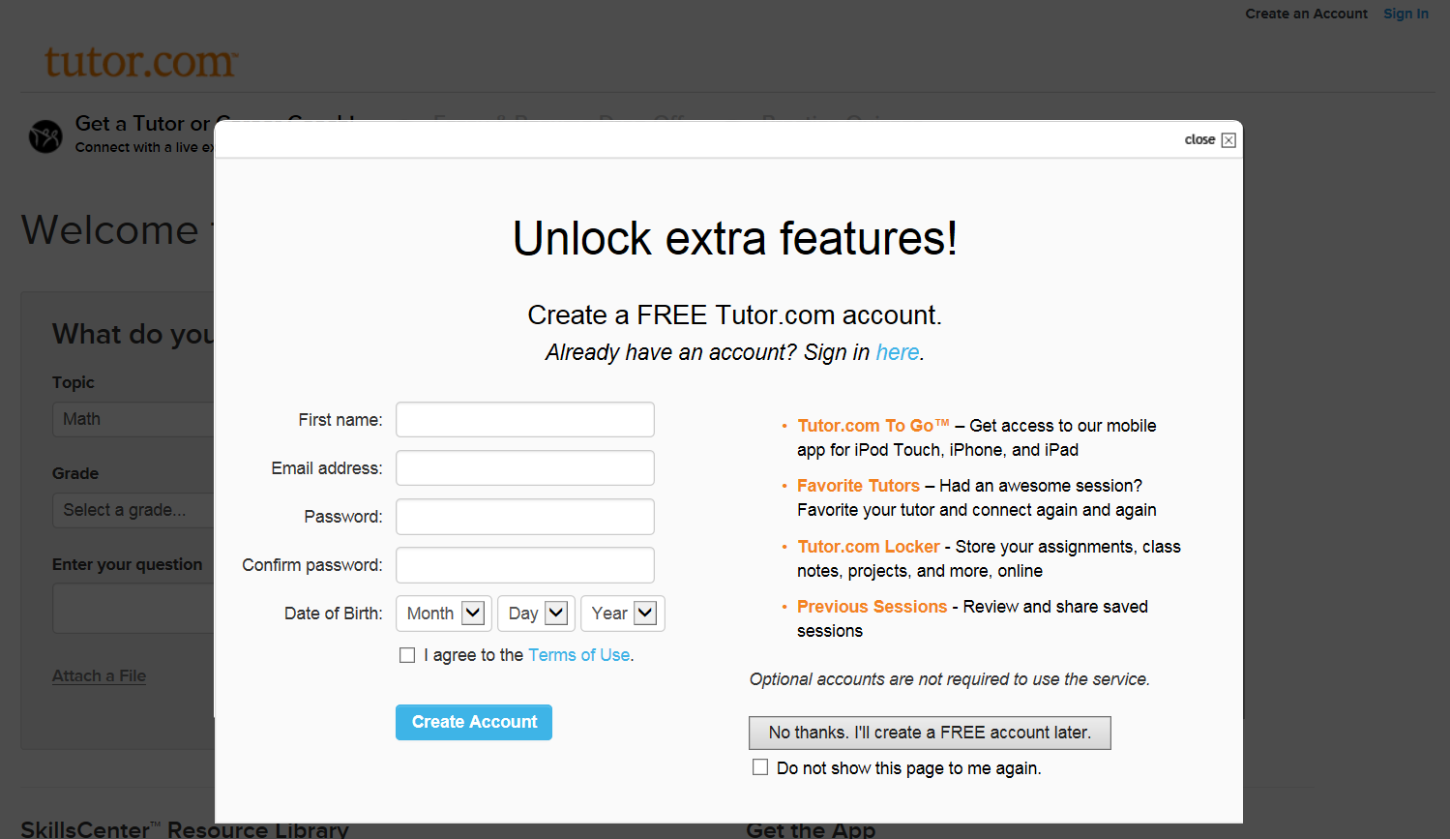
HomeworkAlabama.Org
Just go to HomeworkAlabama.org and choose your center. No library card number or password is needed, though you will have the option to create a free Tutor.com account.
Notes:
Just go to HomeworkAlabama.org and choose your center. No library card number or password is needed, though you will have the option to create a free Tutor.com account.

Slide 9
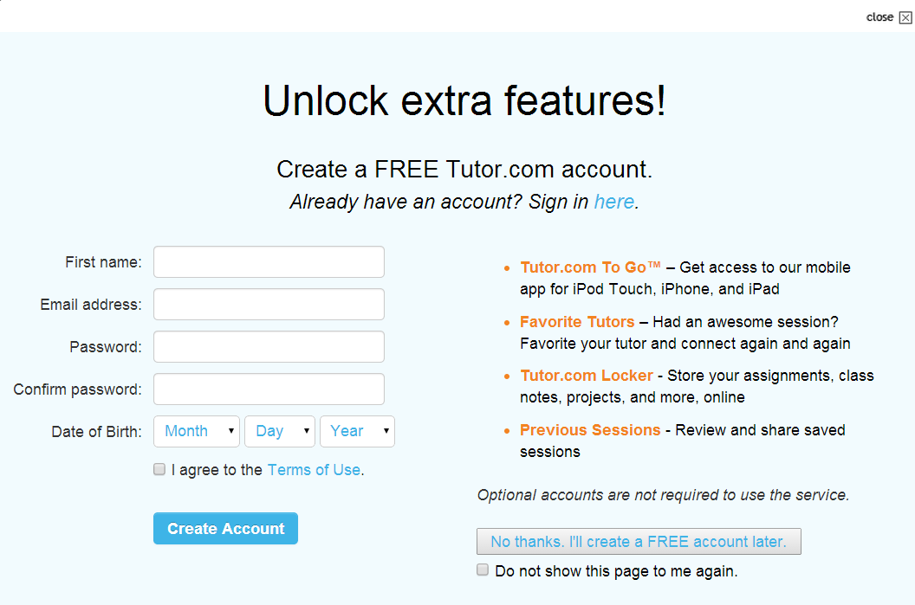
Susan
email@xyz.com
●●●●●●●●
●●●●●●●●

Create an optional Tutor.com account to unlock extra, personalized features.
Creating an account is safe and easy, but you may also select "No Thanks" and continue as a guest.
Notes:
Create an optional Tutor.com account to unlock extra, personalized features. Creating an account is safe and easy, but you may also select “No Thanks” and continue as a guest.

Slide 10
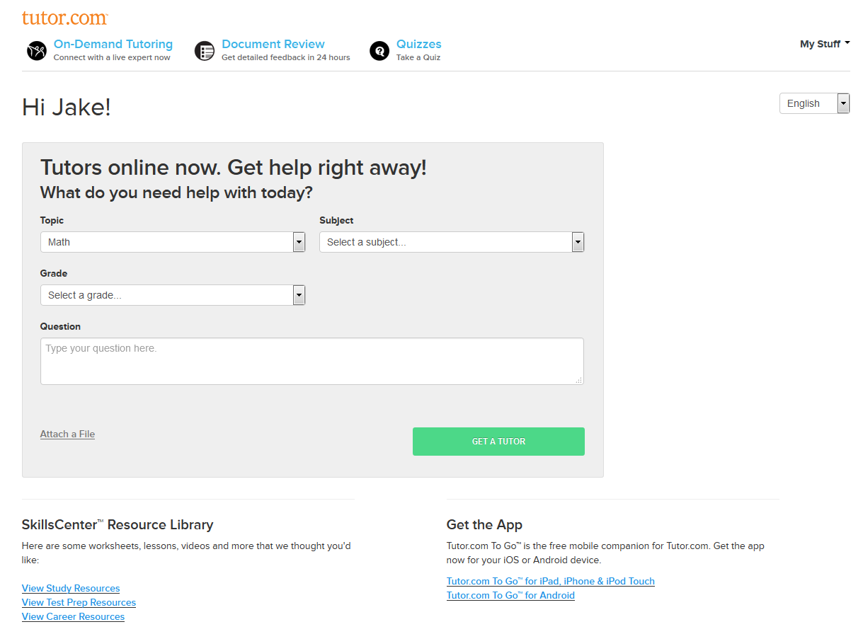
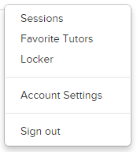
If you have created an account, you will have many options after logging in.
choose to connect with a favorite tutor or even review your previous work.
You can submit an essay for review, assess or practice your skills with quizzes,
Notes:
If you have created an account, you will have many options after logging in. You can submit an essay for review, assess or practice your skills with quizzes, choose to connect with a favorite tutor or even review your previous work.

Slide 11
Solve for x. 4x + 10 = 22
Let's take a look at the online classroom. From the Get a Tutor! tab on our portal,
answer a few short questions about the help you need. Then click Get a Tutor! to get connected.
Notes:
Let’s take a look at the online classroom. From the Get a Tutor! tab on our portal, answer a few short questions about the help you need. Then click Get a Tutor!

Slide 12
Whiteboard Tools
Chat
Once the classroom opens, you'll be connected to a tutor.
Chat back and forth with your tutor in our chat box.
Use the whiteboard to draw out your problem, create an outline or post a picture of your assignment.
You can even turn the whiteboard into graph paper if needed.
Notes:
Once the classroom opens, you’ll be connected to a tutor. Chat back and forth with your tutor in our chat box. Use the whiteboard to draw out your problem, create an outline or post a picture of your assignment. You can even turn the whiteboard into graph paper if needed.

Slide 13
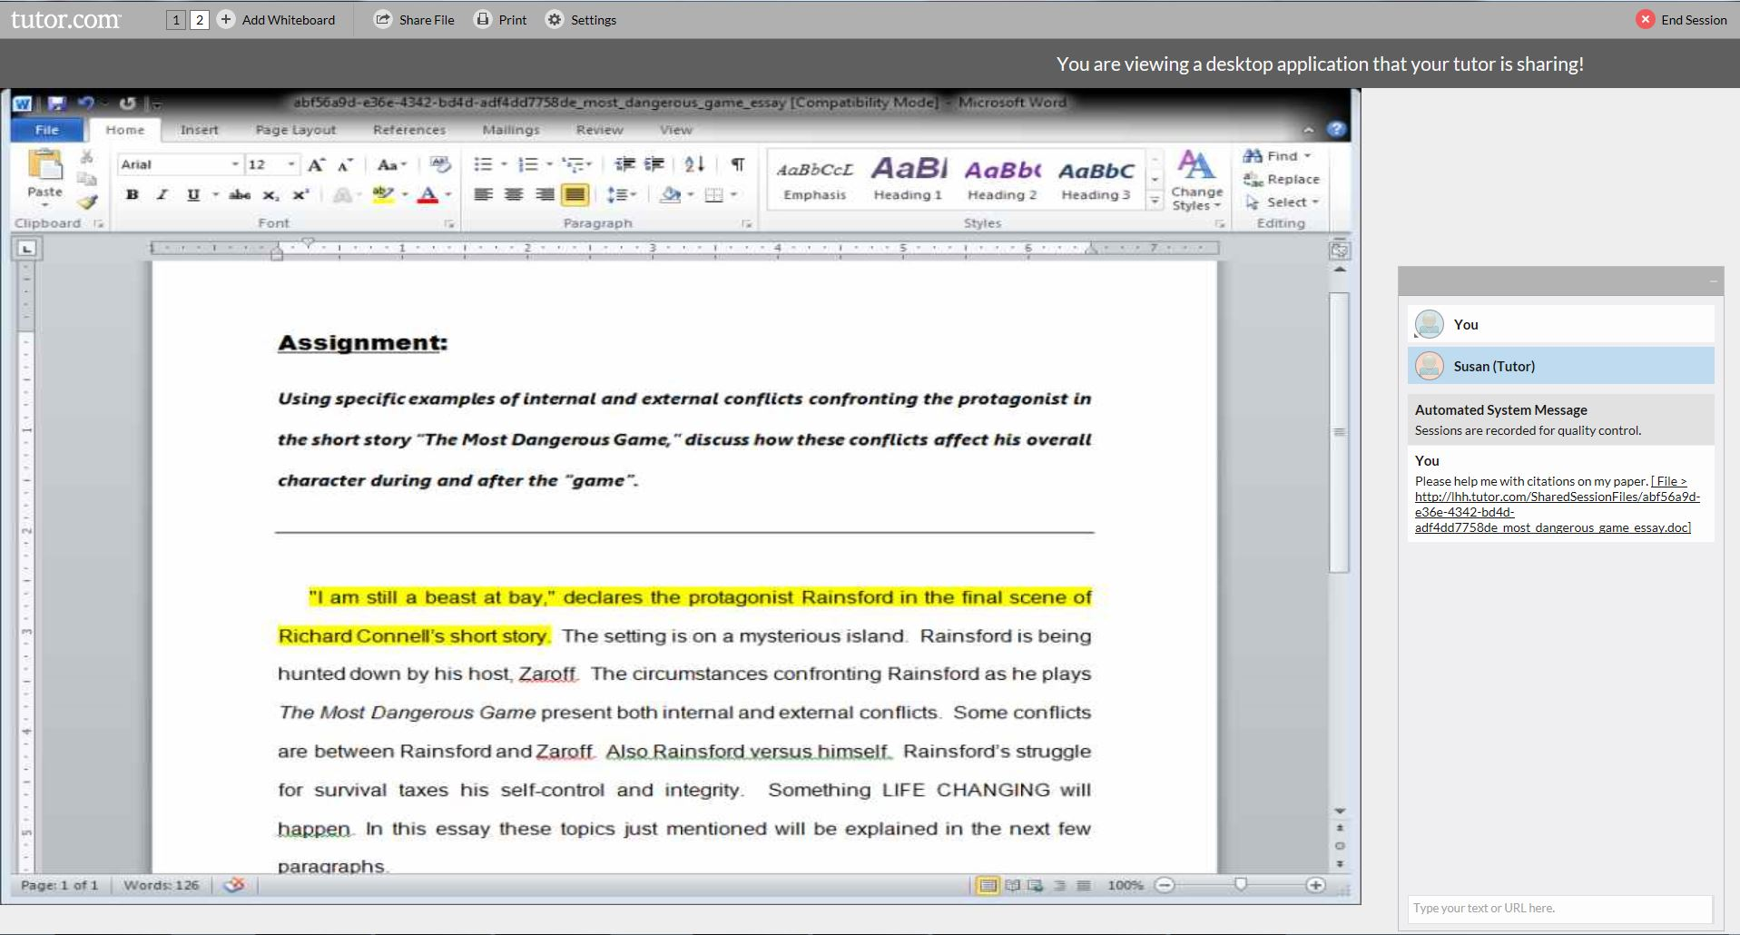
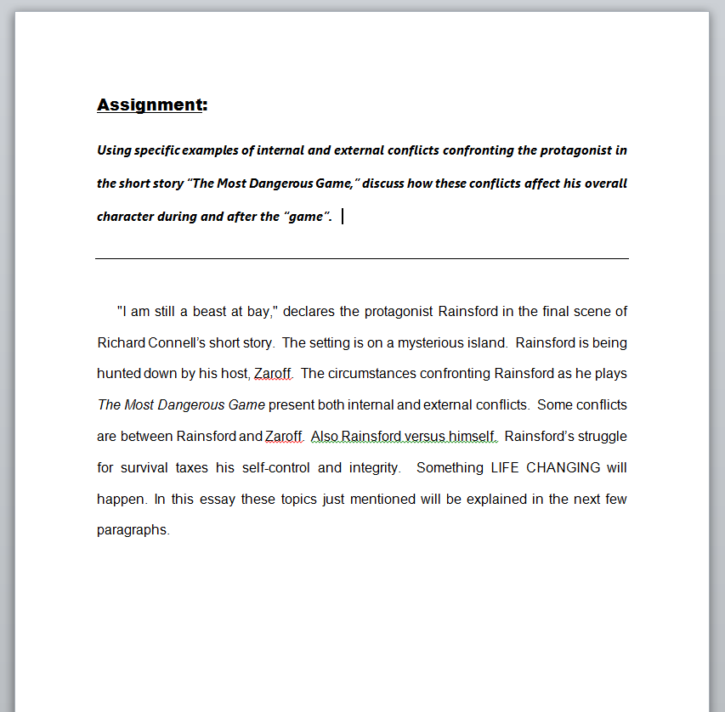
The tutor will highlight areas of the document that need attention, discuss these with you and help with corrections.
Have an essay or book report for the tutor to review? Upload it in the classroom to view with the tutor.
Notes:
Have an essay or book report for the tutor to review? Upload it in the classroom to view with the tutor. The tutor will highlight areas of the document that need attention, discuss these with you and help with corrections.

Slide 14
This has really helped through my problems. the tutors are awesome to work with and will teach how to do
your work.
At the end of every session, please tell us how we did. We use the surveys to reward our tutors and to improve our service.
Notes:
At the end of every session, please tell us how we did! We use the surveys to reward our tutors and to improve our service.

Slide 15
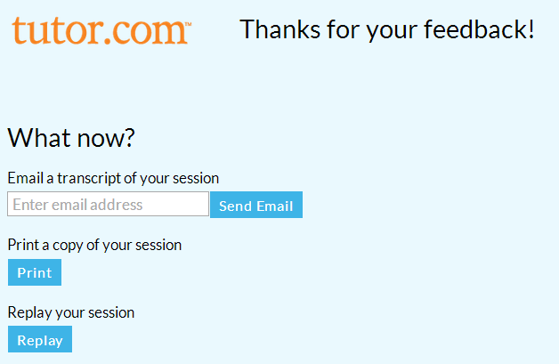
Once you complete the end of session survey, you will have the option to share, print or review your session.
Notes:
Once you complete the end of session survey, you will have the option to share, print or review your session.

Slide 16
HomeworkAlabama.Org
Get Your HOMEWORK Done.
Get Back to Your Life!
Use HomeworkAlabama.org to get your homework done first. Then, get back to your life!
Provided by Alabama Public Library Service. Powered by Tutor.com
Notes:
Get started today at tutoring.mdpls.org. Contact the Miami-Dade Public Library System for more information.

