Slide 1
Tutor.com
Learning
Suite
http://www.tutor.com/cmspublicfiles/WWW/Nassau_2018_Spring_Training.pptx
Recent updates
and program reminders

Slide 2



three major components
Real-Time Tutoring
3,000+ expert tutors
On-demand, 2pm-10pm
40+ subjects *
Asynchronous Reviews *
Essays/Writing
Resumes/Cover Letters
Math Questions
  Algebra through Calculus
Self-Study Tools
SAT/ACT Essentials
SkillsCenter™
Practice Quizzes*
* Not all features available for ‘Basic’ Programs

Slide 3
Basic versus premium
 | Premium | Basic
Online tutors 7 days/wk from 2-10 p.m. | ✓ | ✓
Live 1-to-1 tutoring in: Math, Reading, Writing, English, Science, Social Studies | ✓ | ✓
Live 1-to-1 tutoring in: Test Prep and Job Prep | ✓ | ✓
Live 1-to-1 tutoring in: ESL/ELL and Citizenship | ✓ | ✓
Live 1-to-1 tutoring in: Spanish Language Learning (for English speakers) | ✓
Live 1-to-1 tutoring in: Microsoft Office (Word, Excel, PowerPoint) | ✓
English- and Spanish-Speaking Tutors | ✓ | ✓
SAT/ACT Essentials (featuring The Princeton Review test prep materials) | ✓ | ✓
TASC High School Equivalency assistance through the Skills Center | ✓ | ✓
Drop-off Essay Writing Review | ✓
Drop-off High School Math (Algebra-Calculus) | ✓
Drop-off Resume and Cover Letter Review | ✓
Assessment Quizzes | ✓
Client Resource Center with marketing and training materials | ✓ | ✓
Customized marketing materials for your library | ✓
Monthly statistics reports | ✓ | ✓
Client Portal access to detailed reporting tools for usage and user accounts | ✓
No turnaways for users, even during busy times | ✓ | service limited to 180 sessions per library
Basic Programs
Bayville
Bellmore
Bethpage
East Williston
Farmingdale
Hempstead
Hewlett Woodmere
Locust Valley
Malvern
Peninsula
Rockville Centre
Roosevelt
Wantagh
Westbury

Slide 4
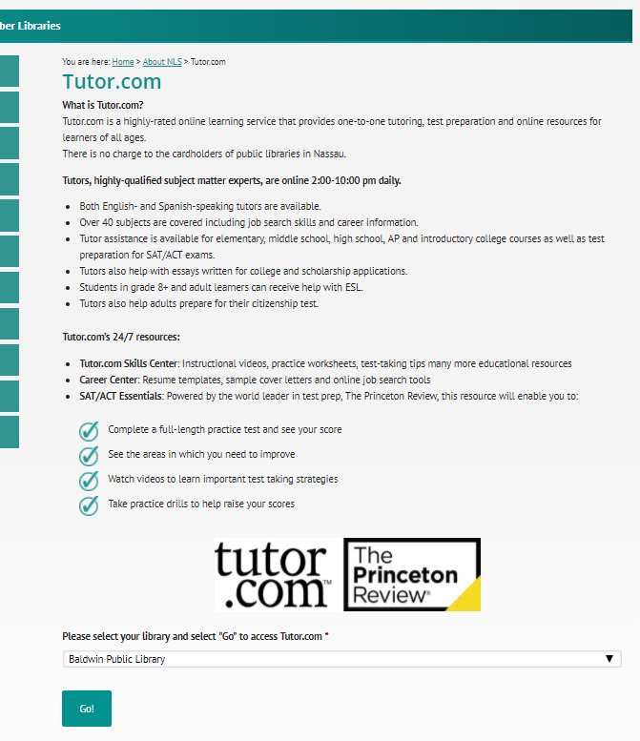
Added in 2017
The NLS Landing Page
www.nassaulibrary.org/about/tutor-com

Slide 5
Alternate Urls
www.tutor.com/nassau
Baldwin Manhasset
Bryant/Roslyn Massapequa
East Meadow Merrick
East Rockaway Mineola
Floral Park North Bellmore
Franklin Square North Merrick
Garden City Oceanside
Glen Cove OB-EN
Gold Coast Plainview
Hillside Port Washington
Island Park Sea Cliff
Island Trees Seaford
Levittown Shelter Rock
Long Beach Uniondale
Lynbrook Williston
www.tutor.com/nassau2
Elmont
Freeport
Hicksville
Lakeview
Plainedge
Valley Stream
West Hempstead
www.tutor.com/greatneck
www.tutor.com/jericho
www.tutor.com/syosset
www.tutor.com/nassau3
Bayville
Bellmore
Bethpage
East Williston
Farmingdale
Hempstead
Hewlett Woodmere
Locust Valley
Malvern
Peninsula
Rockville Centre
Roosevelt
Wantagh
Westbury

Slide 6
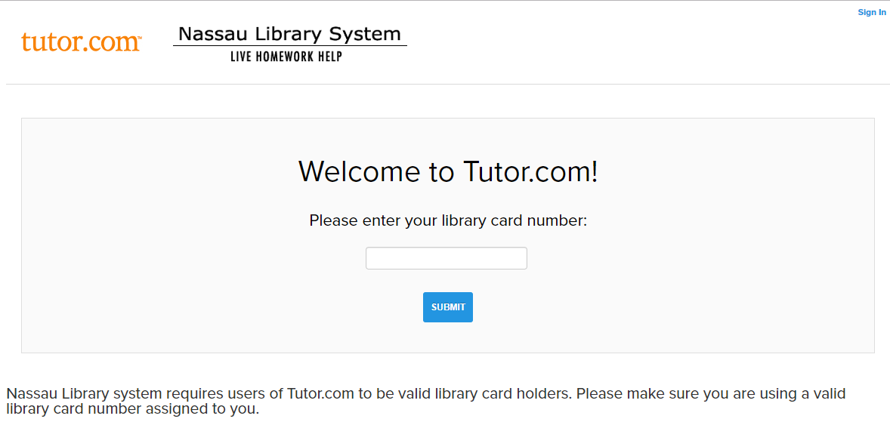
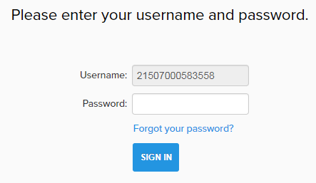
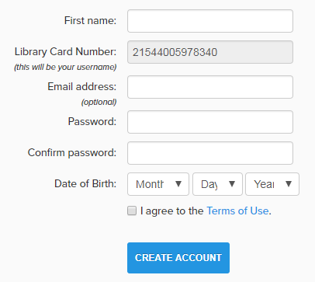
Logging In With Patron API
Patron Experience
Enter Library Card Number
If Tutor.com account exists, enter password.
If Tutor.com account does NOT exist, create account.
(Different wording for different errors. Take screenshots.)
OR

Slide 7
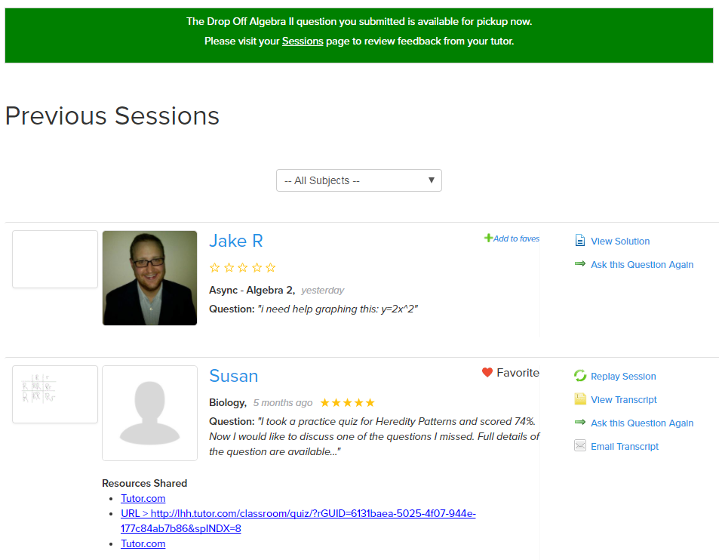
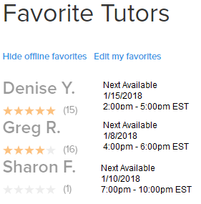
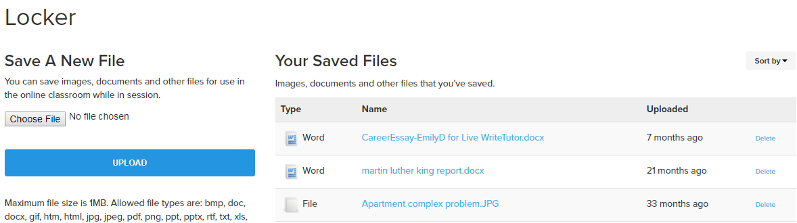
Patron Experience
Tutor.com Account
Previous Sessions
  Drop-off Review Retrieval
Favorite Tutors
Virtual Locker
COPPA Compliant

Slide 8
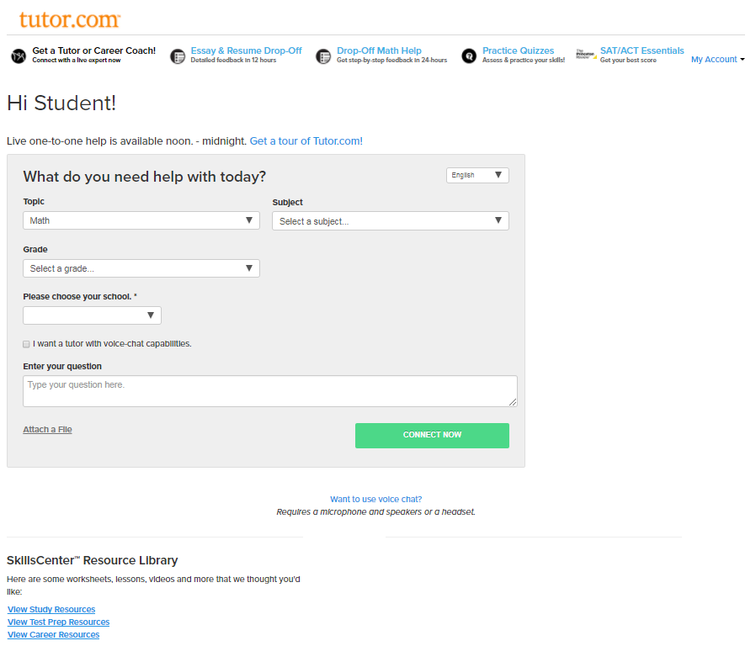
Patron Experience
Tutor.com Entry Page
Top Navigation Bar
My Account Menu
Defaults to “Get a Tutor”
SkillsCenter™ at Bottom
Changing in early 2018

Slide 9
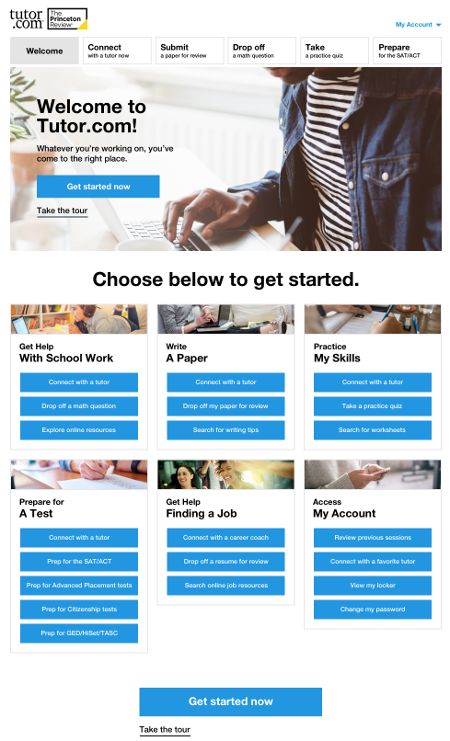
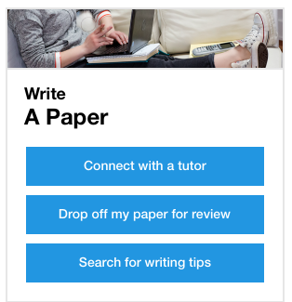
Coming in 2018
New Landing Page
Improved ‘merchandising’
Customizable navigation
Bolder, brighter display

Slide 10
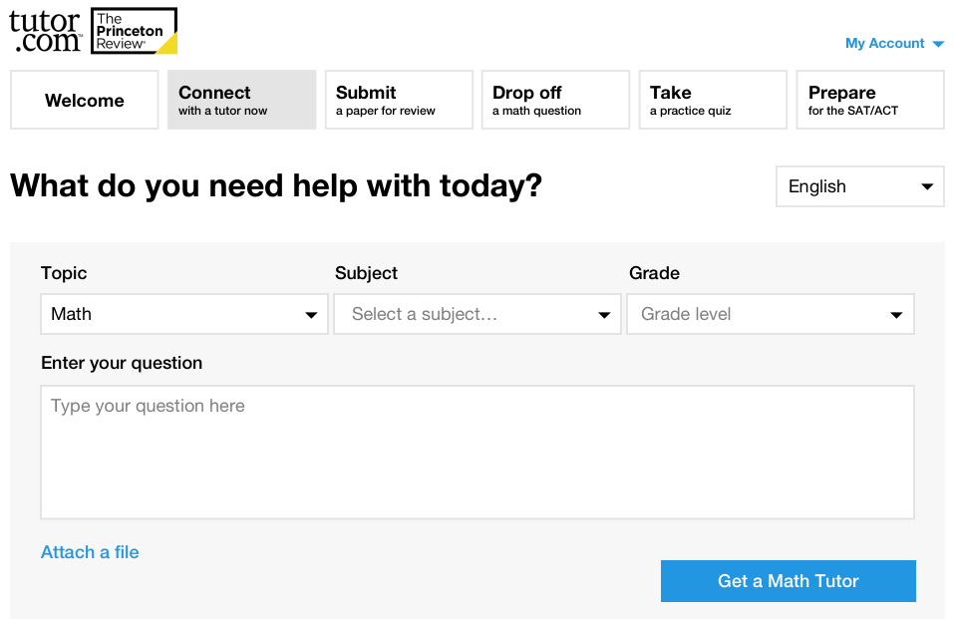
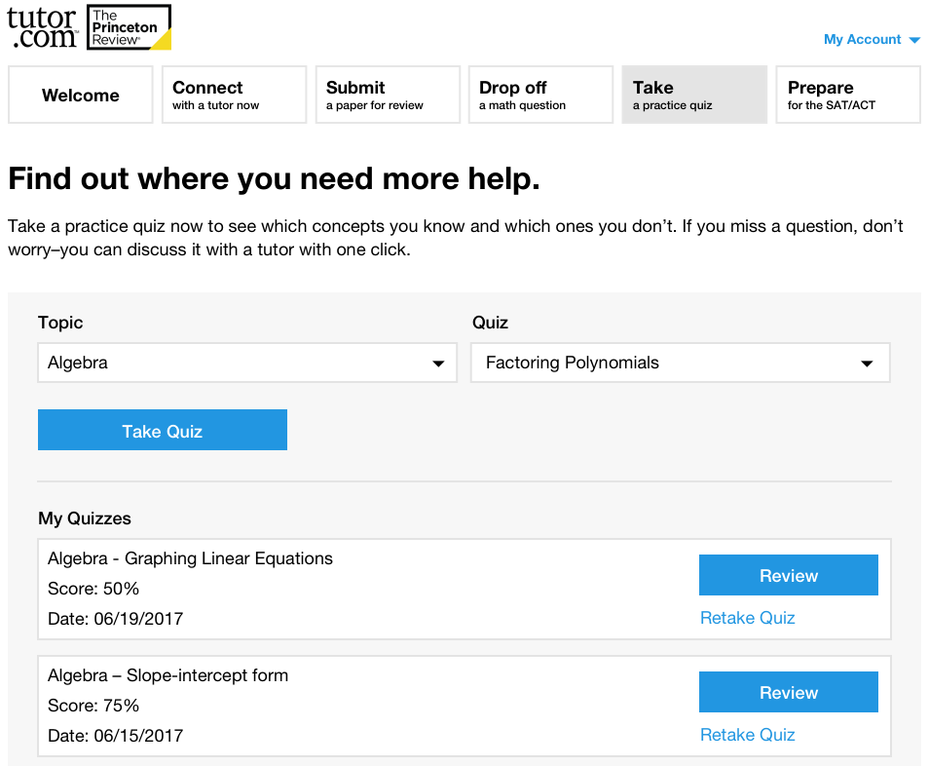
Coming in 2018
New Look & Feel

Slide 11
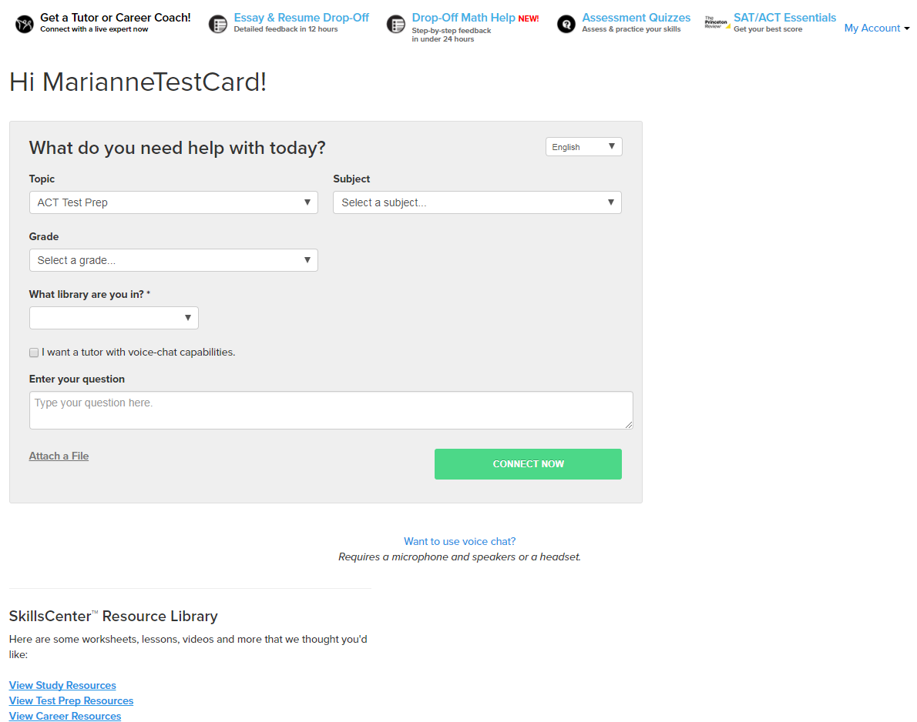
Patron experience
Get a Tutor or Career Coach
K-12th + intro-college
Adult Learners
Job Seekers
Homework Help
Skills Building
Remedial Tutoring
Test Preparation
WriteTutor Coaching
Job Search Assistance

Slide 12
Tutoring subjects available
Math* | Science* | Social Studies* | Languages | Writing | Test Prep | Computer & Job
Basic I & II | Basic | History | English | Book Reports | AP® Test | Job Searches
Algebra I & II | Earth Science | Government | -Grammar | Creative Writing | PSAT® | Applications
Geometry | Biology | Geography | -Literature | Essays | ACT® | Cover Letters
Trigonometry | Chemistry | Political Science | -Vocabulary | General Technique | SAT® | Résumés
Pre- & Calculus | Physics |  | Reading Comp. | Letters | HSE/TASC | Interview Prep
Statistics |  |  | ESL/ELL | Research Papers | Citizenship | MS Word®
 |  |  | Spanish | Short Stories |  | MS Excel®
 |  |  |  |  |  | MS PowerPoint®
*Bilingual Spanish speaking tutors available

Slide 13
Example questions
Subject | Student Question
SAT Prep: Writing | “I am doing the Identifying Sentence Errors portion of a SAT Practice Worksheet, and I need some help with some of the questions.”
ESL for ELL | Past versus Passed
Microsoft Office® | “how to use excel to create a chart”
Reading Comprehension | “What type of constituent is underlined in the sentence below? The nice unicorns from that planet are visiting us regularly. “
Job Search Help | “Hello. can you help me reword my experiences and job descriptions to tailor it to the position in which i am seeking employment? i will send you my resume with no personal info. “
GED/HiSET/TASC Prep | “Trying to earn my GED, I need help with the Bill Of Rights. I need help on remembering 10 armaments.”
Matematicas Primeria | “Nesecito ayuda con matematicas leccion 1.9 y 1.10”

Slide 14
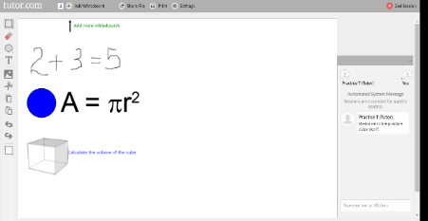
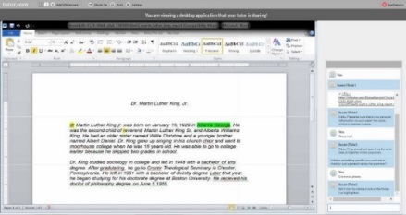
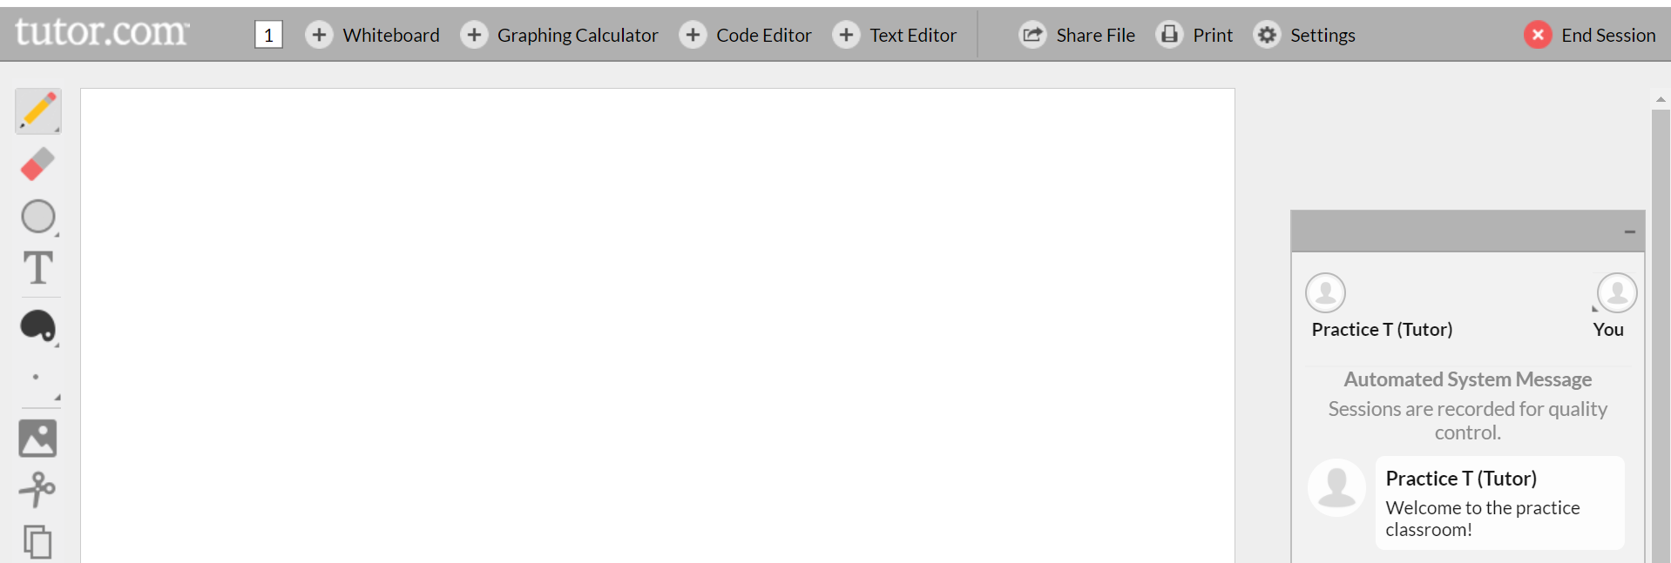
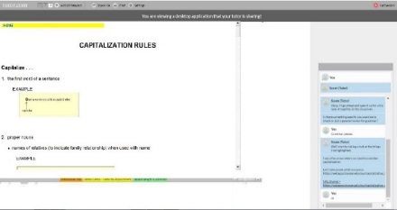
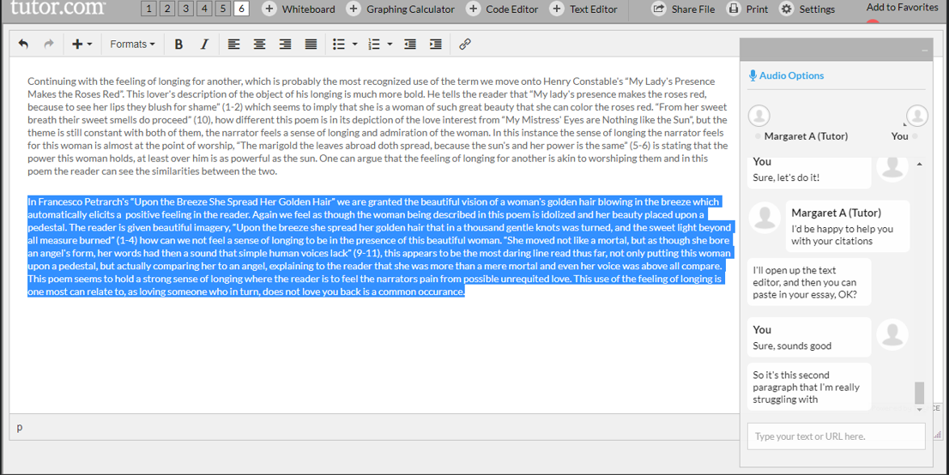
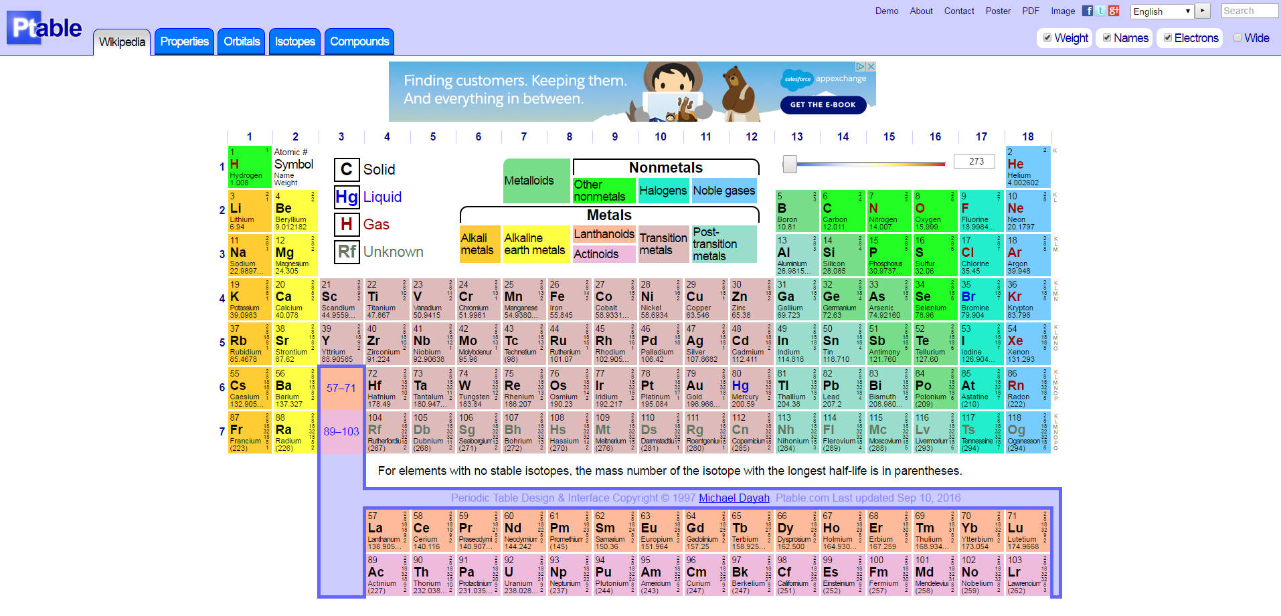
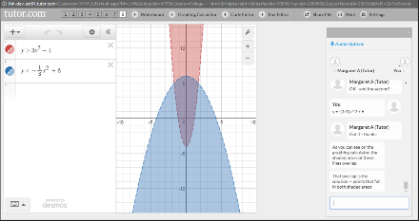
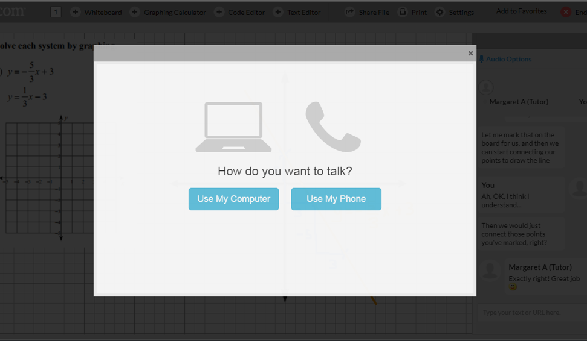
Added in 2017
New Online Classroom Tools
www.tutor.com/Classroom/HTML5/?Practice=1
Chat & Interactive Whiteboard
Shared Application Viewing
Add new tools from the top tool bar
Shared Website Viewing
NEW – Two Way Text Editor
NEW – Graphing Calculator
NEW – Voice/Audio Option

Slide 15
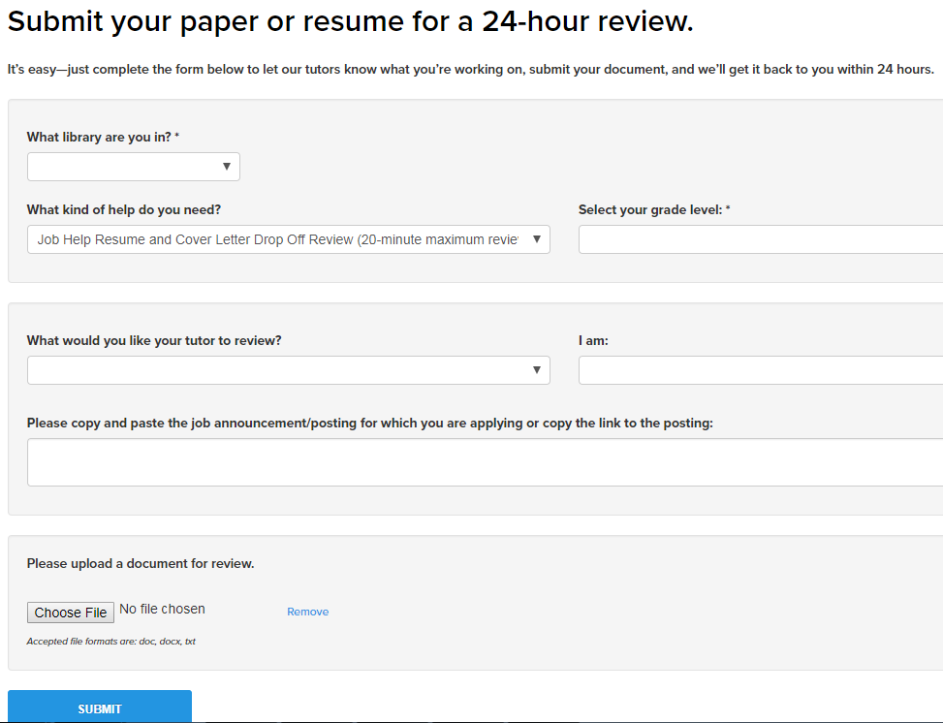
Patron experience
Premium Service Only
Essay & Résumé Drop-Off
K-12th + intro-college
Adult Learners
Job Seekers
Open 24/7
Turn-Around: ≈5-6 Hours
5,000 Character Maximum
Guidance, Not Editing
(exceptions for résumés)

Slide 16
Example questions
Grade | Describe Your Assignment
9th Grade | “Persuasive essay, two claims with evidence, and a counter claim.”
12th Grade | “Write journal entries of the beg,middle,end of the book All quiet on western front”
College – Intro Level | “The essay should be about 5 pages long. You must do ONE outside reading and incorporate it into the paper. This is to be a thesis paper, so you should argue for a position--e.g. that voluntary euthanasia should be legal. Or you can make it more specific, e.g. physician assisted suicide but not euthanasia, etc.”
Recent Graduate: Job Seeker | “No specific job announcement/posting. Just need a general review of my resume. Thank you!”
Adult | “Personal statement for family medicine residency. I am mostly concerned about conciseness and flow.”
Job Seeker | “Hi. One of the current desk monitors near my job reccomended I email the Resident safety program directly even though I already applied because supposedly the program stony brook uses is really slow. Do you mind just reading over the email?”

Slide 17
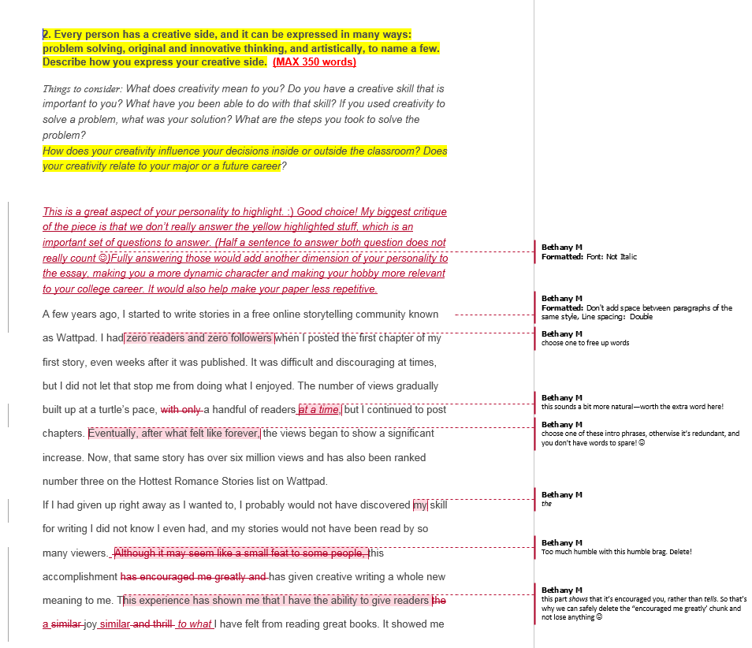
Patron Experience
Summary Feedback Form
Strengths: Great topic! Good Flow!
Weaknesses: We have some places where we can cut words and phrases to give you more space to answer the questions we didn’t really touch on enough from the prompt.
Recommended Next Steps: After you work through these changes, make sure you read the essay out loud to make sure everything is good to go! ☺ Don’t be discouraged– my application essay took 11-12 drafts to be really ready for submission to a highly competitive school. You’re doing a fabulous job, and you’re really close to being finished! :D You got this!!!

Slide 18
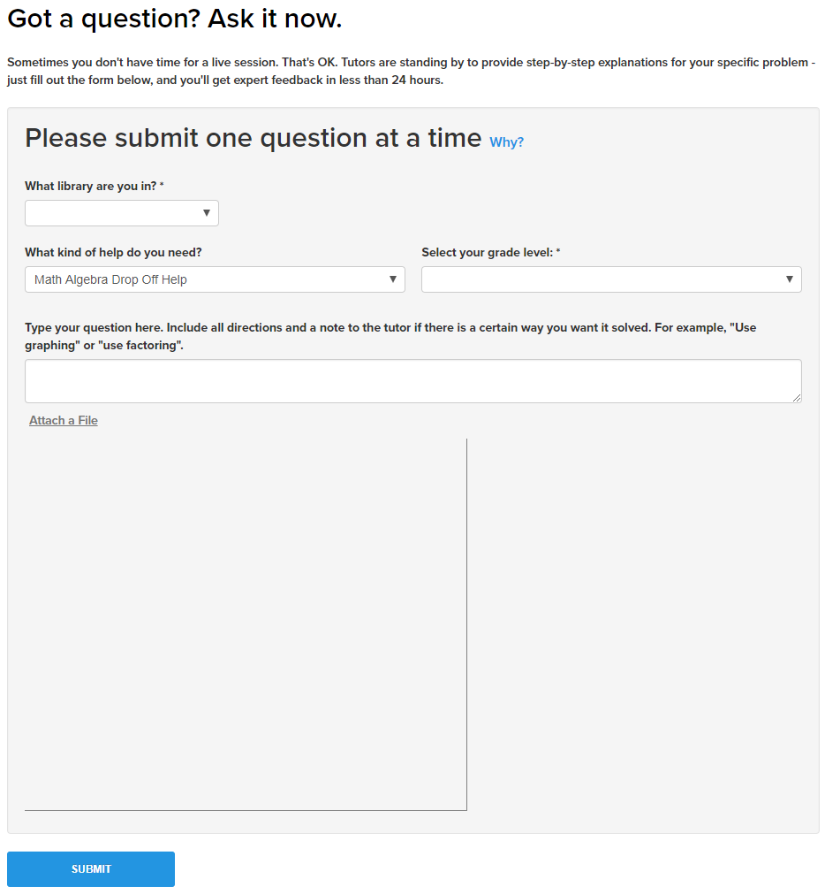
Patron experience
Premium Service Only
Math Drop-Off
High School & College Level
Algebra through Calculus
Open 2pm – 10pm for submission
Turn-Around: ≈12 Hours
One Problem Per Submission
Ideal for students that need extra time to “process” math or for those that have number anxiety.

Slide 19
Example questions
Grade | Describe Your Assignment
9th Grade | “Two planes leave an airport at the same time heading in the same direction. One plan is traveling at 350 mph and the other is traveling at 400mph. How long will it take for the difference between the two planes to be 75 miles?”
10th Grade | “Hi, I'm currently doing this problem on my Solving Quadratic Systems Homework and I don't know how to do it. Please use the quadratic formula for this one and help solve it algebraically. Thank you.”
11th Grade | “I wanted help understanding the e (base of natural logarithms) and the ln for logs.”
12th Grade | “determine the y intercept of the line represented by the given equation -y=7/4x+8/7 I know we have to divide by -1 to get the answer because the teacher said so but I do not understand why we have to divide -1 for this problem, how do I know when to do that?”
College | “Please see attached. I'm confused because when I get to the last step of integrating sin^2(x) again, wouldn't I just be back in a loop of integrating and replacing the answer with the given trig identity?”

Slide 20
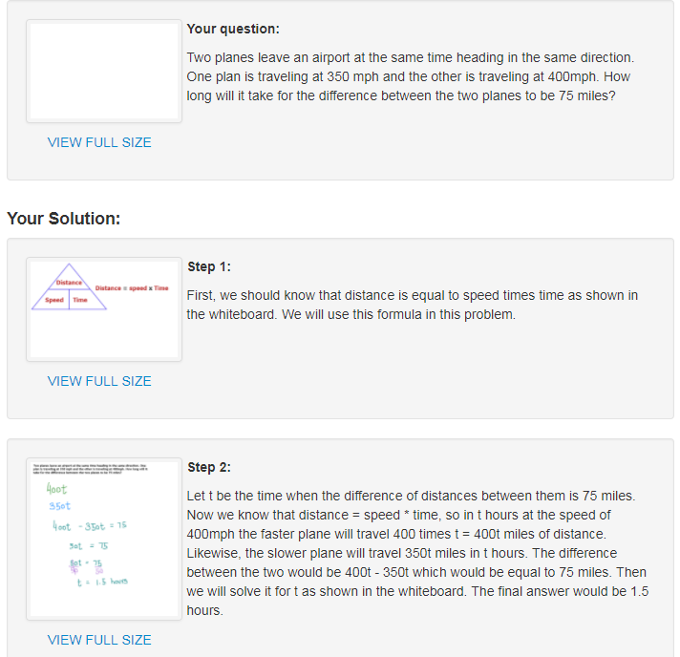
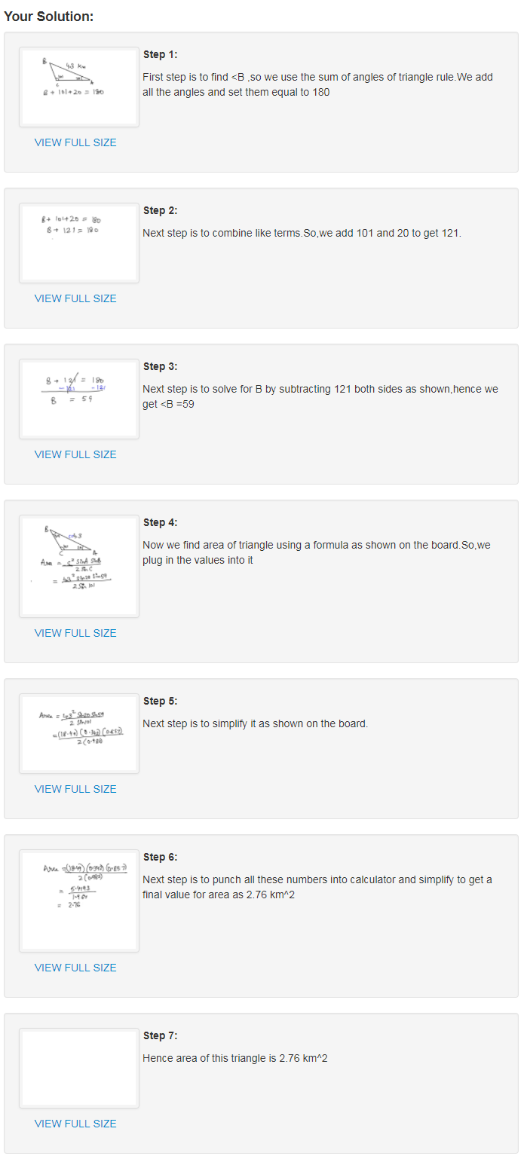
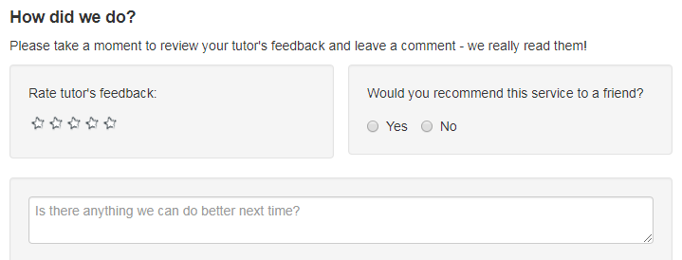
Patron Experience
Step by Step
Explanation for each step
Neatly drawn whiteboards
Post-response feedback form
Not a substitution for real-time tutoring sessions
Can be helpful as a time-management tool

Slide 21
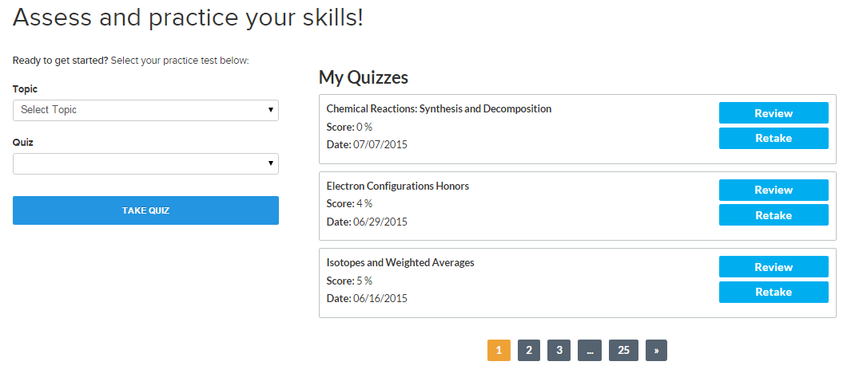
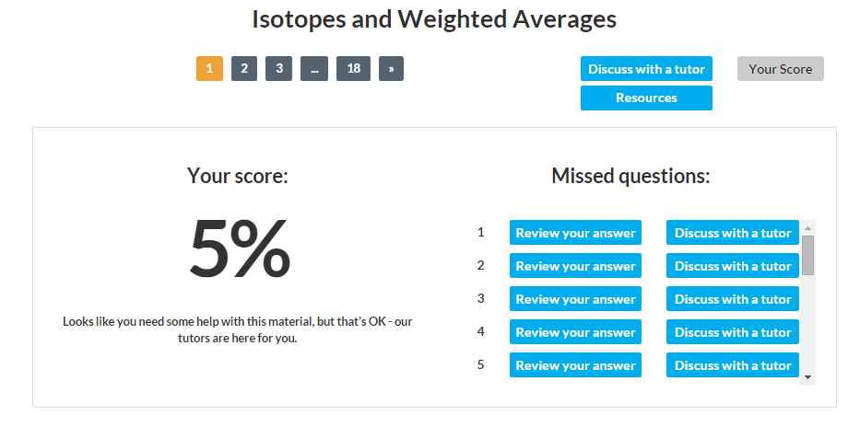
Patron Experience
Practice Quizzes/Skills Drills
High School/End of Chapter
Math Fundamentals
Algebra I
Geometry
Algebra II
Calculus
Biology
Chemistry
Physics
English/Language Arts
Premium Service Only

Slide 22
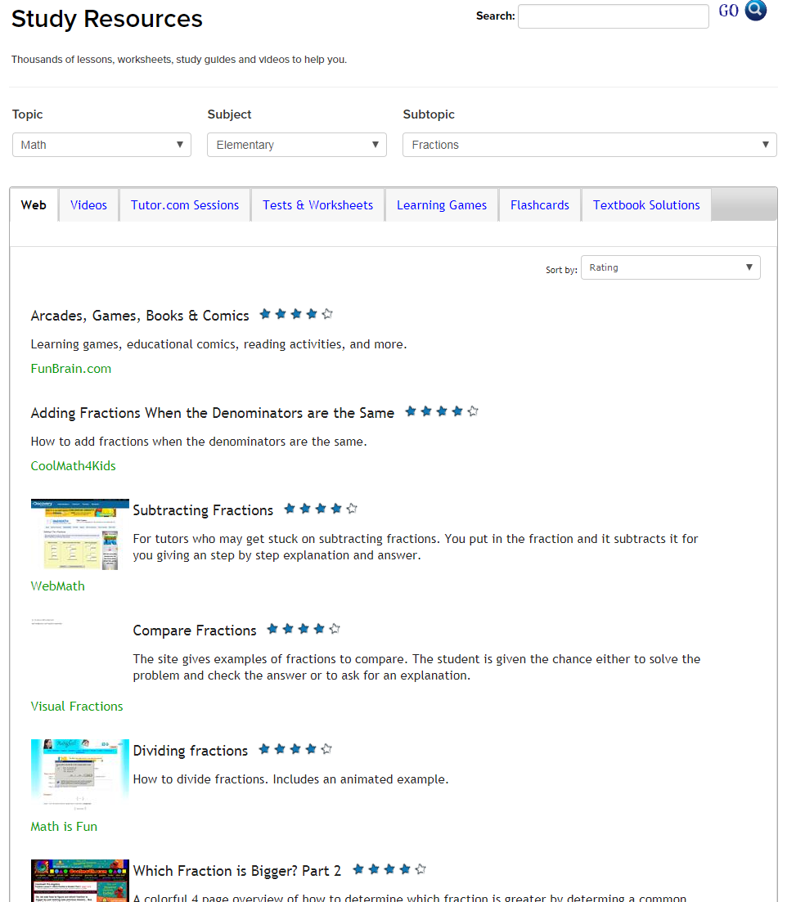
Patron Experience
SkillsCenter™ Resource Library
Study • Test Prep • Job Search
Websites
Videos
Tutor.com Sessions
Sample Tests & Worksheets
Learning Games
Flashcards
Textbook Solutions

Slide 23
Questions?
http://www.tutor.com/cmspublicfiles/WWW/Nassau_2018_Spring_Training.pptx
Next Up:
Sat/act essentials

Slide 24
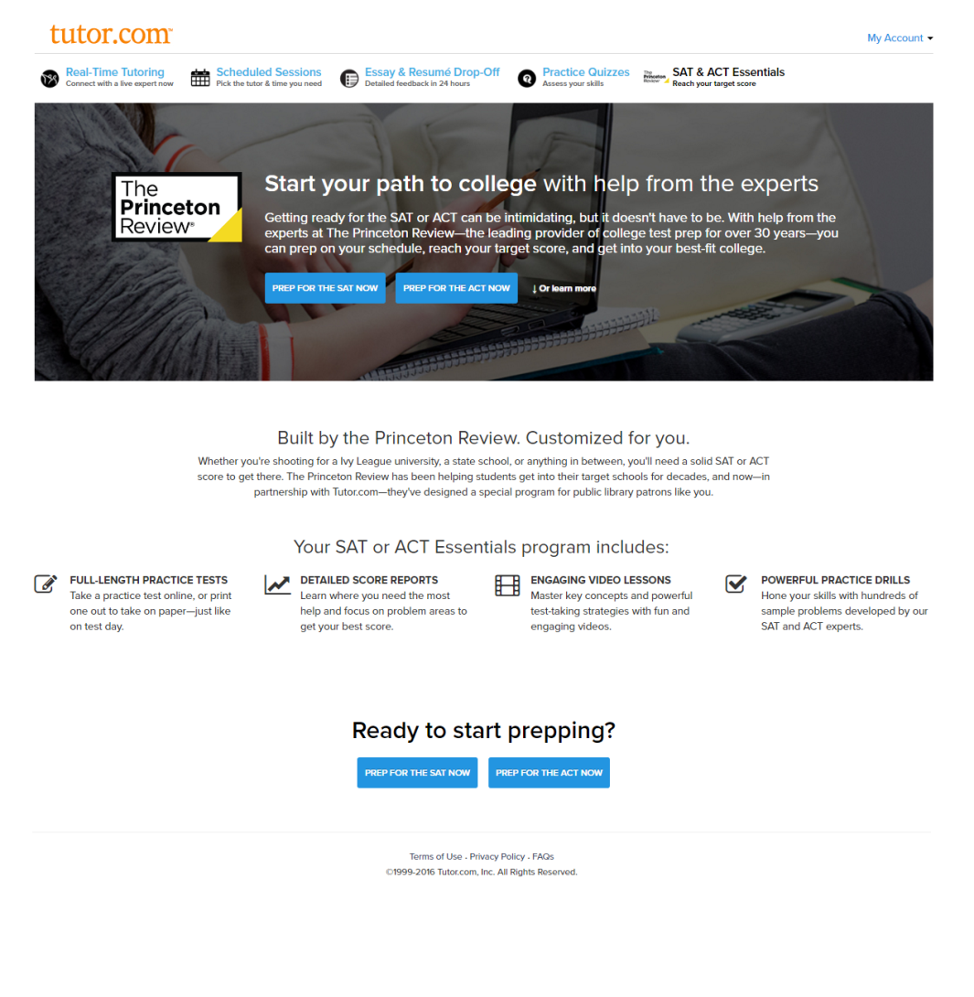
Patron Experience
SAT/ACT Essentials
The Princeton Review’s Self-Paced Prep Course
Practice Tests for ACT & SAT
Detailed Score Report
Video Lessons
Practice Drills
Admissions Advice

Slide 25

Admissions advice
Taking Both SAT & ACT can be beneficial.
Increase chances of MERIT BASED AID.
Provide more information to admissions counselors.
ACT could, for some schools, replace the SAT Subject Tests.
SAT Test Dates
Mar 10 Oct 6
May 5 Nov 3
June 2 Dec 1
Aug 25
ACT Test Dates
Feb 10 Sep 8
Apr 14 Oct 27
June 9 Dec 8
July 14
Early Decision/Early Action
Applications generally due on or around Nov. 1, Nov 15, Dec. 1 or Dec 15, depending on school.

Slide 26
Patron experience
In-Library Practice Tests
Choose SAT or ACT. Check local schools to see what they require. Do the high schools offer one and not the other? Does New York offer aid based on test scores?
Choose your space: computer lab or classroom style? Capacity? Quiet Environment?
Advertise and inform.
  Require registration.
  Require library card (due to authentication).
  Provide “Pre-Program Packet.”
Print Materials
  Test Booklet & Bubble Sheet if not in computer lab
Do a dry-run to get a “Score Report” and understand the process
Remember to book enough time in the room. These tests are LONG. Give time to log everyone in if using computers.
Give at least 15 minutes to explain “Essentials” prior to the test.

Slide 27
Pre-Program Packet
Steps to Prepare
Get a library card.
Register for a Tutor.com Account.
Complete “Test Strategies” module.
What to Bring
https://collegereadiness.collegeboard.org/sat/taking-the-test/test-day-checklist
https://www.act.org/content/act/en/products-and-services/the-act/test-day.html
How to Use Essentials Guide
www.tutor.com/clientcarelib/essentials
Be prepared for students that have not taken these steps. You’ll need extra time at the beginning to get a few of them setup with Tutor.com accounts.

Slide 28
TEST day
Provide refreshments. The tests do allow for “break time.”
If using computers, have computers already on the Tutor.com authentication page.
Spend 10-15 minutes showing them the Tutor.com service and explaining how to use their Score Reports & Coursework to improve.
If using printed tests and bubble sheets, be sure to show them how to enter their answers into the Essentials program. Tell them EXACTLY which practice test they are taking.
When it is time to start, launch the online proctor. Even if using computers to take the test, the online proctor simulates the test day environment so they can learn pacing.

Slide 29
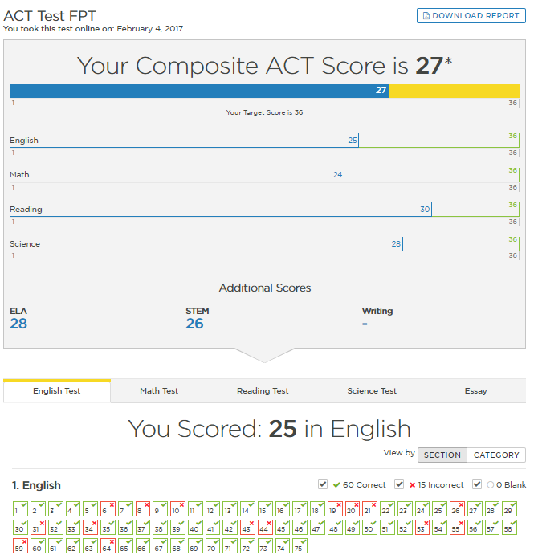
Understanding score reports
Composite Score
  Total
  By Section
  Compared to Target
Section Score
  By Question
  By Category

Slide 30
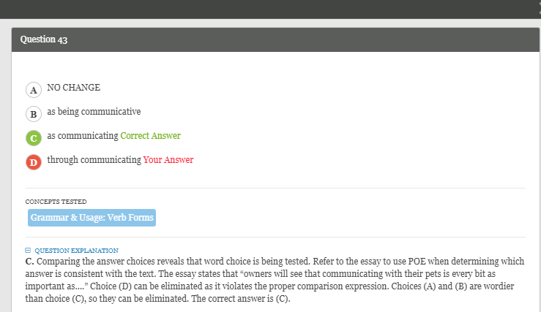
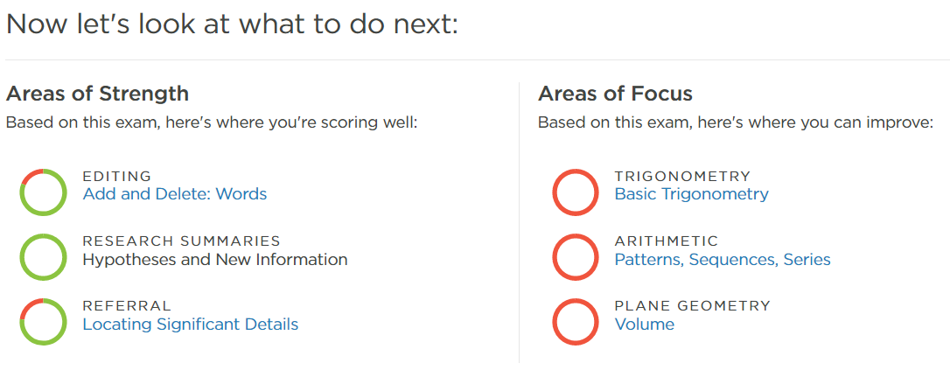
Using score reports
Question & Category
  Correct Answer Shown
  Explanation Given
  Concept Categorized
Areas of Focus
  Ordered by Priority
  Leads to Coursework

Slide 31
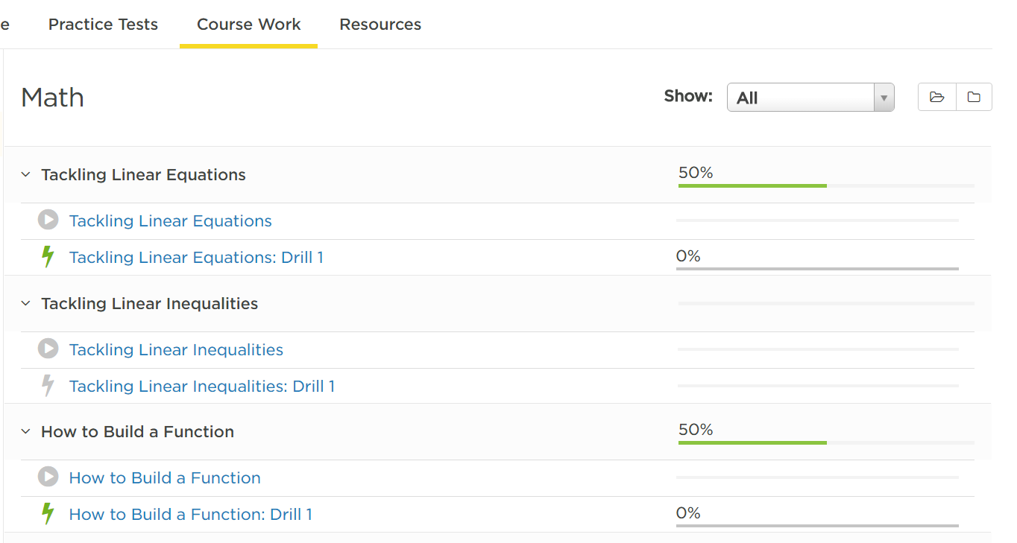
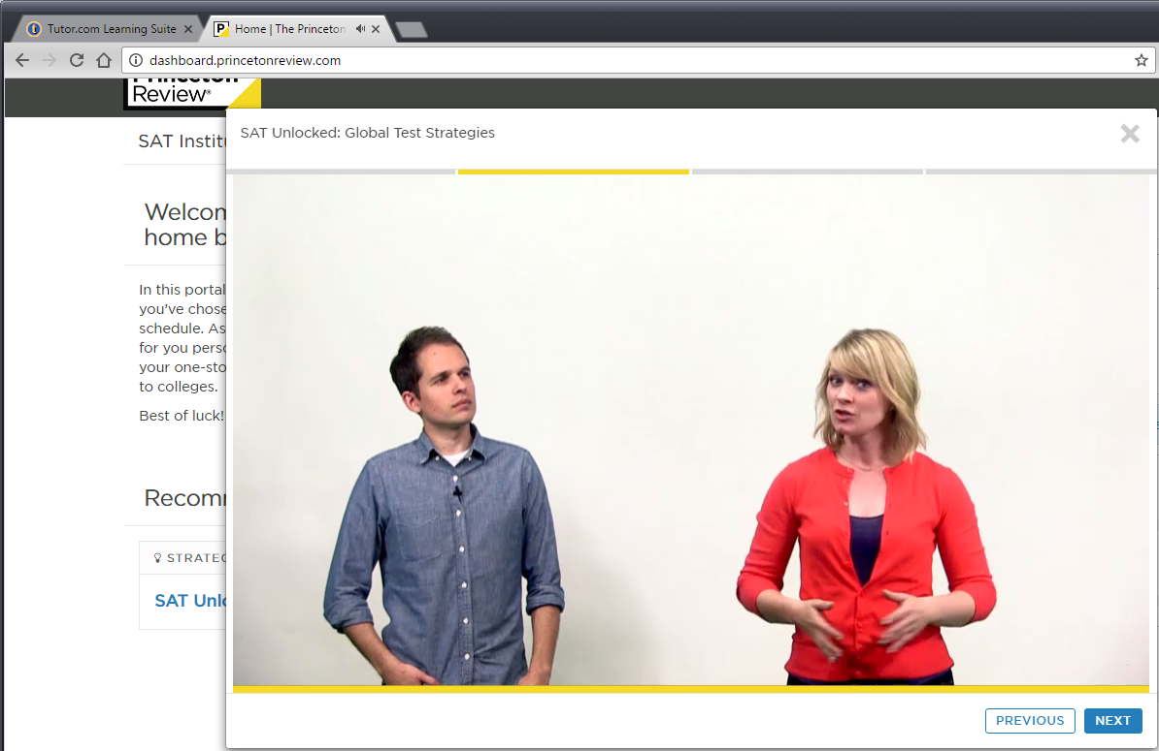
Post-Practice Test
Progress of Coursework
Video Lessons & Practice Drills

Slide 32
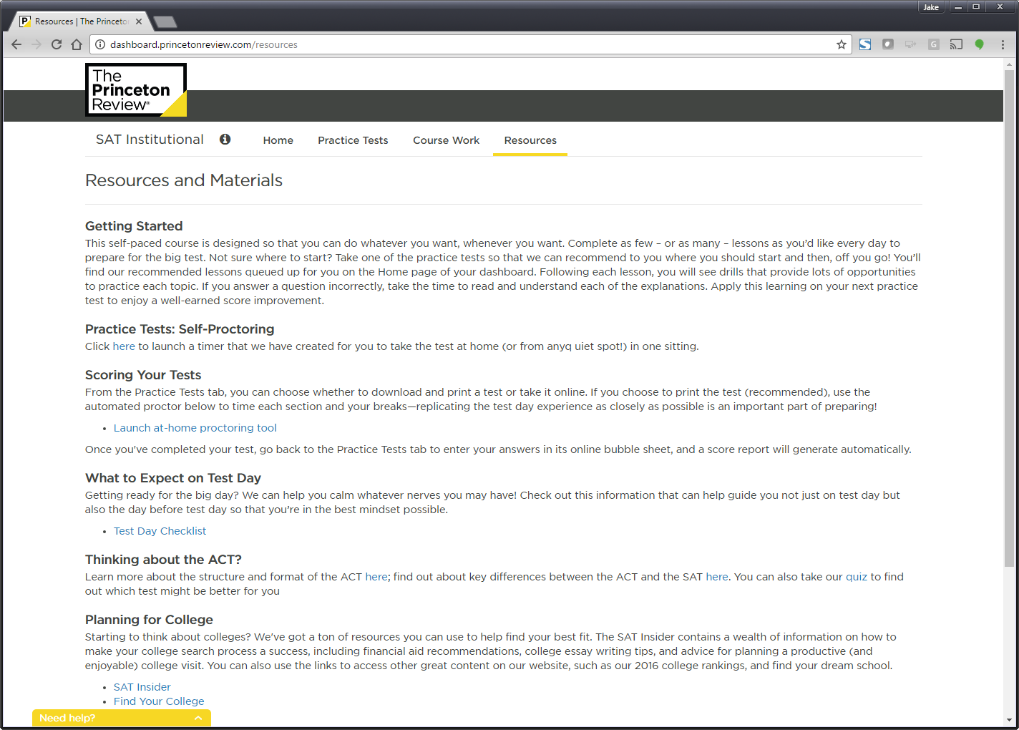
Post-Practice Test

Slide 33
Questions?
http://www.tutor.com/cmspublicfiles/WWW/Nassau_2018_Spring_Training.pptx
Next Up:
Marketing

Slide 34
Standardized Test Dates
April 11th – 13^{th:} Grades 3-8 English/Language Arts
May 1st – 11th: Advanced Placement Examinations
May 1st – 3rd: Grades 3-8 Math
May 29th – June 4th: Grades 4-8 Science
June 12th-22nd: High School Finals and Regents

Slide 35
www.tutor.com/clientcarelib
Month | Theme Ideas | In-Library | In-Schools | In Community | Electronic
Jan | New School Year Resolutions! Spring college admissions activities | Make Resolution Mobiles. Have students set resolutions about school. Show them Tutor.com to help keep those resolutions. | Restock flyers, brochures, etc. at the schools. Outreach to guidance counselors, especially with SAT/ACT Essentials information for spring tests. | Work with the local community college or BOCES to inform HSE/TASC takers of tutoring opportunities. There are 2 TASC tests given each month at Nassau Community College. | Focus on spring test dates for SAT/ACT. Post reminders to file FAFSA. “Dreaming of College” social media post. “Make Tutor.com part of your New Year’s Resolution.”
Feb | Library Lovers’ Month. Standardized Test Prep Starting. Random Acts of Kindness Week. | Electronic Resources “Speed Dating” for teens. Setup multiple computers (if available) with different resources and give teens 2-3 minutes at each station to explore. | Distribute “Top 10 Things Teachers Should Know” about Tutor.com via email and include a note about how Tutor.com tutors align their techniques with Common Core. | Reach out to church/synagogue/mosque youth leaders. If they focus their ministry on serving the whole person, they may touch on areas outside of religion. “How the library can help you destress.” | Tweet “I LOVE TUTOR.COM” student comments or “My tutor was so nice.” Guest blog post from a teen that tried Tutor.com and “loves” it.
Mar | “Luck” (St. Patrick’s Day). 3rd Quarter Report Cards coming in April. | “It’s your lucky day” table setup. Rotate resources through the week. Put out brochures or bookmarks and an iPad or laptop for demos. | Focus on English teachers. Send them flyers for WriteTutor and encourage them to offer extra credit to students using Tutor.com before handing in big papers. | Boys and Girls Club often have in-person tutoring or homework help programs. Drop off some brochures about Tutor.com so they can provide their members with supplemental assistance outside of regular program hours. | Instagram “Lucky You” graphic. “Still too cold to go outside? Go ahead. Get tutoring help from the comfort of your couch.” Post the pie graph of your usage by subjects on Pi day.

Slide 36
www.tutor.com/clientcarelib
Month | Theme Ideas | In-Library | In-Schools | In Community | Electronic
Apr | Spring sports. Testing begins. Last quarter begins. | With science testing in early May, consider a month of STEM programming in April. You can use Tutor.com science packets if you don’t plan to use them in the summer. Hang up “Science got you stumped” flyers. | Outreach to coaches & Advanced Placement teachers. Consider advertising at high school sporting events (banner sign on baseball fence?). | Hang flyers on community bulletin boards (restaurants, grocery stores, laundromats) or focus on workforce development. Visit local WD offices with information. | “Working on a paper?” Instagram/facebook/twitter post. Reuse “Get in the game” posts. “Is bedtime prime study time?” targets the upper level high school students that are stressed with end of year testing and college apps.
May | AP® Tests. 4-8 Science Tests. National Math Education Month | Raffle: patrons submit math sessions for a drawing at end of month. | Teachers’ Appreciation Week and School Principals’ Day. Send out an email inviting teachers and principals to a “Pop In” night (popcorn & demos) or a Demos & Donuts morning. | Educate local youth organizations that see a lot of kids over the summer about library programs and Tutor.com. They YMCA, S.T.R.O.N.G., Big Brothers Big Sisters, etc. | Post challenging math questions on social media with a link to your Tutor.com program to celebrate National Math Education Month.
Jun | Finals/Regents, end of year. Finish strong. | Test Prep & Writing flyers throughout the teen area. | With summer reading at the front of all librarians’ minds, just focus on pre-scheduling social media posts for June so you don’t have to think about promoting Tutor.com during your busy summer reading season. |  | Year end push on social media. Post about: Don’t give up. The end is in sight. Study for finals. Perfect your paper. Ace the ACT.

Slide 37
www.tutor.com/clientcarelib
Month | Theme Ideas | In-Library | In-Schools | In Community | Electronic
Jul | Summer STEM Packets. Planning Time | Use Tutor.com math and science packets for the summer to help keep students engaged with the program even when school is “out.”
Aug | Starting Strong! Gearing up for a great year! | B2S party or Program for parents | Attend B2S nights. Email to principals/teachers. | Pitch news article to local media about library resources for school. | Highlight on website. Blog post. “Keep calm & connect” post on FB, Instagram, Twitter
Sep | Library Card Sign-Up (LCSU)! | Provide program cards or Tutor.com branded library card holders with every new library card. | ConnectEd (or similar) initiative. Outreach to school librarian/media specialist. PTA meetings. (Top 10 Things Parents Should Know) | A library card can save you, $x every year. Get one today! Pitch to Chamber of Commerce members as an employee perk. “We’ll come to your place of business to distribute applications.” | “When you need help, it’s there” as part of a larger LCSU push on social. Email/newsletter article listing benefits of library membership they might not be aware of (Tutor.com).
Oct | Fall sports, college admissions, 1st semester projects, looming holidays | Host a college night at library and promote Essentials as well as essay writing tutors | Reach out to coaches. Athletes needing help to stay academically eligible can use Tutor.com after practice. | Job seekers applying for seasonal jobs for extra holiday cash can use Tutor.com’s Job Search Center for help. | “Get in the Game” social media posts. Blog post for teens on time management.
Nov | Report Cards. Thanksgiving. | Put speech bubbles with comments of “Thanks to Tutor.com” around the teen area or on top of computer monitors. | Brochures for teachers on Parent/Teacher conference night | Outreach to homeless shelters. As the weather gets colder and holidays come around, they see more visitors. Kids are homeless, too. ☹ | “Regretting your report card? Raise your grades with Tutor.com!” social media. Also, post post-session comments of “Thanks.”
Dec | Planning Time | Dec. is a slower month for Tutor.com so instead of trying to promote usage this month, use this time to plan your promotions for the second half of the school year.

Slide 38

Questions?
http://www.tutor.com/cmspublicfiles/WWW/Nassau_2018_Spring_Training.pptx
Susan Del Rosario
(920) 327-2859
Susan.delrosario@tutor.com

